Slide 1
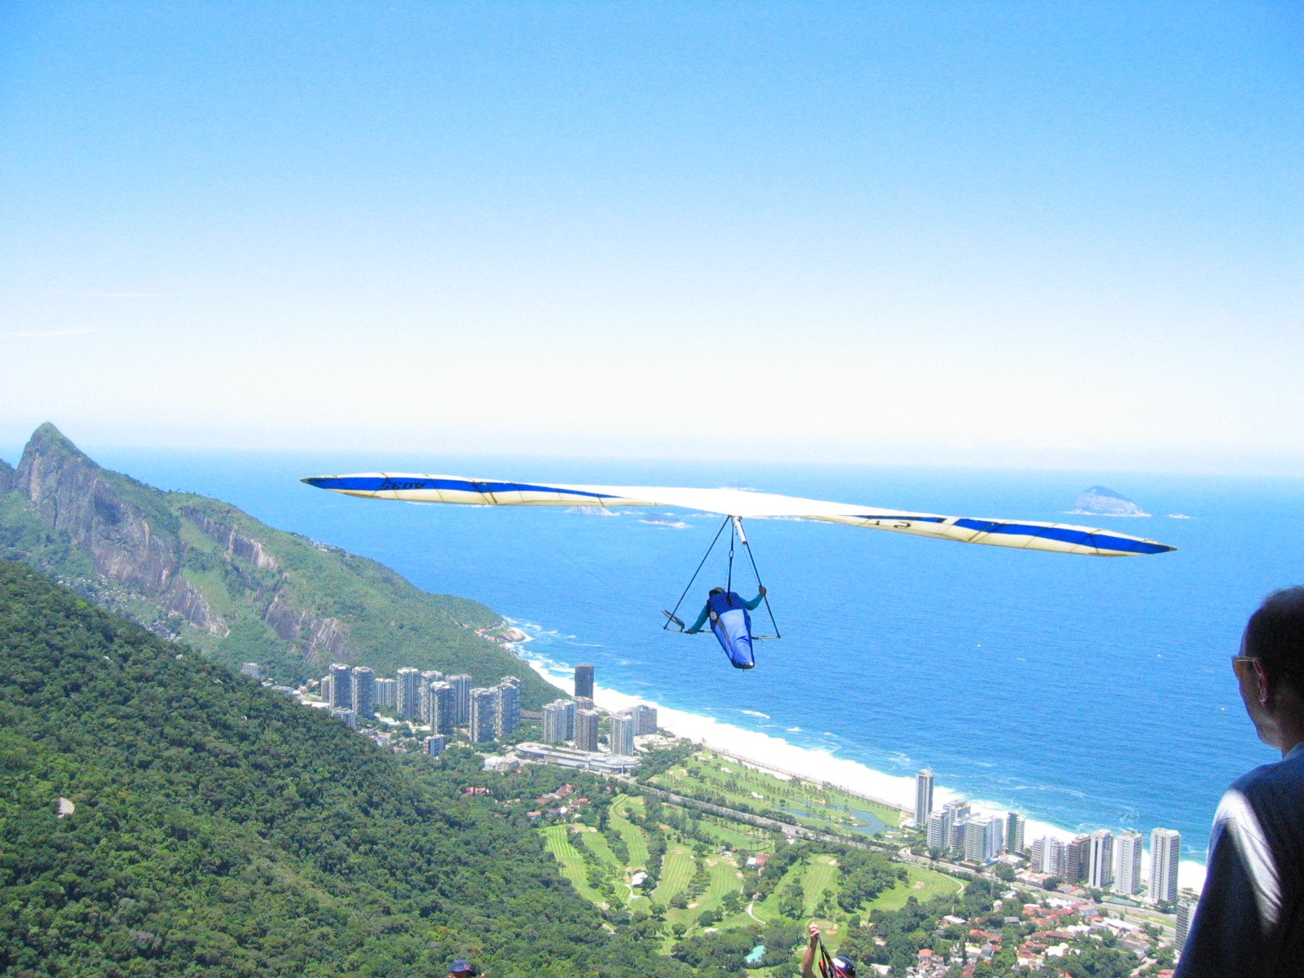
GRADE 10 · LESSON 22
Use of English: Articles and Synonyms
Artikllar (a, an, the yoki artiklsiz) va ma’nodosh iboralar
Use of English: Articles. Synonyms.
Jordan Fischer from Chicago · CC BY 2.0
sozlar.com

Slide 2
LESSON AIMS
Bugungi maqsad
1
Find the extra article in six sentences (ex. 1)
2
Add the missing articles in five sentences (ex. 2)
3
Match four expressions with their synonyms (ex. 3)
4
Complete six key word transformations with two to five words (ex. 4)

Slide 3
GRAMMAR
Articles — a / an / the or no article (–)
A / AN · THE
NO ARTICLE (–)
🎵
go to the cinema · on the radio · play the flute
listen to music · watch television · love swimming
🌍
the USA · the UK · the Alps · the Grand Canyon
Mount Rushmore · Europe · London · Lake Superior
🕒
in the morning · at the weekend
at night · on Friday · in March · in 2002
🏫
the police · the army · the Earth
go home · go to school · be in prison · in Class 7
💼
a new hobby (first time) · an artist (job) · an hour
chemistry · Teenagers love games (in general)
a or an? Listen to the first SOUND, not the letter: an hour, an umbrella, but a university, a uniform (Grammar database p. 173).

Slide 4
BOOK TASK · 17 MINUTES
Book tasks — Laser B1+, p. 29
Books open, word list closed. Try alone first — then check with Grammar database pp. 172–173.
1
ex.1 — Circle the extra word in each sentence (six sentences).
2
ex.2 — Correct the sentences. Add articles where necessary.
3
ex.3 — Synonyms: match 1–4 with a–d (regret, want to do, look forward to doing, object to).
4
ex.4 — Complete the second sentence with the word given: 2–5 words, do NOT change the word.
5
Tip for ex.4: after look forward to / object to / approve of use -ing.

Slide 5
CHECK AND TEACH · 7 MINUTES
Answer key — Laser B1+, p. 29
1
ex.1 1 the (music) · 2 the (Class 7) · 3 the (bus) · 4 the (swimming) · 5 the (Mount Rushmore) · 6 the (stamps)
2
ex.2 1 a lot of · 2 on the radio · 3 a new hobby … the whole evening
3
ex.2 4 or even a mountain nearby · 5 to be an artist
4
ex.3 1 c · 2 a · 3 d · 4 b
5
ex.4 1 felt like having · 2 don’t approve of / disapprove of · 3 wish I hadn’t given
6
ex.4 4 can’t wait to join · 5 is looking forward to taking · 6 do you object to

Slide 6
FOCUS
a, an, the yoki artiklsiz?
QOIDA
QOIDA
Artiklsiz: umumiy ma’no (listen to music, love swimming, Teenagers love games), fanlar, at night, on Friday, in March, in Class 7, go home, be in prison, on television.
the: go to the cinema, on the radio, play the flute; yagona narsa (the Earth, the Moon); tashkilotlar (the police).
Joy nomlari: the — the USA, the UK, the Alps, the Grand Canyon, the English Channel; artiklsiz — Mount Rushmore, Europe, London.
a / an — birinchi marta tilga olinganda va kasbda: a new hobby, an artist; tovushga qarab: an hour, lekin a university.
Ma’nodoshlar: regret doing = wish you hadn’t done; want to = feel like doing; look forward to doing = can’t wait to do; object to = not approve of.
to predlog bo‘lsa — keyin -ing: look forward to joining, object to playing.

Slide 7
VOCABULARY
A. Free-time activities and clubs (1/3)
🎧️
listen to music
musiqa tinglamoq
In my free time I listen to music and read books.
🎬️
go to the cinema
kinoga bormoq
On Saturdays we often go to the cinema together.
🎸️
play the guitar
gitara chalmoq
My sister wants to play the guitar in a band.
🪈️
play the flute
fleyta chalmoq
Nilufar is learning to play the flute at music school.

Slide 8
VOCABULARY
A. Free-time activities and clubs (2/3)
🏫️
an after-school club
darsdan keyingi to‘garak
Our school has an after-school club for chess and drama.
♟️
the chess club
shaxmat to‘garagi
I go to the chess club every Wednesday after lessons.
🩰️
ballet lessons
balet darslari
My little sister has ballet lessons twice a week.
🪂️
hang-gliding
deltaplanda uchish
My uncle goes hang-gliding in the hills every Saturday.

Slide 9
VOCABULARY
A. Free-time activities and clubs (3/3)
🎙️
a karaoke competition
karaoke tanlovi
Dave is taking part in a karaoke competition on Friday.
🏉️
rugby
regbi
Sarah plays rugby for the school team.
🏀️
a local basketball team
mahalliy basketbol jamoasi
Timur plays for a local basketball team in Chilonzor.
📅️
at the weekend
dam olish kunlari
We play football in the park at the weekend with friends.

Slide 10
VOCABULARY
B. Arts and media (1/2)
🎺️
the trumpet
truba (cholg‘u)
Jasur gave up the trumpet when he was twelve.
😂️
comedies
komediyalar
I like comedies more than horror films.
✏️
drawing
rasm chizish
My hobby is drawing, so I’d like to study art.

Slide 11
VOCABULARY
B. Arts and media (2/2)
🎨️
an artist
rassom
When I grow up, I’d like to be an artist like my uncle.
📺️
on television
televizorda
There’s a great music show on television tonight.
📻️
on the radio
radioda
My dad always listens to football matches on the radio in the car.

Slide 12
VOCABULARY
C. Places: the or no article? (1/2)
🌊️
the English Channel
La-Mansh bo‘g‘ozi
Jenny would like to swim the English Channel one day.
🏜️
the Grand Canyon
Katta Kanyon (AQShda)
The Grand Canyon is one of the most famous sights in America.
🗿️
Mount Rushmore
Rashmor tog‘i (AQShda)
Mount Rushmore has the faces of four American presidents.

Slide 13
VOCABULARY
C. Places: the or no article? (2/2)
🏔️
the Alps
Alp tog‘lari
My uncle went hang-gliding in the Alps last year.
⛰️
hills
tepaliklar, adirlar
There are no mountains near our town, only hills and fields.
🗽️
the USA
AQSh (Amerika Qo‘shma Shtatlari)
My cousin lives in the USA, not in Canada.

Slide 14
VOCABULARY
D. Synonyms (ex. 3) (1/2)
😔️
regret
afsuslanmoq, pushaymon bo‘lmoq
I regret selling the old guitar to a friend.
🙂️
feel like
(biror narsa qilgisi) kelmoq
I don’t feel like going to the cinema tonight.
🤩️
can’t wait
intiqlik bilan kutmoq, sabri chidamaslik
I can’t wait to see the new film at the cinema.

Slide 15
VOCABULARY
D. Synonyms (ex. 3) (2/2)
✋️
object to
qarshi bo‘lmoq, e’tiroz bildirmoq
My parents object to me playing games late at night.
👍️
approve of
ma’qullamoq
My grandma doesn’t approve of my uncle’s hobby.
👎️
disapprove of
ma’qullamaslik, norozi bo‘lmoq
Many teachers disapprove of phones in the classroom.

Slide 16
PRONUNCIATION
Say it — don’t just read it
Weak forms: a, an and the are short and unstressed. the = /ðə/ before a consonant, /ði/ before a vowel sound:
the cinema
/ðə/
the radio
/ðə/
the Alps
/ði/
the English Channel
/ði/
an after-school club
/ən/
the USA
/ðə/
an artist
/ən/
a karaoke competition
/ə/
Say it fast: I’d like to be an /ən/ artist. · We swam in the /ði/ English Channel.

Slide 17
WHOLE CLASS
Practice — complete the sentence (1/2)
1
I listen to the news on ________ radio every morning.
2
My cousin wants to be ________ engineer.
3
We went to the USA and saw ________ Grand Canyon.
4
Oscar had ________ lot of time to start new hobbies.
5
Hang-gliding needs hills or even ________ mountain nearby.
6
It takes ________ hour to get there by train. (a / an)

Slide 18
WHOLE CLASS
Practice — complete the sentence (2/2)
7
I regret giving up the trumpet. = I wish I ________ given up the trumpet.
8
I want to go out. = I feel like ________ out. (go)
9
I’m looking forward to joining the team. = I can’t ________ to join the team.
10
My mum doesn’t approve of my hobby. = My mum objects ________ my hobby.

Slide 19
PAIR / GROUP WORK · 5 MINUTES
Vocabulary activity
1
Match the beginnings (1-10) with the endings (a-j).
2
Read your complete sentences aloud.
3
Give the Uzbek meaning of the key word in each sentence.
4
When you finish, swap tables with the other group.

Slide 20
PAIRS · 4 MINUTES
Speaking
Pairs: tell your partner three things you feel like doing this weekend and one thing you can’t wait to do this year.
Tell your partner about something you regret. Your partner repeats it with I wish you hadn’t …
Is there anything your parents object to or don’t approve of? Use the -ing form after to and of.

Slide 21
TODAY'S WORDS IN CONTEXT
A hobby with a view (1/2)
My uncle Rustam is an engineer, but at the weekend he has a very different life: he goes hang-gliding. He took it up three years ago, after a holiday in the Alps. He says he regrets only one thing — he wishes he hadn’t waited so long!
There are no mountains near our town, so every Saturday he drives for an hour to the hills. My grandma doesn’t approve of his hobby. "Why can’t you just listen to music or watch television like everybody else?" she asks.
Cover the word list. Can you understand the words in bold from the sentence?

Slide 22
TODAY'S WORDS IN CONTEXT
A hobby with a view (2/2)
But my uncle can’t wait to fly again every week. Next summer he’s going to the UK to fly over the sea, and I’m looking forward to seeing the photos. Maybe one day I’ll feel like trying it too.
Cover the word list. Can you understand the words in bold from the sentence?

Slide 23
TODAY'S WORDS IN CONTEXT
Read and answer
1
Why is there ‘an’ before ‘engineer’?
2
Why is there ‘the’ before ‘Alps’ and ‘UK’, but no article before ‘music’?
3
What does the uncle regret?
4
Who doesn’t approve of his hobby?
5
Find a phrase that means the same as ‘is looking forward to’.

Slide 24
PAIRS · ESDA QOLDIMI?
Memory check — say it another way
Men gapni aytaman, siz qavsdagi so‘z bilan bir xil ma’noda qaytarasiz.
1
I want to go swimming. (feel)
2
I regret telling him. (wish)
3
I’m looking forward to the party. (wait)
4
Dad doesn’t approve of my hair. (object)
5
the or no article? — ___ Alps · ___ Mount Rushmore · ___ USA · ___ rugby

Slide 25
UZ
Qiyin joyi — o‘zbekcha
O‘zbek tilida artikl yo‘q, shuning uchun eng ko‘p xato — ortiqcha the (✗ the music, the swimming) yoki tushib qolgan a / an (✗ I’m student).
Kasb doim a / an bilan: She’s an engineer. I want to be a pilot.
the — «o‘sha, hammaga ma’lum, yagona»: the Moon, the radio, the police.
regret doing = wish + had done: o‘tmishdagi ishdan afsus — «…masam bo‘lardi».
look forward to va object to da to — predlog, shuning uchun keyin -ing keladi.

Slide 26
HOMEWORK
Uy vazifasi
1
Laser B1+ Workbook p. 21, ex. 1–3.
2
Learn the 30 items with the flashcards: sozlar.com/vocab/cards/?set=grade10-lesson22
3
Write six sentences about your free time: two with the, two with no article, one with feel like and one with can’t wait to.

Slide 27
IMAGE CREDITS
Rasmlar manbasi
cover
Jordan Fischer from Chicago · CC BY 2.0 · https://commons.wikimedia.org/w/index.php?curid=2766891

Slide 28
Uchta so‘z — ertaga ham esingizda qoladi
Juftingizga ayting, so‘ng daftaringizga yozib qo‘ying.
sozlar.com/vocab/cards/?set=grade10-lesson22

