Slide 1
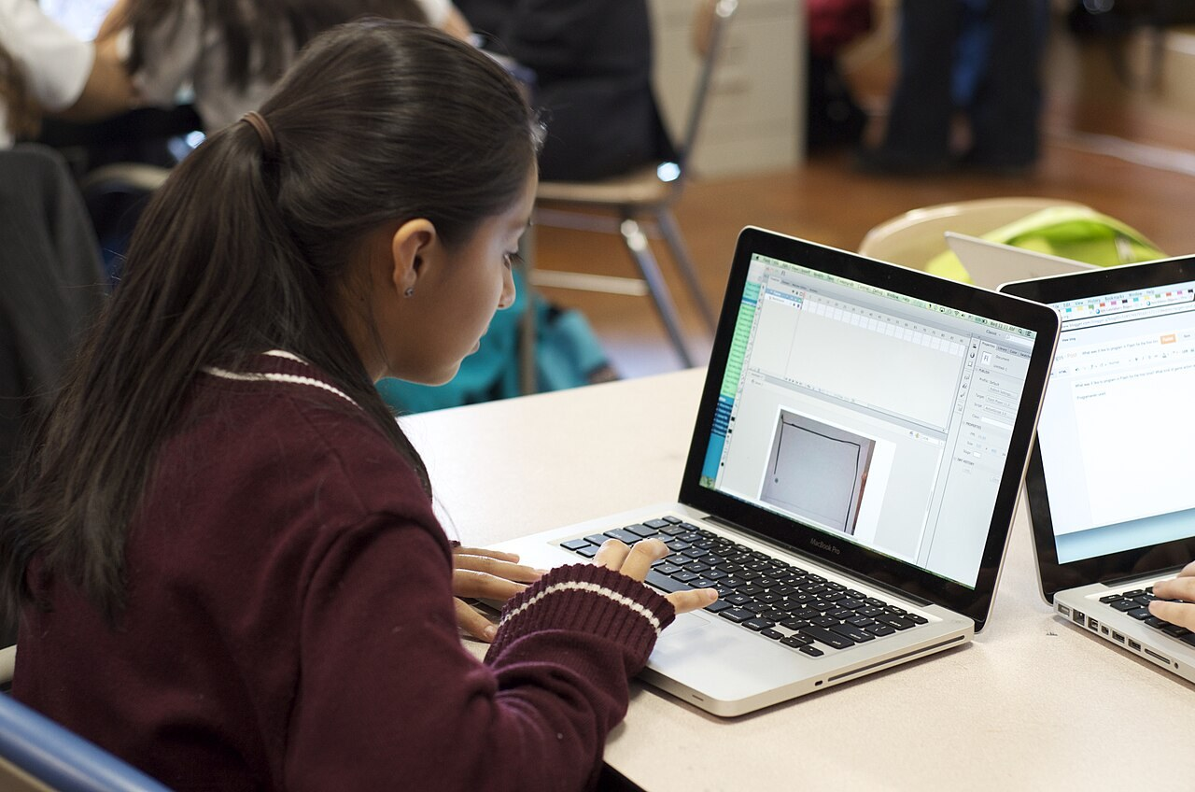
GRADE 7 · LESSON 22
Unit 4. Reading: Linton School Website
4-bo‘lim. O‘qish: Linton maktabi sayti
Unit 4. Reading: Linton school
KAB2013 · CC BY-SA 3.0
sozlar.com

Slide 2
LESSON AIMS
Bugungi maqsad
1
Tick the words they know and learn the rest: magazine, review, blog, postcard … (Get ready!)
2
Read the Linton School website and decide if five sentences are true or false (p. 32 ex. 1)
3
Match six questions with answers and complete a summary with nine words (p. 33 ex. 2–3)
4
Complete six definitions (Wordpower) and say what they like about the website (ex. 4)

Slide 3
BOOK TASK · 4 MINUTES
Unit 4 · Get ready! — Laser A1+, p. 32
Read All About It! Tick (✔) the words you know. Cross (✘) the ones you don’t know. Be honest!
1
article · book · email · letter
2
magazine · newspaper · poem · review
3
story · website · blog · postcard
4
Pairs: compare. Explain one word your partner doesn’t know — in English or with a picture.

Slide 4
BOOK TASK · 7 MINUTES
Book task — Laser A1+, p. 32, ex. 1
Books open, word list closed. Read the Linton School website (Home page).
1
First look at the tabs: News · Sport · Calendar · Short stories and poems · Links …
2
Read fast once — do not stop at new words.
3
ex.1 — Decide if the five sentences are true (T) or false (F).
4
Underline the line in the text that gives you the answer.
5
One word can make a sentence false: a teacher ≠ a pupil.

Slide 5
BOOK TASK · 9 MINUTES
Book tasks — Laser A1+, p. 33
Now read the welcome poem and the box about Mr Jennings too.
1
ex.2 — Match each question (1–6) with an answer (a–f).
2
ex.3 — Write a word from the box in each gap (nine gaps).
3
Wordpower! — Write one letter in each gap to complete the six words.
4
Fast finishers: find three more words from the Get ready! box on the website.

Slide 6
CHECK AND TEACH · 4 MINUTES
Answer key — Laser A1+, pp. 32–33
1
ex.1 1 T · 2 F (she’s a pupil, the editor) · 3 F (no teachers work on the site) · 4 T · 5 F (Mr Jennings is the Head; he answers the questions)
2
ex.2 1 c · 2 e · 3 a · 4 b · 5 f · 6 d
3
ex.3 1 website · 2 newspaper · 3 links · 4 welcome · 5 editor · 6 sections · 7 calendar · 8 poem · 9 interview
4
Wordpower 1 editor · 2 reporter · 3 calendar · 4 opinion / view · 5 programme · 6 review
5
Ask WHERE: students read out the line from the text for each answer.

Slide 7
VOCABULARY
A. Things we read (Get ready!) (1/2)
✉️
a letter
xat
Grandpa still writes me a letter every month.
📖️
a magazine
jurnal
My sister buys a fashion magazine every week.
🗞️
a newspaper
gazeta
Dad reads the newspaper with his morning tea.
📜️
a poem
she’r
We’re learning a poem by heart for the spring concert.
⭐️
a review
taqriz (film, kitob haqida fikr)
I always read a review of a film before I watch it.

Slide 8
VOCABULARY
A. Things we read (Get ready!) (2/2)
📗️
a short story
qisqa hikoya
Our teacher reads us a short story every Friday.
🌐️
a website
veb-sayt
You can find the bus times on the city website.
💻️
a blog
blog (internetdagi kundalik)
My cousin writes a cooking blog with lots of photos.
📮️
a postcard
ochiq xat, otkritka
We always send Grandma a postcard from our holiday.

Slide 9
VOCABULARY
B. The school website (1/2)
🧒️
a pupil
maktab o‘quvchisi
There are eight hundred pupils at our school.
🧑‍💼
the editor
muharrir
The editor chooses the best articles for the magazine.
🎤️
a reporter
muxbir
A reporter from the local TV is at our school today.
📶️
online
onlayn, internetda
My mum does all her shopping online.

Slide 10
VOCABULARY
B. The school website (2/2)
🆕️
the latest news
eng so‘nggi yangiliklar
I check my phone for the latest news every morning.
🗂️
a section
bo‘lim
The sports section is at the back of the newspaper.
🖱️
click on a link
havolani bosmoq
I click on the link, and the photos open.
🏠️
the home page
bosh sahifa
You can see all the sections on the home page of the website.

Slide 11
VOCABULARY
C. School events and people (1/2)
📆️
this term
shu chorakda
We’ve got three English tests this term.
🎉️
a school event
maktab tadbiri
The Navruz party is the biggest school event in spring.
🎶️
a concert
konsert
My sister sings in the school concert on Friday.
🎭️
a school play
maktab spektakli
Aziz is the king in our school play this year.
⚽️
a sports match
sport musobaqasi, o‘yin
There’s a big sports match at our school on Saturday.

Slide 12
VOCABULARY
C. School events and people (2/2)
🏆️
a school team
maktab jamoasi
Our school team is playing in the final on Saturday.
🗓️
a calendar
taqvim; tadbirlar jadvali
There’s a big calendar on the wall of our classroom.
🎙️
an interview
intervyu, suhbat
The famous footballer gives an interview after the match.
👨‍🏫
the Head
maktab direktori
Our Head talks to all the pupils on Monday morning.

Slide 13
VOCABULARY
D. Opinions (1/2)
💬️
an opinion
fikr
In my opinion, this film is too long.
🗣️
a view
fikr, qarash
What’s your view on homework at the weekend?
📺️
a programme
(tele/radio) ko‘rsatuv, dastur
My favourite TV programme is about wild animals.
🤝️
share your opinion
o‘z fikri bilan o‘rtoqlashmoq
I like to share my opinion with my friends.

Slide 14
VOCABULARY
D. Opinions (2/2)
😠️
rude
qo‘pol, odobsiz
It’s rude to talk on your phone at the dinner table.
👎️
nasty
yomon, haqoratli (gap, izoh)
Some people write nasty comments under videos.
🎵️
rhyme
qofiyadosh bo‘lmoq
‘Cat’ and ‘hat’ rhyme.

Slide 15
FOCUS
Reading a web page — find it fast
• Avval yorliqlarga (tabs) qarang: News, Sport, Calendar, Links — ma’lumot qaysi bo‘limda ekanini aytadi.
• Kim kim? Angela Barker — the editor (o‘quvchi!), Tony, Tariq, Paula — reporters, Mr Jennings — the Head.
• T/F: matndan o‘sha gapni toping va so‘zma-so‘z solishtiring — bitta so‘z gapni F qiladi (a teacher ≠ a pupil).
• Fikr aytish: In my opinion, … · My view is … · I like the poem because it rhymes.
• like = «…ga o‘xshaydi»: It’s like a school newspaper, but it’s online.

Slide 16
PRONUNCIATION
Say it — don’t just read it
Word stress: say each word and clap on the BIG syllable.
magaZINE
/ˌmæɡəˈziːn/
NEWSpaper
/ˈnjuːzpeɪpə/
EDitor
/ˈedɪtə/
rePORter
/rɪˈpɔːtə/
CALendar
/ˈkælɪndə/
INterview
/ˈɪntəvjuː/
reVIEW
/rɪˈvjuː/
oPINion
/əˈpɪnjən/
interview and review end the same, but the stress is different: IN-ter-view, re-VIEW.

Slide 17
WHOLE CLASS
Practice — complete the sentence (1/2)
1
Jasur chooses the best articles for our school website. He’s the ________. (e…)
2
A ________ from the newspaper is asking the players some questions. (r…)
3
Look at the ________ on the website — the concert is on 15 May. (c…)
4
Our school magazine isn’t on paper. We read it ________. (o…)
5
I think pizza is better than plov — that’s my ________. (o…)
6
There’s a good cooking ________ on TV tonight. (p…)

Slide 18
WHOLE CLASS
Practice — complete the sentence (2/2)
7
‘Moon’ and ‘soon’ ________. (r…)
8
The pupils are actors in the school ________ on Friday. (p…)
9
I read a ________ of the new book. The writer says it’s great. (r…)
10
The ‘Sport’ ________ of the website has got all the match results. (s…)

Slide 19
PAIR / GROUP WORK · 5 MINUTES
Vocabulary activity
1
Match the beginnings (1-10) with the endings (a-j).
2
Read your complete sentences aloud.
3
Give the Uzbek meaning of the key word in each sentence.
4
When you finish, swap tables with the other group.

Slide 20
PAIRS · 4 MINUTES
Speaking
Ex.4: What do you like about the Linton School website? Tell your partner two things and say why: I like the welcome poem because it rhymes.
Our school website: which sections do you want on it? News, Sport, Calendar … Agree on four sections for the home page with your partner.
Ask your partner: What do you read — magazines, blogs, newspapers or websites? Which one is your favourite?

Slide 21
TODAY'S WORDS IN CONTEXT
Welcome to the Bilim School website! (1/2)
Hello, and welcome to the new website for all pupils at Bilim School in Samarkand! My name’s Jasur. I’m thirteen, and I’m the editor. Two other pupils, Malika and Sardor, are our reporters.
Our site is like a school newspaper, but it’s online, so your parents can read it too. You can click on the ‘News’ link for the latest news. The ‘Calendar’ section has got all the school events for this term — the Navruz concert, the football matches and the school play.
Cover the word list. Can you understand the words in bold from the sentence?

Slide 22
TODAY'S WORDS IN CONTEXT
Welcome to the Bilim School website! (2/2)
This week Malika has got an interview with our Head, Mrs Rahimova. She talks about her favourite books and her free time. Sardor has got a review of the new film ‘Sky Riders’. In his opinion, it’s brilliant!
We want your articles, short stories and poems too. You can send them to us by email. And if you’ve got a view about something, you can share it with the whole school. But no rude or nasty words, please! — Jasur
Cover the word list. Can you understand the words in bold from the sentence?

Slide 23
TODAY'S WORDS IN CONTEXT
Read and answer
1
Who is the editor of the Bilim School website?
2
Why can parents read the website too?
3
Where can you find the school events for this term?
4
Who is Malika’s interview with?
5
What is Sardor’s opinion of the film ‘Sky Riders’?
6
What can pupils send to the website?

Slide 24
PAIRS · ESDA QOLDIMI?
Memory check — who or what is it?
Men ta’rifni aytaman, siz so‘zni aytasiz.
1
A person who asks questions and writes news stories → a …
2
A page with all the dates of school events → the …
3
What you think about something → an … / a …
4
A film or book report: good or bad? → a …
5
Four things you can read: a m…, a n…, a p…, a b…

Slide 25
UZ
Qiyin joyi — o‘zbekcha
editor — muharrir (gazeta, jurnal yoki saytni boshqaradi); reporter — muxbir (yangilik yozadi, savol beradi).
opinion va view — ikkalasi ham «fikr»: In my opinion, … · What’s your view?
the Head — Britaniyada maktab direktori (head teacher). pupil — maktab o‘quvchisi.
term — o‘quv choragi: Britaniya maktablarida o‘quv yili uch termga bo‘linadi.
review — film, kitob yoki konsert haqida fikr (yaxshimi, yomonmi); interview — savol-javob suhbati.

Slide 26
HOMEWORK
Uy vazifasi
1
Workbook pp. 23–24, ex. 1–4 (kalendar reja).
2
Learn the 33 items with the flashcards: sozlar.com/vocab/cards/?set=grade7-lesson22
3
Read the Bilim School text again with the audio and answer the six questions.

Slide 27
IMAGE CREDITS
Rasmlar manbasi
cover
KAB2013 · CC BY-SA 3.0 · https://commons.wikimedia.org/wiki/File:Globaloria_student_at_computer.jpg

Slide 28
Uchta so‘z — ertaga ham esingizda qoladi
Juftingizga ayting, so‘ng daftaringizga yozib qo‘ying.
sozlar.com/vocab/cards/?set=grade7-lesson22

