Slide 1
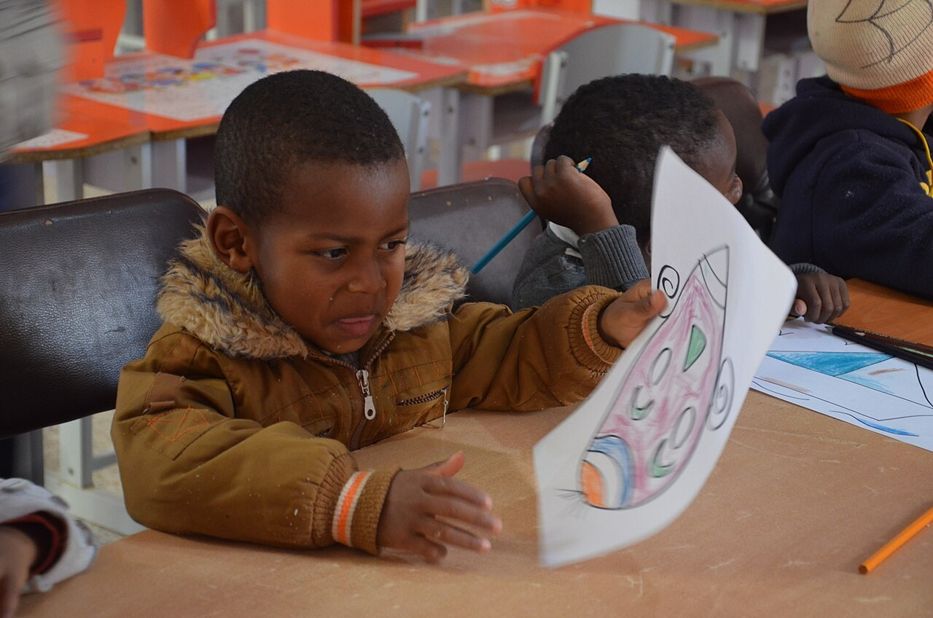
GRADE 8 · LESSON 22
Project: My Story
Loyiha: Mening hikoyam
Project work: My story
BRAHIM DJELLOUL · CC BY-SA 4.0
sozlar.com

Slide 2
LESSON AIMS
Bugungi maqsad
1
Choose a story and complete the four-paragraph planner (ex. 1–2)
2
Write a first draft and tick the five checklist statements (ex. 3)
3
Correct their draft and plan the final version and picture (ex. 4–5)
4
Present the story to a partner and give one positive comment

Slide 3
BOOK TASK · 9 MINUTES
Book tasks — Laser A2, p. 31
Plan your project! Use your notes from lessons 20 and 21.
1
ex.1 — p.28 dagi hikoyangizmi (ko‘proq ma’lumot bilan) yoki yangi hikoyami? Belgilang.
2
ex.2 — PLANNER: Title · Paragraph 1 (When? Where? Who? What were you doing? Why?)
3
ex.2 — Paragraph 2 (What happened first? Did anyone say anything?)
4
ex.2 — Paragraph 3 (What happened next? Why?) · Paragraph 4 (What happened at the end?)
5
ex.3 — birinchi qoralamani yozing va beshta bandni belgilang (✓).
6
ex.4–6 — xatosiz qayta yozing, rasm qo‘shing, kartonga yopishtiring — devorga osamiz!

Slide 4
VOCABULARY
A. Writing and checking (ex. 3–4) (1/3)
〰️
underline
tagiga chizmoq
Underline the most important words in red.
📏️
at least
kamida
Your story should be at least eighty words long.
🗨️
direct speech
ko‘chirma gap
Use direct speech to show what people said.
🔠️
a capital letter
bosh harf
Start every sentence with a capital letter.
⏺️
a full stop
nuqta (tinish belgisi)
Put a full stop at the end of every sentence.

Slide 5
VOCABULARY
A. Writing and checking (ex. 3–4) (2/3)
🖊️
a comma
vergul
Don’t forget a comma after ’In the end’ at the start of a sentence.
❗️
punctuation
tinish belgilari
Check the punctuation before you give your work to the teacher.
🧽️
rub out
(o‘chirg‘ich bilan) o‘chirmoq
Use an eraser to rub out the wrong letters.
❌️
cross out
ustidan chizib tashlamoq
Cross out the wrong word and write the right one.
💯️
without mistakes
xatosiz
Write your story again without mistakes on clean paper.

Slide 6
VOCABULARY
A. Writing and checking (ex. 3–4) (3/3)
📄️
copy out
(toza varaqqa) ko‘chirib yozmoq
Copy out your story on a new page of your notebook.
✍️
neatly
toza, chiroyli qilib
Please write neatly so that everybody can read it.
📘️
the final version
yakuniy variant
We have to give the final version to the teacher on Monday.

Slide 7
VOCABULARY
B. Making the project (ex. 5–6) (1/3)
🎨️
draw a picture
rasm chizmoq
Draw a picture of the funniest moment in your story.
🔗️
connected to
…ga bog‘liq, …ga aloqador
The picture should be connected to the story in some way.
🖌️
felt-tip pens
flomasterlar
Write the title with bright felt-tip pens so that everybody can see it.
🗂️
a piece of card
bir varaq karton
Our teacher gave each of us a piece of card for the project.

Slide 8
VOCABULARY
B. Making the project (ex. 5–6) (2/3)
🧴️
glue
yelim
Put some glue on the back of the photo.
✂️
scissors
qaychi
Be careful with the scissors — they are very sharp.
📰️
cut out
qirqib olmoq
Cut out the photo and put it next to your story.
🖍️
coloured pencils
rangli qalamlar
Colour your picture with coloured pencils, not paints.

Slide 9
VOCABULARY
B. Making the project (ex. 5–6) (3/3)
📎️
sticky tape
yopishqoq lenta, skotch
We used sticky tape to put the poster on the wall.
⬇️
at the bottom
pastki qismida, pastida
There is a small photo at the bottom of the page.
⬆️
at the top
yuqori qismida, tepasida
Write the title in big letters at the top of the card.
🪧️
a poster
plakat
Our class made a poster about our favourite stories.

Slide 10
VOCABULARY
C. Showing the project
🖼️
put up
(devorga) osib qo‘ymoq
Let’s put up our stories on the classroom wall.
🔊️
read aloud
ovoz chiqarib o‘qimoq
Malika stood up and read aloud to the whole class.
🎤️
present
taqdim etmoq
Tomorrow we will present our projects to the parents.
🗳️
vote for
…ga ovoz bermoq
The class voted for the funniest story.
👏️
clap
qarsak chalmoq
Everybody clapped when Aziz finished his story.

Slide 11
TODAY'S WORDS IN CONTEXT
THE GOAT THAT CAME TO SCHOOL (1/2)
Last spring, on a sunny Monday morning, I was sitting in my English lesson with my friend Bobur. The windows were open because it was very hot.
First, we heard a strange noise outside. Then a white goat put its head through the window! 'Don't move!' our teacher said quietly.
Suddenly, the goat jumped into the classroom and started eating Bobur's homework. Everybody was laughing, and Bobur shouted, 'Stop! That's my project!'
Cover the word list. Can you understand the words in bold from the sentence?

Slide 12
TODAY'S WORDS IN CONTEXT
THE GOAT THAT CAME TO SCHOOL (2/2)
In the end, the school guard came and took the goat back to its farm. Bobur had to copy out his homework neatly again, but our class voted for this story as the funniest, and now it's on a poster on the classroom wall.
Cover the word list. Can you understand the words in bold from the sentence?

Slide 13
TODAY'S WORDS IN CONTEXT
Read and answer
1
Does the story have a title? What is it?
2
How many paragraphs are there?
3
Find an example of the past continuous.
4
Find the direct speech in the story.
5
Why were the windows open?

Slide 14
PAIRS · ESDA QOLDIMI?
Memory check — what do you need?
Men vaziyatni aytaman, siz kerakli so‘z yoki narsani ayting.
1
You want to stick the photo on the card. → ?
2
You want to cut out the picture. → ?
3
There is a wrong word in your draft. → ?
4
Every sentence starts with … → ?
5
The class chooses the funniest story. → ?

Slide 15
FOCUS
Topshirishdan oldin — beshta tekshiruv (p. 31 ex.3)
• Sarlavha bormi? Qisqa va qiziq bo‘lsin.
• Kamida to‘rtta xatboshi — har biri planner’dagi bitta qatorga mos.
• Past simple + past continuous — fon (was/were + -ing) va voqea (-ed / noto‘g‘ri fe’l).
• Ko‘chirma gap — qo‘shtirnoq ichida: 'Don’t move!' the teacher said.
• because bilan kamida bitta sabab.

Slide 16
PRONUNCIATION
Say it — don’t just read it
Taqdimotda aniq aytilishi kerak bo‘lgan so‘zlar:
punctuation /ˌpʌŋktʃuˈeɪʃn/
scissors /ˈsɪzəz/
neatly /ˈniːtli/
glue /ɡluː/
felt-tip pens /ˈfelt tɪp penz/
connected to /kəˈnektɪd tə/
read aloud /riːd əˈlaʊd/
a piece of card /ə piːs əv kɑːd/

Slide 17
WHOLE CLASS
Practice — complete the sentence (1/2)
1
I wrote it in pencil, so I can ________ out the mistake with my eraser.
2
Names of people and cities always start with a capital ________.
3
We need some ________ to cut out the photos for our poster.
4
My story has ________ least four paragraphs.
5
'Help!' she shouted. — This is direct ________.
6
When the teacher has seen your story, write it again ________ mistakes.

Slide 18
WHOLE CLASS
Practice — complete the sentence (2/2)
7
Stick your story and your picture on a piece of c________.
8
Write your name at the b________ of the card.

Slide 19
PAIR / GROUP WORK · OPTIONAL
Vocabulary activity
1
Match the beginnings (1-10) with the endings (a-j).
2
Read your complete sentences aloud.
3
Give the Uzbek meaning of the key word in each sentence.
4
When you finish, swap tables with the other group.

Slide 20
PAIRS · 5 MINUTES
Speaking
Planner’ni juftingizga og‘zaki aytib bering — u «What happened next?» deb so‘raydi.
Qoralamani almashtiring: juftingiz beshta bandni va tinish belgilarini (a capital letter, a full stop, a comma) tekshirib, bitta tuzatish taklif qiladi.
Hikoyangizni taqdimot iboralari bilan taqdim eting: My story is called … It's a … story about …

Slide 21
UZ
Qiyin joyi — o‘zbekcha
the final version — «toza nusxa»; copy out — qoralamani toza varaqqa ko‘chirib yozmoq.
direct speech — «ko‘chirma gap»: kimningdir aynan so‘zlari qo‘shtirnoq ichida.
glue — «yelim», sticky tape — «skotch»; scissors doim ko‘plikda: The scissors are sharp.
put up — «devorga osib qo‘ymoq»: put up our projects on the wall.
rub out — o‘chirg‘ich bilan o‘chirmoq; cross out — ustidan chizib tashlamoq.

Slide 22
HOMEWORK
Uy vazifasi
1
Project: finish your story and add pictures — final version on a piece of card, your name at the bottom.
2
Learn the 30 items with the flashcards: sozlar.com/vocab/cards/?set=grade8-lesson22

Slide 23
IMAGE CREDITS
Rasmlar manbasi
cover
BRAHIM DJELLOUL · CC BY-SA 4.0 · https://commons.wikimedia.org/wiki/File:ATELIER_DE_DESSIN_A_TIMIMOUN_010.jpg

Slide 24
Uchta so‘z — ertaga ham esingizda qoladi
Juftingizga ayting, so‘ng daftaringizga yozib qo‘ying.
sozlar.com/vocab/cards/?set=grade8-lesson22

