Slide 1
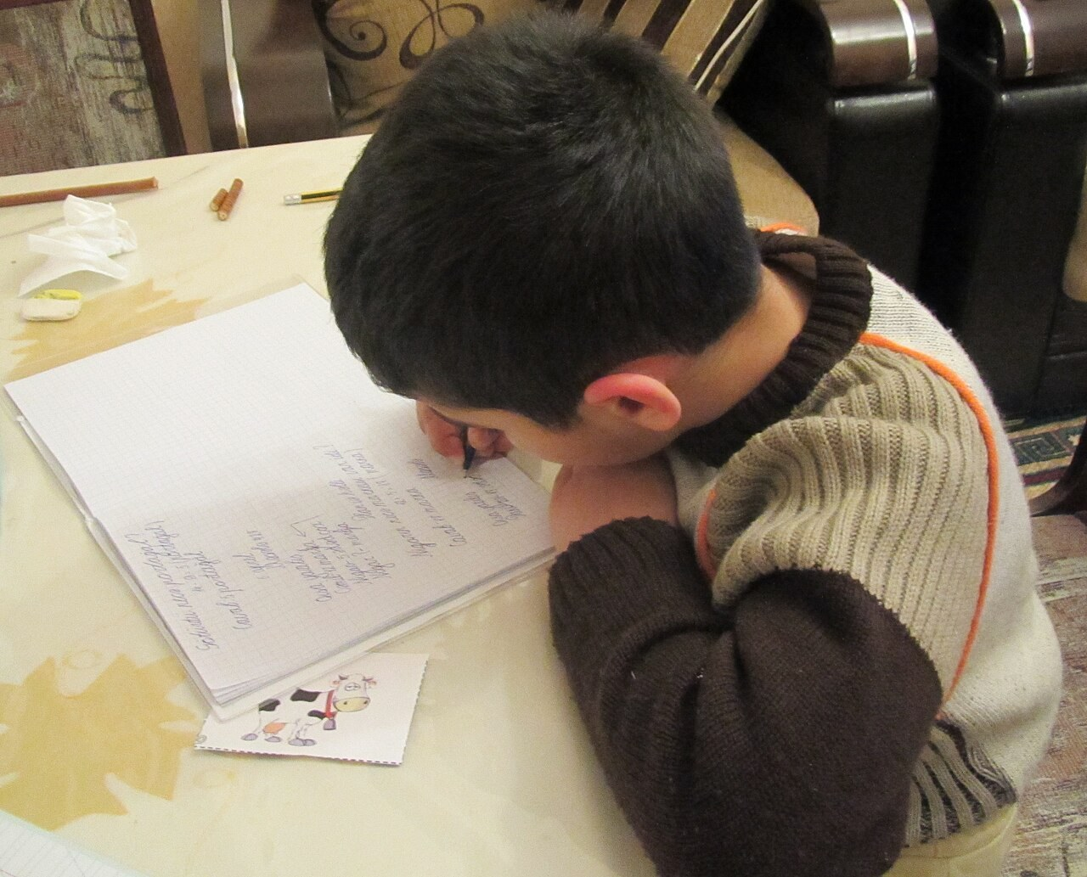
GRADE 8 · LESSON 21
Writing a Story
Hikoya yozish
Writing a story
Moonsun1981 · CC BY-SA 3.0
sozlar.com

Slide 2
LESSON AIMS
Bugungi maqsad
1
Put the five parts of the model story in order (ex. 1)
2
Compare it with the p.28 story and find the extra information (ex. 2)
3
Find and underline examples of the five Language Lab features
4
Write the opening paragraph of their own story using the past continuous

Slide 3
BOOK TASK · 8 MINUTES
Book tasks — Laser A2, p. 30
Books open, word list closed. Work alone first.
1
ex.1 — o‘qing va beshta qismni (a–e) to‘g‘ri tartibga qo‘ying: Part 1 … Part 5.
2
ex.2 — p.28 dagi hikoya bilan solishtiring: qaysi bet? uzunroqmi yoki qisqaroq?
3
ex.2 — qaysi qahramon faqat shu hikoyada bor? Qanday qo‘shimcha ma’lumotlar bor?
4
Language Lab — beshta qoidaning har biriga hikoyadan misol topib, tagiga chizing.

Slide 4
CHECK AND TEACH · 8 MINUTES
Answer key — Laser A2, p. 30
1
ex.1 Part 1 b · Part 2 e · Part 3 a · Part 4 c · Part 5 d
2
ex.2 1 page 28 · 2 longer · 3 their mother (and the brother has a name — Greg)
3
ex.2 (4) the title · Saturday · it was raining · Greg's words · I fell off my chair
4
ex.2 (4) 'Stop!' · what fell (chess, juice, phones) · Mum came in · they both stood there laughing
5
Lab 1–3 A GAME, A JOKE AND A TERRIBLE MESS! · we were playing chess / I was still laughing · 'Stop!'
6
Lab 4–5 because it was raining / because I was laughing so much · 'I heard a great joke …' / 'Stop!'

Slide 5
VOCABULARY
A. Parts of a story (1/2)
🏷️
a title
sarlavha
Think of a short, funny title for your story.
💬️
quote marks
qo‘shtirnoq
Put the words people say in quote marks.
▶️
the beginning
boshlanishi, boshi
At the beginning of the story, two boys are playing chess.
🏁️
the ending
yakuni, oxiri (hikoya, film)
I didn’t like the ending of the film — it was too sad.

Slide 6
VOCABULARY
A. Parts of a story (2/2)
🌈️
a happy ending
baxtli yakun
Most children’s stories have a happy ending.
👀️
the reader
o‘quvchi, kitobxon
A good title makes the reader want to read the story.
➕️
extra information
qo‘shimcha ma’lumot
Add some extra information about the weather and the place.
🔁️
similar
o‘xshash
My story is similar to yours — my cat broke a cup too.

Slide 7
VOCABULARY
B. A game, a joke and a terrible mess (p. 30) (1/3)
🌪️
a terrible mess
dahshatli tartibsizlik, ag‘dar-to‘ntar
After the birthday party, the kitchen was a terrible mess.
🌧️
outside
tashqarida
It was raining outside, so we played board games at home.
🎬️
in the middle of
…ning o‘rtasida
The lights went out in the middle of the film.
✅️
finish
tugatmoq, (aytib) bo‘lmoq
When he finished telling the joke, we all laughed.

Slide 8
VOCABULARY
B. A game, a joke and a terrible mess (p. 30) (2/3)
🤭️
can’t stop laughing
kulgidan to‘xtay olmaslik
The film was so funny that I couldn’t stop laughing.
🪑️
fall off
(stul, velosiped)dan yiqilib tushmoq
My little brother fell off his chair during dinner.
⏰️
too late
juda kech, kech bo‘lib qolgan
I ran to the bus stop, but it was too late.
🍊️
a glass of orange juice
bir stakan apelsin sharbati
Would you like a glass of orange juice with your breakfast?

Slide 9
VOCABULARY
B. A game, a joke and a terrible mess (p. 30) (3/3)
🚪️
come in
kirib kelmoq
When Mum came in, we were still playing on the floor.
⏳️
still
hali ham, hamon
It was ten o’clock, but my brother was still sleeping.
🧍️
stand there
(o‘sha yerda) turib qolmoq
We just stood there and didn’t know what to say.

Slide 10
VOCABULARY
C. Story linking words (1/3)
1️⃣
first
avval, birinchidan
First, I opened the box very carefully.
2️⃣
then
keyin, so‘ngra
Then I saw a little kitten inside it.
3️⃣
after that
shundan keyin
After that, we took the kitten to the vet.
⚡️
suddenly
to‘satdan, birdan
Suddenly, the lights went out and everybody screamed.

Slide 11
VOCABULARY
C. Story linking words (2/3)
🌱️
at first
avvaliga, dastlab
At first, I was scared, but then I started laughing.
🕑️
later
keyinroq
Two hours later, Dad came home with a big pizza.
🔔️
at that moment
o‘sha paytda, shu payt
At that moment, the door opened and Grandma walked in.
🔑️
finally
nihoyat
We looked everywhere and finally found the keys under the sofa.

Slide 12
VOCABULARY
C. Story linking words (3/3)
🎉️
in the end
oxir-oqibat, oxirida
In the end, everybody laughed and the evening was great.
🍀️
luckily
xayriyatki, baxtimizga
The glass fell on the floor. Luckily, it didn’t break.
📅️
the next day
ertasi kuni
The next day, we told the whole class about our adventure.

Slide 13
TODAY'S WORDS IN CONTEXT
THE CAKE, THE CAT AND A BIG SURPRISE (1/2)
Last Friday it was my grandmother's birthday. It was raining outside, so the whole family was at home. Mum was making a big chocolate cake and I was helping her.
First, we put the cake on the kitchen table. Then Mum said, 'Watch the cake, please! Don't let the cat in!' and she went to answer the phone.
I was sitting in the middle of the kitchen floor, reading a comic, when suddenly our cat, Momo, jumped onto the table. 'Stop!' I shouted, but it was too late. The cake fell on the floor. It was terrible!
Cover the word list. Can you understand the words in bold from the sentence?

Slide 14
TODAY'S WORDS IN CONTEXT
THE CAKE, THE CAT AND A BIG SURPRISE (2/2)
When Mum came in, we both just stood there. In the end, Grandma laughed because Momo had chocolate on his nose, and we bought a new cake from the shop.
Cover the word list. Can you understand the words in bold from the sentence?

Slide 15
TODAY'S WORDS IN CONTEXT
Read and answer
1
Why was the family at home?
2
Find one example of the past continuous.
3
Find an imperative in the story.
4
What were the exact words the writer shouted?
5
Why did Grandma laugh?

Slide 16
PAIRS · ESDA QOLDIMI?
Memory check — which feature?
Men gapni o‘qiyman, siz Language Lab dagi qaysi qoida ekanini ayting (1–5).
1
'Luckily, it didn't break!' she said. → ?
2
It was raining outside. → ?
3
A TERRIBLE MESS IN THE KITCHEN → ?
4
In the end, we laughed because the cat had cake on its nose. → ?
5
Come in and sit down! → ?

Slide 17
FOCUS
Yaxshi hikoyaning beshta belgisi (Language Lab)
• Sarlavha — qisqa va qiziq: The Cake, the Cat and a Big Surprise.
• Past continuous — fon: It was raining. Mum was making a cake. Voqea esa past simple: The cat jumped.
• Imperative — qahramon buyruq beradi: 'Don’t let the cat in!'
• because — sabab: Grandma laughed because …
• Qo‘shtirnoq — aynan aytilgan so‘z: 'Stop!' I shouted. Vergul va nuqta qo‘shtirnoq ICHIDA.

Slide 18
PRONUNCIATION
Say it — don’t just read it
Kartadagi so‘zlar — urg‘u va talaffuz:
suddenly /ˈsʌdənli/
finally /ˈfaɪnəli/
luckily /ˈlʌkɪli/
quote marks /ˈkwəʊt mɑːks/
extra information /ˌekstrə ˌɪnfəˈmeɪʃn/
similar /ˈsɪmələ/
a terrible mess /ə ˈterəbl mes/
the reader /ðə ˈriːdə/
-ly qo‘shilganda urg‘u o‘zgarmaydi: SUDden → SUDdenly, FInal → FInally, LUCKy → LUCKily.

Slide 19
WHOLE CLASS
Practice — complete the sentence (1/2)
1
My friend told a joke and we couldn't ________ laughing for five minutes.
2
We usually give a story a ________.
3
We use quote ________ to show what people said.
4
We got to the cinema at nine, but it was too ________ — the film was over.
5
S________, there was a loud noise and everybody screamed.
6
When my dad came ________, we were still playing.

Slide 20
WHOLE CLASS
Practice — complete the sentence (2/2)
7
'I was reading when the phone rang.' 'Was reading' is the past ________.
8
I fell off my bike. L________, I didn't hurt myself.

Slide 21
PAIR / GROUP WORK · 5 MINUTES
Vocabulary activity
1
Match the beginnings (1-10) with the endings (a-j).
2
Read your complete sentences aloud.
3
Give the Uzbek meaning of the key word in each sentence.
4
When you finish, swap tables with the other group.

Slide 22
PAIRS
Speaking
Juftlikda: p.28 dagi og‘zaki hikoya va p.30 dagi yozma hikoyaning uchta farqini ayting (the title, the ending, extra information).
20-darsdagi eslatmalaringizdan hikoyangizga sarlavha o‘ylab toping va juftingizga ayting.
Juftingizga birinchi xatboshini og‘zaki ayting: When? Where? Who? What were you doing?

Slide 23
UZ
Qiyin joyi — o‘zbekcha
past continuous (was/were + -ing) — hikoyaning FONI: «… qilayotgan edi».
past simple — fon ustida bo‘lgan VOQEA: I was reading when the cat jumped.
In the end — «oxir-oqibat»; at the end — «oxirida» (joy/vaqt nuqtasi).
Inglizcha qo‘shtirnoq: 'Stop!' yoki “Stop!” — o‘zbekchadagi «…» o‘rniga.
At first — «avvaliga» (keyin vaziyat o‘zgaradi); First, — «avval» (voqealar ketma-ketligida birinchi qadam).

Slide 24
HOMEWORK
Uy vazifasi
1
Write a story of 80–100 words: 'An unforgettable day'. Use a title, the past continuous, because and some direct speech.
2
Learn the 30 items with the flashcards: sozlar.com/vocab/cards/?set=grade8-lesson21

Slide 25
IMAGE CREDITS
Rasmlar manbasi
cover
Moonsun1981 · CC BY-SA 3.0 · https://commons.wikimedia.org/wiki/File:Az-Writing_boy_e-citizen.jpg

Slide 26
Uchta so‘z — ertaga ham esingizda qoladi
Juftingizga ayting, so‘ng daftaringizga yozib qo‘ying.
sozlar.com/vocab/cards/?set=grade8-lesson21

