Slide 1
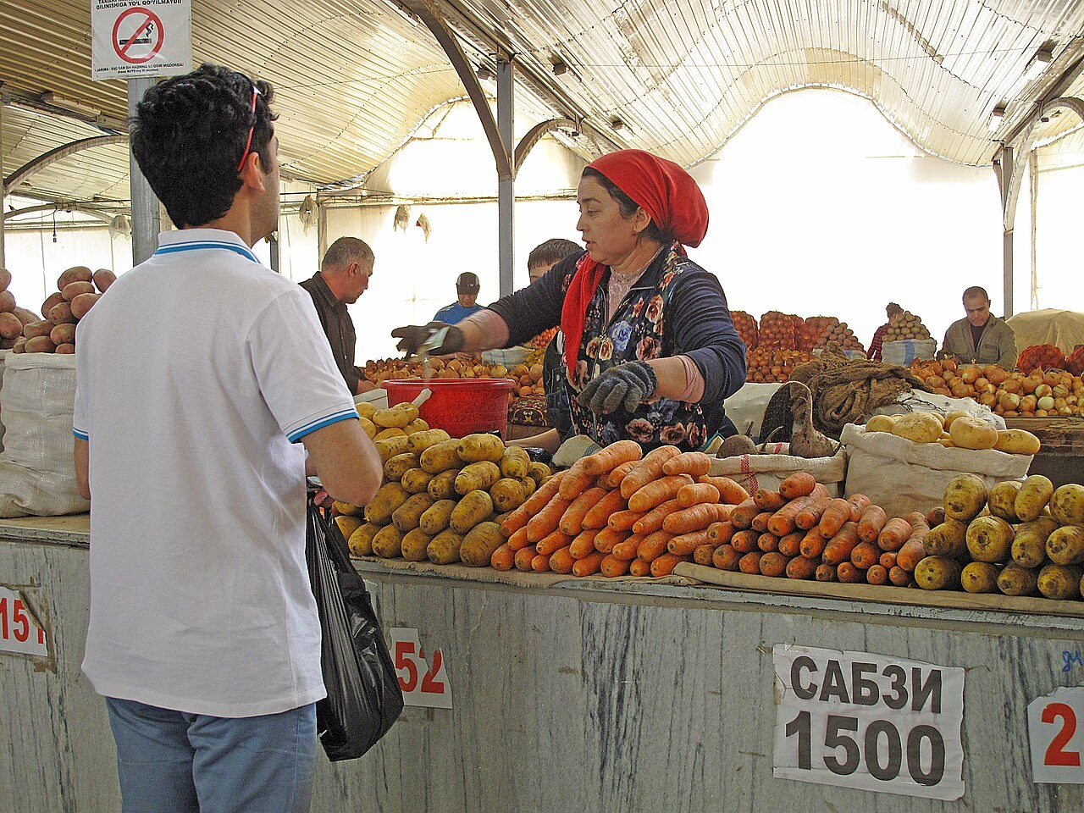
GRADE 7 · LESSON 21
Plan Your Project
Loyihani rejalashtirish: yozgi rasm tavsifi
Plan your project
Enric · CC BY-SA 4.0
sozlar.com

Slide 2
LESSON AIMS
Bugungi maqsad
1
Describe a few things that are happening in the summer picture (p. 31 ex. 1)
2
Answer the ten questions with short notes (ex. 2)
3
Complete the planner for paragraphs 1–4 (ex. 3)
4
Write the first two paragraphs of the description (ex. 4) and plan the town project

Slide 3
BOOK TASK · 6 MINUTES
Book task — Laser A1+, p. 31, ex. 1
The same shopping centre — but now it is summer. Describe a few things that are happening.
1
Namuna: A man is carrying a girl on his shoulders.
2
What is different from the winter picture on p. 30?
3
Find: a boy on a bike · a police officer · a baby in a pram · a man with something to read.
4
Say four sentences with is / are + -ing.

Slide 4
VOCABULARY
A. Planning a description
📝️
make notes
qisqa qaydlar yozmoq
Before you start writing, make notes in your planner.
🗂️
a planner
reja jadvali
My planner has got four parts, one for each paragraph.
✍️
a description
tasvir, tavsif
Malika is writing a description of a photo from her holiday.
🖼️
describe
tasvirlamoq, ta’riflamoq
Can you describe the people in this picture?

Slide 5
VOCABULARY
B. The summer picture (1/3)
☀️
a sunny day
quyoshli kun
It’s a sunny day, so lots of people are walking in the park.
🏖️
summer clothes
yozgi kiyim
In July everyone is wearing light summer clothes.
🩳️
shorts
kalta shim, shorti
My brother is wearing blue shorts and a white cap.
👖️
jeans
jinsi shim
The girl in the shop is wearing jeans and a yellow top.

Slide 6
VOCABULARY
B. The summer picture (2/3)
👗️
a dress
ko‘ylak (ayollar ko‘ylagi)
My sister is wearing a long green dress to the wedding.
👚️
a skirt
yubka
A woman in a skirt is reading a magazine as she walks.
🩴️
sandals
sandal (yozgi oyoq kiyim)
My feet are hot, so I’m wearing sandals today.
👮️
a police officer
politsiyachi
A police officer is helping an old woman cross the road.

Slide 7
VOCABULARY
B. The summer picture (3/3)
🚲️
ride a bike
velosiped haydamoq
Look! That girl is riding a bike with her little dog.
🍼️
push a pram
bolalar aravachasini itarmoq
My aunt is pushing a pram in the park.
📖️
walk and read at the same time
yurib ketayotib o‘qimoq
A man is walking and reading at the same time. Be careful!
🏢️
outside the building
bino tashqarisida
Outside the building, some children are playing with a ball.

Slide 8
VOCABULARY
C. How do they feel? (1/2)
🤩️
excited
hayajonlangan
The children look excited because it’s the first day of the holidays.
😟️
worried
xavotirda, tashvishlangan
Mum looks worried because my little brother is very late.
😮️
surprised
hayron qolgan, ajablangan
Grandpa is surprised — there’s a cake with his name on it!

Slide 9
VOCABULARY
C. How do they feel? (2/2)
😨️
scared
qo‘rqib ketgan
The little girl is scared of the big dog.
😌️
relaxed
xotirjam, bemalol
Dad is sitting in the garden and he looks very relaxed.
⏱️
in a hurry
shoshilib, shoshib turgan
Sorry, I can’t talk now — I’m in a hurry!

Slide 10
VOCABULARY
D. Shopping in my town (1/2)
🍉️
a bazaar
bozor
On Sundays my family buys fruit at the bazaar.
🥖️
a stall
rasta, peshtaxta
This man has a stall with fresh bread.
🥕️
fresh fruit and vegetables
yangi uzilgan meva va sabzavotlar
You can buy fresh fruit and vegetables at our local market.

Slide 11
VOCABULARY
D. Shopping in my town (2/2)
🏬️
a shopping street
savdo ko‘chasi
There are lots of cafés on the main shopping street.
☕️
a café
kafe
Some people are drinking tea at a café next to the supermarket.
🏷️
a caption
rasm osti yozuvi
Write a caption under each photo in your project.

Slide 12
BOOK TASK · 7 MINUTES
Book tasks — Laser A1+, p. 31, ex. 2–3
First make notes (ex. 2), then put them in the planner (ex. 3).
1
ex.2 — answer questions 1–10 with short notes, not full sentences.
2
ex.3 — copy the planner: Paragraph 1–4 · Useful information · Your notes.
3
Use the sentence starters from p. 30: This is a picture of … · Near the door, … · In the middle of …
4
Do NOT copy the winter text — the summer picture is different!

Slide 13
TEACHER · ACCEPT OTHER GOOD ANSWERS
Answer key — Laser A1+, p. 31, ex. 2 (possible notes)
1
1–2 in a shopping centre · it’s sunny / hot; people are playing outside
2
3–5 a man in the middle · carrying a girl on his shoulders · happy, having fun
3
6–8 a boy on a bike, a police officer behind him · riding / running after him · excited / angry
4
9–10 going in and out of the shops, shopping, talking · relaxed, enjoying themselves

Slide 14
FOCUS
From notes to sentences
• Qayd — qisqa, gap emas: shopping centre · sunny · summer clothes.
• Qaydni gapga aylantiring: sunny → It’s a sunny day outside.
• Harakat — present continuous: boy — bike → A boy is riding a bike.
• His-tuyg‘u — I think / looks: I think he’s excited. She looks worried.
• Har xatboshi — bitta vazifa (Planner: Paragraph 1–4).

Slide 15
STRATEGY
Plan your description — the planner (p. 31 ex. 3)
1
Paragraph 1: This is a picture of … · It’s … outside · people are wearing … · I think it’s a … day.
2
Paragraph 2: Near the door, … · Next to them, … · I think …
3
Paragraph 3: In the middle of the shopping centre, … · It looks … · In front of them, there’s a …
4
Paragraph 4: Everyone’s … · They’re buying … · It looks like …

Slide 16
PRONUNCIATION
Say it — don’t just read it
Feelings ending in -ed: three different sounds /d/, /t/, /ɪd/ — then two tricky nouns.
worried
/ˈwʌrid/ — /d/
surprised
/səˈpraɪzd/ — /d/
scared
/skeəd/ — /d/
relaxed
/rɪˈlækst/ — /t/
excited
/ɪkˈsaɪtɪd/ — /ɪd/
a bazaar
/ə bəˈzɑː/
a café
/ə ˈkæfeɪ/
Only -t or -d before -ed gives an extra syllable: ex-ci-ted, but re-laxed.

Slide 17
WHOLE CLASS
Practice — complete the sentence (1/2)
1
Look at the picture first and make short ________ in your planner. (n…)
2
Read my ________ of the summer picture — it’s got four paragraphs. (d…)
3
It’s very hot today, so I’m wearing ________ on my feet. (sa…)
4
Look at the photo and ________ what the people are doing. (d…)
5
It’s hot, so people are wearing ________ clothes. (s…)
6
A boy is ________ a bike in the shopping centre! (ride)

Slide 18
WHOLE CLASS
Practice — complete the sentence (2/2)
7
A police ________ is running after him. (o…)
8
A woman is ________ a pram next to the shop. (push)
9
The man looks ________ — he’s late for work. (w…)
10
Under each photo, write a short ________ — one sentence about it. (c…)

Slide 19
PAIR / GROUP WORK · 4 MINUTES
Vocabulary activity
1
Match the beginnings (1-10) with the endings (a-j).
2
Read your complete sentences aloud.
3
Give the Uzbek meaning of the key word in each sentence.
4
When you finish, swap tables with the other group.

Slide 20
PAIRS
Speaking
Ask and answer the ten questions from ex. 2 about the summer picture. Answer with notes first, then with a full sentence.
Compare your planners: read your paragraph 2 notes; your partner finds the people in the picture.
Project talk: tell your partner two places in our town where people go shopping and what you can buy there.

Slide 21
TODAY'S WORDS IN CONTEXT
Shopping in my town (a model project) (1/2)
Photo 1. This is the bazaar in my town. It’s open every day, but on Sunday mornings there are lots of people. My family usually comes here at nine o’clock.
Photo 2. Here you can buy fresh fruit and vegetables. In this photo, my mum is buying tomatoes and apples. The man at the stall is smiling — I think he’s happy because she’s buying a lot!
Photo 3. This is our main shopping street. There’s a big supermarket, two clothes shops and a bookshop. In this photo, it’s a sunny day and people are wearing summer clothes. My brother is in a hurry because he wants an ice cream!
Cover the word list. Can you understand the words in bold from the sentence?

Slide 22
TODAY'S WORDS IN CONTEXT
Shopping in my town (a model project) (2/2)
Photo 4. Next to the supermarket there’s a small café. Some people are drinking tea and they look very relaxed. I like shopping in my town because everything is near my house. — Diyora, 12
Cover the word list. Can you understand the words in bold from the sentence?

Slide 23
TODAY'S WORDS IN CONTEXT
Read and answer
1
When are there lots of people at the bazaar?
2
What is Diyora’s mum buying in photo 2?
3
Why does Diyora think the man at the stall is happy?
4
Why is her brother in a hurry?
5
Why does Diyora like shopping in her town?

Slide 24
PAIRS · ESDA QOLDIMI?
Memory check — notes to sentences
Men qaydni aytaman, siz uni to‘liq gapga aylantirasiz.
1
sunny → It’s …
2
boy — bike → A boy is …
3
police officer — running → …
4
woman — pram → …
5
people — café — relaxed → Some people are …

Slide 25
UZ
Qiyin joyi — o‘zbekcha
Qayd (notes) — qisqa so‘zlar: sunny, summer clothes. Matnda esa to‘liq gap yoziladi.
-ed sifatlar odamning his-tuyg‘usini bildiradi: I’m excited — «hayajondaman» (✗ I’m exciting).
look + sifat: She looks worried — «xavotirda ko‘rinadi».
a bazaar — «bozor»; a stall — bozordagi «rasta, peshtaxta».
Loyihada har rasm ostiga caption — bir gaplik izoh yozing: My mum is buying apples.

Slide 26
HOMEWORK
Uy vazifasi
1
Project (kalendar reja): 8–10 sentences and pictures about shopping in your town — use the model on the lesson page.
2
Finish your description of the summer picture (p. 31 ex. 4), paragraphs 3–4.
3
Learn the 28 items with the flashcards: sozlar.com/vocab/cards/?set=grade7-lesson21

Slide 27
IMAGE CREDITS
Rasmlar manbasi
cover
Enric · CC BY-SA 4.0 · https://commons.wikimedia.org/wiki/File:084_Eski_Juva_Bozori,_mercat_de_Chorsu_(Taixkent),_parada_de_verdures,_pastanagues.jpg

Slide 28
Uchta so‘z — ertaga ham esingizda qoladi
Juftingizga ayting, so‘ng daftaringizga yozib qo‘ying.
sozlar.com/vocab/cards/?set=grade7-lesson21

