Slide 1
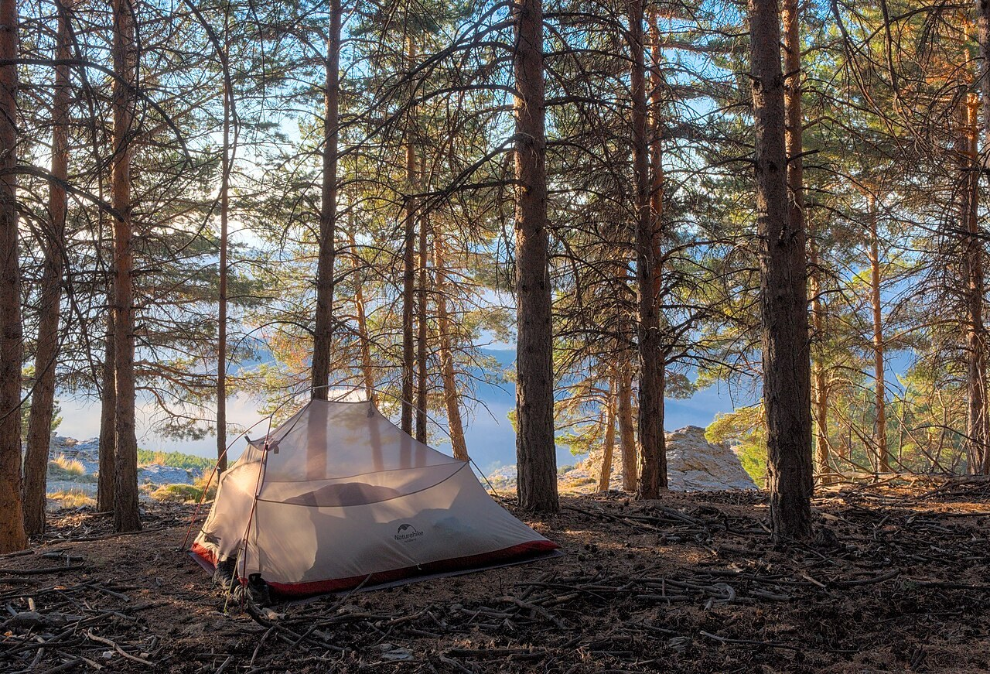
GRADE 10 · LESSON 20
Vocabulary Builder: Free Time Activities
Bo‘sh vaqt mashg‘ulotlari: go, do, play; vaqt haqida iboralar
Vocabulary builder: Free time activities
Trougnouf (Benoit Brummer) · CC BY 4.0
sozlar.com

Slide 2
LESSON AIMS
Bugungi maqsad
1
Sort fourteen activities under go, do and play (ex. 1)
2
Correct the wrong verb in six sentences (ex. 2)
3
Match six time idioms and say what they mean (ex. 3)
4
Complete definitions with phrasal verbs with down (ex. 4) and money words (ex. 5)

Slide 3
BOOK TASK · 16 MINUTES
Book tasks — Laser B1+, p. 27
Vocabulary builder. Books open, word list closed — try alone first.
1
ex.1 — Match 14 free time activities with go, do or play.
2
ex.2 — Tick (✓) the correct verbs; rewrite the wrong ones.
3
ex.3 — Idioms: time. Match 1–6 with a–f. What do the idioms mean?
4
ex.4 — Phrasal verbs with down: complete the five definitions.
5
ex.5 — Magic metaphors: valuable · save · spend · waste.

Slide 4
CHECK AND TEACH · 8 MINUTES
Answer key — Laser B1+, p. 27 (1/2)
1
ex.1 go: camping, horse-riding, swimming, skiing, fishing, canoeing
2
ex.1 do: ballet, karate, judo, gymnastics
3
ex.1 play: basketball, video games, volleyball, the piano
4
ex.2 1 doing · 2 correct · 3 correct · 4 playing · 5 do · 6 go
5
ex.3 1 c · 2 e · 3 f · 4 a · 5 b · 6 d
6
ex.4 1 turn down · 2 look down on · 3 come down with · 4 puts … down · 5 gets you down

Slide 5
CHECK AND TEACH · 8 MINUTES
Answer key — Laser B1+, p. 27 (2/2)
7
ex.5 1 save · 2 wasting · 3 spend · 4 valuable

Slide 6
FOCUS
go, do or play? — three rules
• go + -ing faoliyat: go swimming, go skiing, go camping, go fishing, go horse-riding.
• play + jamoaviy va to‘p o‘yinlari, o‘yinlar, cholg‘u: play volleyball, play chess, play video games, play the piano.
• do + yakka sport / mashg‘ulot (-ing bilan tugamaydi): do ballet, do karate, do judo, do gymnastics.
• on time = belgilangan vaqtda; in time = ulgurib, kech qolmasdan (just in time to see…).
• down bilan frazal fe’llar ko‘pincha salbiy: turn down, look down on, get sb down, let sb down.
• Ingliz tilida vaqt — pul (Time is money.): spend time, waste time, run out of time; kitobda (ex.5) yana save time, valuable.

Slide 7
VOCABULARY
A. go, do or play? (1/4)
⛺️
go camping
chodirda dam olishga bormoq
We go camping in the mountains every summer.
🏇️
go horse-riding
ot minishga bormoq
My cousins go horse-riding in the village every weekend.
🏊️
go swimming
suzishga bormoq
Dilnoza goes swimming at the sports centre on Wednesdays.
⛷️
go skiing
chang‘i uchishga bormoq
In January we went skiing in Chimgan for the first time.

Slide 8
VOCABULARY
A. go, do or play? (2/4)
🎣️
go fishing
baliq oviga bormoq
My grandad goes fishing early on Sunday mornings.
🛶️
go canoeing
kanoeda suzishga bormoq
We went canoeing on the lake last August.
🎳️
go bowling
boulingga bormoq
On Saturday we went bowling with our cousins.
🩰️
do ballet
balet bilan shug‘ullanmoq
My little sister does ballet at the music school.

Slide 9
VOCABULARY
A. go, do or play? (3/4)
🥋️
do karate
karate bilan shug‘ullanmoq
Bekzod has been doing karate for three years.
🥇️
do judo
dzyudo bilan shug‘ullanmoq
My brother does judo at the sports centre.
🥷️
do martial arts
yakkakurash bilan shug‘ullanmoq
My cousins have been doing martial arts at the sports centre since last year.
🏀️
play basketball
basketbol o‘ynamoq
We play basketball in the school gym on Fridays.

Slide 10
VOCABULARY
A. go, do or play? (4/4)
🏐️
play volleyball
voleybol o‘ynamoq
In summer we play volleyball on the beach.
🎮️
play video games
video o‘yin o‘ynamoq
My brother plays video games only at the weekend.
🎭️
do drama
teatr to‘garagiga qatnashmoq
My sister does drama at the youth centre and loves acting.
♟️
play chess
shaxmat o‘ynamoq
My grandfather taught me to play chess when I was six.

Slide 11
VOCABULARY
B. Idioms with time (1/2)
🙌️
have time on your hands
bo‘sh vaqti ko‘p bo‘lmoq
In the holidays I have a lot of time on my hands.
🃏️
kill time
vaqt o‘tkazmoq (zerikmaslik uchun)
We played cards to kill time at the airport.
🐢️
take your time
shoshilmasdan, bemalol qilmoq
There’s no hurry — take your time with the test.

Slide 12
VOCABULARY
B. Idioms with time (2/2)
⏰️
on time
belgilangan vaqtda, kechikmay
The concert started exactly on time, at seven o’clock.
🏃️
in time
vaqtida, ulgurib (kech qolmay)
We got to the stadium just in time to see the first goal.
⚡️
in no time
bir zumda, juda tez
Don’t worry — we’ll be there in no time.

Slide 13
VOCABULARY
C. Phrasal verbs with down (1/2)
🙅️
turn down
rad etmoq, qabul qilmaslik
She turned down the offer to join the city team.
🧐️
look down on
mensimaslik, past nazar bilan qaramoq
Good players never look down on beginners.
🤧️
come down with
(yengil kasallikka) chalinmoq
I came down with a cold the day before the match.
🐴️
put down
(qari yoki kasal hayvonni) uxlatmoq
The vet said the old horse was very ill and had to be put down.

Slide 14
VOCABULARY
C. Phrasal verbs with down (2/2)
🌧️
get sb down
ruhini tushirmoq, siqmoq
Rainy weather always gets me down.
💔️
let sb down
umidini puchga chiqarmoq
Please don’t let me down — the team needs you on Saturday.
🚗️
break down
buzilib qolmoq
Our car broke down on the way to the lake.

Slide 15
VOCABULARY
D. Time collocations
🕊️
free time
bo‘sh vaqt
What do you like doing in your free time?
⌚️
spend time
vaqt sarflamoq
I spend a lot of time practising the guitar.
🗑️
waste time
vaqtni behuda sarflamoq
Don’t waste time on your phone — start your homework.
⌛️
run out of time
vaqt yetmay qolmoq
I ran out of time and didn’t finish the last question.
📅️
can’t afford the time
(…ga) vaqt ajrata olmaslik
I’d love to join the club, but I can’t afford the time before my exams.

Slide 16
PRONUNCIATION
Say it — don’t just read it
Phrasal verbs: the stress usually falls on the particle (down):
turn DOWN
look DOWN on
come DOWN with
let me DOWN
ballet
/ˈbæleɪ/
karate
/kəˈrɑːti/
judo
/ˈdʒuːdəʊ/
canoeing
/kəˈnuːɪŋ/
In a sentence: It really gets me DOWN. · She turned the offer DOWN.

Slide 17
WHOLE CLASS
Practice — complete the sentence (1/2)
1
Let’s ________ horse-riding tomorrow. (go / do / play)
2
How long have you been ________ karate? (going / doing / playing)
3
How much time do you spend ________ video games? (going / doing / playing)
4
I ________ ballet twice a week after school. (go / do / play)
5
Since my mum retired, she’s got a lot of time on her ________.
6
We got to the pool just ________ time to see Robert win the race. (in / on)

Slide 18
WHOLE CLASS
Practice — complete the sentence (2/2)
7
If you ________ down an offer, you refuse it.
8
If you come down ________ a minor illness, you start suffering from it.
9
The test was long, and we ________ out of time before the last part. (r…)
10
Hurry up! We mustn’t ________ time — the bus leaves in ten minutes. (w…)

Slide 19
PAIR / GROUP WORK · 6 MINUTES
Vocabulary activity
1
Match the beginnings (1-10) with the endings (a-j).
2
Read your complete sentences aloud.
3
Give the Uzbek meaning of the key word in each sentence.
4
When you finish, swap tables with the other group.

Slide 20
PAIRS · 6 MINUTES
Speaking
Pairs: What do you do, play or go in your free time? Give one example for each verb.
Choose two idioms from ex.3 and make true sentences about yourself: I killed time by …
Discuss: What gets you down? What offer would you never turn down? What do you often waste time on?

Slide 21
TODAY'S WORDS IN CONTEXT
My cousin never kills time (1/2)
My cousin Dilnoza never kills time. On Mondays she does ballet, on Wednesdays she goes swimming, and at the weekend she plays volleyball with her school team. In the summer the whole family goes camping in the mountains.
Last month she came down with a cold and had to stay at home. At first she was happy to have time on her hands, but after two days of playing video games the boredom started to get her down.
Cover the word list. Can you understand the words in bold from the sentence?

Slide 22
TODAY'S WORDS IN CONTEXT
My cousin never kills time (2/2)
Then her coach offered her a place in the city team. Of course, she didn’t turn it down. Now she spends even more time training, so she never wastes a minute: to save time, she does her homework on the bus. Her time is valuable — but she always makes time for me.
Cover the word list. Can you understand the words in bold from the sentence?

Slide 23
TODAY'S WORDS IN CONTEXT
Read and answer
1
Which activities does Dilnoza do, go or play?
2
What happened to her last month?
3
What started to get her down?
4
What did she do when the coach offered her a place in the city team?
5
How does she save time?

Slide 24
PAIRS · ESDA QOLDIMI?
Memory check — go, do or play?
Men mashg‘ulotni aytaman, siz fe’l bilan to‘liq aytasiz.
1
karate → ?
2
fishing → ?
3
basketball → ?
4
martial arts → ?
5
bowling → ?

Slide 25
UZ
Qiyin joyi — o‘zbekcha
go + -ing (go swimming), play — o‘yin va cholg‘u (play the piano), do — qolgan yakka sport (do karate).
on time — «o‘z vaqtida, kechikmay»; in time — «ulgurib, kech qolmay».
kill time — «vaqt o‘tkazmoq» (zerikib kutganda); take your time — «shoshilmasdan, bemalol».
turn down ob’ekt olmoshi bilan: turn it down, ✗ turn down it emas.
Vaqt — pul (Time is money.): spend time — «vaqt sarflamoq», waste time — «vaqtni behuda o‘tkazmoq», run out of time — «vaqt yetmay qolmoq».

Slide 26
HOMEWORK
Uy vazifasi
1
Laser B1+ Workbook p. 21, ex. 1–2.
2
Learn the 34 items with the flashcards: sozlar.com/vocab/cards/?set=grade10-lesson20
3
Write eight sentences about your family’s free time: three with go / do / play, three idioms, two phrasal verbs with down.

Slide 27
IMAGE CREDITS
Rasmlar manbasi
cover
Trougnouf (Benoit Brummer) · CC BY 4.0 · https://commons.wikimedia.org/wiki/File:Tent_camping_along_the_Sulayr_trail_in_La_Taha,_Sierra_Nevada_National_Park_(DSCF5147).jpg

Slide 28
Uchta so‘z — ertaga ham esingizda qoladi
Juftingizga ayting, so‘ng daftaringizga yozib qo‘ying.
sozlar.com/vocab/cards/?set=grade10-lesson20

