Slide 1
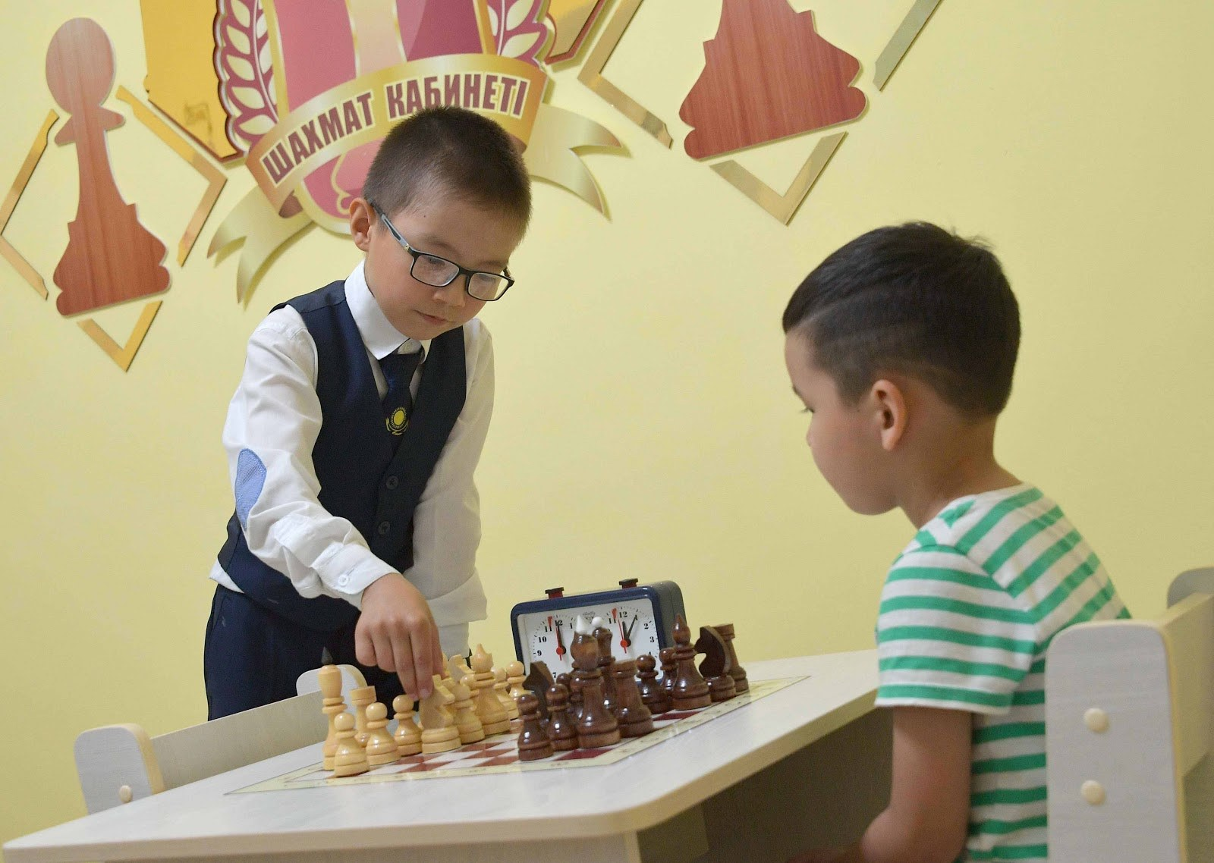
GRADE 8 · LESSON 20
Speaking: Giving Reasons and Telling a Story
Gapirish: sabab ko‘rsatish va voqeani aytib berish
Speaking: Expressing purpose and giving reasons
Unknown author (primeminister.kz) · CC BY 4.0
sozlar.com

Slide 2
LESSON AIMS
Bugungi maqsad
1
Retell the six p.27 stories from short notes (ex. 1)
2
Make notes for their own story in the ex.2 table
3
Tell the story to a partner and then to the class without notes (ex. 3–4)
4
Say which part of a compound noun is stressed: GHOST story (SoundSpot)

Slide 3
BOOK TASK · 7 MINUTES
Book tasks — Laser A2, p. 28
Books open, word list closed.
1
ex.1 — p.27 dagi oltita hikoyani eslatmalardan juftlikda qayta ayting.
2
ex.2 — o‘zingiz bilan bo‘lgan voqea uchun jadvalga eslatma yozing (rost bo‘lmasa — o‘ylab toping!).
3
ex.3 — namunadan foydalanib, hikoyani juftingizga aytib bering.
4
ex.4 — kitobni yoping va eslatmasiz sinfga aytib bering.
5
SoundSpot ex.1 — qaysi qism urg‘uli? Avval taxmin qiling, keyin o‘qituvchidan eshiting.

Slide 4
VOCABULARY
A. Six stories (ex. 1) (1/2)
🐕️
hear a dog bark
itning hurganini eshitmoq
Late at night I heard a dog bark in our garden.
🚪️
walk into the room
xonaga kirib kelmoq
Everybody stopped talking when the head teacher walked into the room.
💡️
realise
anglamoq, sezib qolmoq
I didn’t realise that my friend was standing behind me.

Slide 5
VOCABULARY
A. Six stories (ex. 1) (2/2)
🏍️
a motorbike
mototsikl
My uncle rides a motorbike to work every day.
🚦️
traffic lights
svetofor
We stopped the car because the traffic lights were red.
😢️
cry
yig‘lamoq
The little girl was crying because she couldn’t find her mum.

Slide 6
VOCABULARY
B. My story (ex. 2–3) (1/3)
📖️
a true story
haqiqiy voqea, bo‘lgan voqea
This is a true story — it really happened to my grandfather.
✨️
happen to
(biror kishi) bilan sodir bo‘lmoq, boshidan o‘tmoq
A very strange thing happened to me last week.
🛋️
the living room
mehmonxona (uydagi umumiy xona)
We were sitting in the living room and watching TV.
🎒️
drop
tushirib yubormoq
I dropped my school bag and all my pencils fell out.

Slide 7
VOCABULARY
B. My story (ex. 2–3) (2/3)
😄️
tell a joke
latifa aytib bermoq
At dinner Grandpa told a joke and we all laughed.
😂️
start laughing
kulib yubormoq, kula boshlamoq
When the cat jumped on the piano, we all started laughing.
🤣️
laugh so much
qotib-qotib kulmoq
I laughed so much that my stomach hurt.
💥️
hit the table
stolga urmoq, stolga urib yubormoq
Bobur hit the table with his hand and shouted, ’Stop!’

Slide 8
VOCABULARY
B. My story (ex. 2–3) (3/3)
🔨️
break
sinmoq, sindirmoq
The old table broke when my cousin sat on it.
🍽️
fall on the floor
polga tushib ketmoq
My plate fell on the floor and everybody looked at me.
🧃️
spill
to‘kib yubormoq
I laughed so much that I spilled my juice on the table.

Slide 9
VOCABULARY
C. Accidents and reasons (1/2)
🧤️
catch
tutib olmoq, ushlab olmoq
The boy ran into the garden to catch his little dog.
🏃️
run after
orqasidan yugurmoq, quvmoq
The children ran after the ball because they wanted to play.
🐈️
trip over
qoqilib ketmoq
He tripped over the cat and fell on the floor.
💧️
slip
toyilib ketmoq, sirg‘alib ketmoq
I slipped on the wet floor and dropped my books.

Slide 10
VOCABULARY
C. Accidents and reasons (2/2)
🩹️
hurt
shikastlamoq, og‘ritib olmoq
Ali fell off his bike and hurt his knee.
🙈️
by mistake
adashib, bilmasdan
I took my sister’s phone by mistake — they look the same.
🎯️
on purpose
ataylab, qasddan
I’m sorry! I didn’t break your pencil on purpose.
🤔️
a reason
sabab
There was a good reason why we were late: the bus broke down.

Slide 11
VOCABULARY
D. Feelings
🍅️
go red
(yuzi) qizarib ketmoq
My face went red because everybody was looking at me.
😱️
shocked
hang-mang bo‘lgan, qattiq hayratda qolgan
We were shocked when we saw the broken window.
😨️
scared
qo‘rqib ketgan
My little brother was scared because he heard a strange noise.
😤️
annoyed
g‘ashi kelgan, asabiylashgan
My sister was annoyed because I took her pen by mistake.
😠️
angry
jahli chiqqan, g‘azablangan
Dad was angry because we broke the window with our ball.

Slide 12
TODAY'S WORDS IN CONTEXT
The day I laughed at the wrong moment (1/2)
This is a funny story. It happened two weeks ago, at my cousin's birthday party. We were sitting at a long table and my uncle was making a speech.
My cousin Jasur was sitting next to me. He told me a joke in a very quiet voice — I can't remember what it was now — and I started laughing. I was laughing so much that I hit my glass by mistake. It fell on the floor and broke, and the juice went everywhere.
Cover the word list. Can you understand the words in bold from the sentence?

Slide 13
TODAY'S WORDS IN CONTEXT
The day I laughed at the wrong moment (2/2)
Everybody looked at me. Because of this, my face went red. My uncle stopped his speech and said, 'Is my speech really so funny?' Then everybody laughed too, so it was OK in the end.
Cover the word list. Can you understand the words in bold from the sentence?

Slide 14
TODAY'S WORDS IN CONTEXT
Read and answer
1
Is this story sad, funny or strange?
2
When and where did it happen?
3
Why did the writer start laughing?
4
Why did the glass fall on the floor?
5
Find two ways the writer gives a reason in the story.

Slide 15
PAIRS · ESDA QOLDIMI?
Memory check — Why?
Men voqeani aytaman, siz because bilan sababini qo‘shasiz.
1
My face went red …
2
Dad was angry …
3
She slipped and hurt her knee …
4
He started laughing …
5
I ran after the bus … (to + verb)

Slide 16
FOCUS
Sabab va maqsad — Phrase Bank (p. 28)
• because + gap — SABAB: He fell over because the floor was wet.
• Because of this, … — sabab oldingi gapda: The road was icy. Because of this, we walked slowly.
• so — NATIJA: It was raining, so we stayed in.
• to + fe’l — MAQSAD: I went out to buy bread. (✗ for buy)
• Hikoyada was/were + -ing — fon (nima bo‘layotgan edi), o‘tgan zamon — voqea.

Slide 17
PRONUNCIATION
Say it — don’t just read it
SoundSpot (p. 28) qoidasi kartalarda ham — qo‘shma otda urg‘u BIRINCHI so‘zda; qolganlari — qiyin so‘zlar:
traffic lights /ˈtræfɪk laɪts/
the living room /ðə ˈlɪvɪŋ ruːm/
a motorbike /ə ˈməʊtəbaɪk/
realise /ˈrɪəlaɪz/
annoyed /əˈnɔɪd/
shocked /ʃɒkt/
a reason /ə ˈriːzn/
on purpose /ɒn ˈpɜːpəs/
Qoida: ot + ot birikmasida (qo‘shma otda) urg‘u odatda birinchi otga tushadi: TRAFFIC lights, LIVING room, GHOST story.

Slide 18
CHECK · 4 MINUTES
Answer key — SoundSpot, p. 28
1
1 GHOST story · 2 LOVE story
2
3 ADventure story · 4 deTECtive story
3
5 science FICtion story
4
Qoida: ot + story — urg‘u birinchi qismga; science fiction ichida urg‘u FIC da: science FICtion story.

Slide 19
WHOLE CLASS
Practice — complete the sentence (1/2)
1
We didn't go to the park ________ it was raining.
2
The bus was late. ________ of this, I missed the first lesson.
3
My little brother ________ over a stone in the park and hurt his knee.
4
Sorry! I took your book by ________.
5
I went to the market ________ buy some apples.
6
It was very cold, ________ I put on my warm coat.

Slide 20
WHOLE CLASS
Practice — complete the sentence (2/2)
7
________ look at your notes — tell the story from memory!
8
When did it ________? — Last Sunday, in the morning.

Slide 21
PAIR / GROUP WORK · OPTIONAL
Vocabulary activity
1
Match the beginnings (1-10) with the endings (a-j).
2
Read your complete sentences aloud.
3
Give the Uzbek meaning of the key word in each sentence.
4
When you finish, swap tables with the other group.

Slide 22
PAIRS · 8 MINUTES
Speaking
Ex.1: juftlikda p.27 dagi oltita hikoyani eslatmalardan qayta ayting — har biriga 2–3 gap.
Ex.3: o‘z hikoyangizni juftingizga ayting; kamida ikki marta because yoki so va kartalardan ikkita so‘z ishlating (trip over, by mistake, go red …).
Juftingiz hikoyani tinglab, bitta savol beradi: Why …?

Slide 23
UZ
Qiyin joyi — o‘zbekcha
because — «chunki»: sabab gapdan KEYIN ham, oldin ham kelishi mumkin.
so — «shuning uchun»: natijani bildiradi. It was cold, so I stayed in.
to + fe’l — «…ish uchun»: I came to help you — «senga yordam berish uchun keldim».
by mistake — «bilmasdan, adashib»; teskarisi on purpose — «ataylab»; make a mistake — «xato qilmoq» (19-dars).
Buyruq: Sit down! — inkori Don’t sit down!; ega (you) aytilmaydi.

Slide 24
HOMEWORK
Uy vazifasi
1
Prepare 6 instructions explaining how to play your favourite game — imperative: Take turns. Roll the dice. Don't …!
2
Learn the 30 items with the flashcards: sozlar.com/vocab/cards/?set=grade8-lesson20
3
Keep your ex.2 notes — you will write the story in the next lesson.

Slide 25
IMAGE CREDITS
Rasmlar manbasi
cover
Unknown author (primeminister.kz) · CC BY 4.0 · https://commons.wikimedia.org/w/index.php?curid=179308087

Slide 26
Uchta so‘z — ertaga ham esingizda qoladi
Juftingizga ayting, so‘ng daftaringizga yozib qo‘ying.
sozlar.com/vocab/cards/?set=grade8-lesson20

