Slide 1
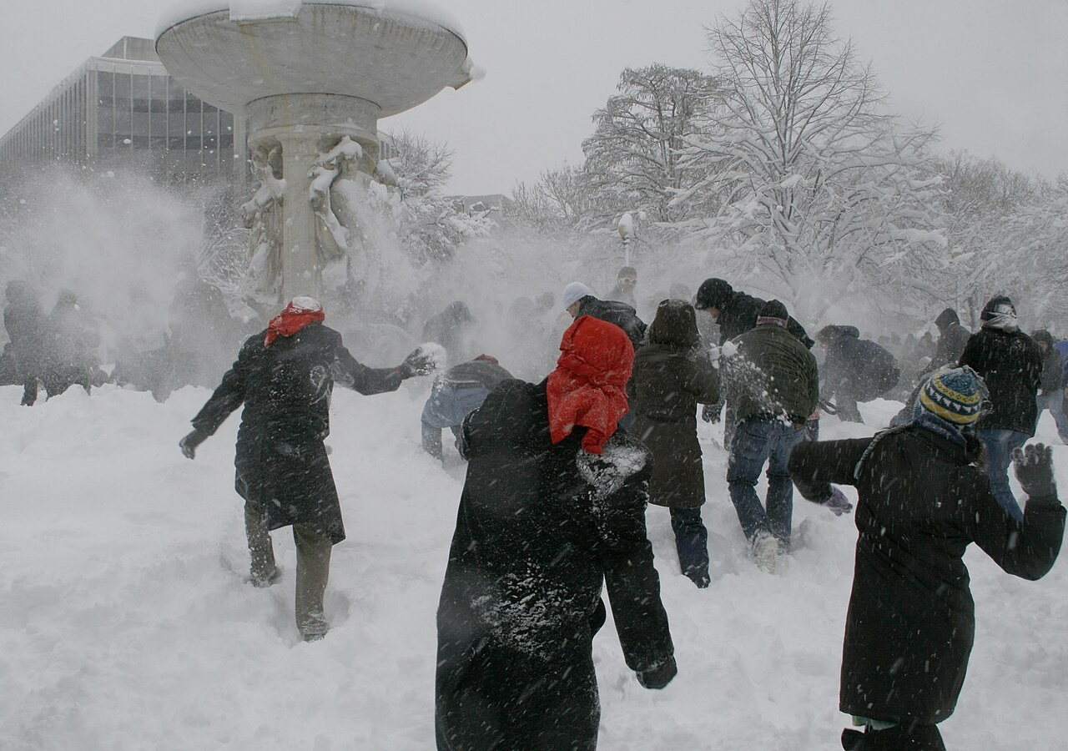
GRADE 7 · LESSON 20
Describing a Picture of People
Odamlar tasvirlangan rasmni yozma tasvirlash
Writing: description of a picture of people
dbking · CC BY 2.0
sozlar.com

Slide 2
LESSON AIMS
Bugungi maqsad
1
Describe a few things that are happening in the picture (p. 30 ex. 1)
2
Decide if four statements about the model text are true or false (ex. 2)
3
Match each paragraph with what it describes (ex. 3)
4
Find examples of the four Language Lab rules and use them in their own sentences

Slide 3
BOOK TASK · 5 MINUTES
Book task — Laser A1+, p. 30, ex. 1
Look at the picture. Describe a few things that are happening.
1
Namuna: A man is carrying a boy on his shoulders.
2
Who is near the door? What are they doing?
3
What is the boy in the middle doing? And the man behind him?
4
Look at the baby. What is she doing?
5
Use: is / are + -ing — present continuous.

Slide 4
VOCABULARY
A. Weather and clothes (1/2)
🌨️
snow
qor yog‘moq
Look out of the window — it’s snowing again!
🌧️
rain
yomg‘ir yog‘moq
Take an umbrella — it’s raining outside.
🥶️
a cold day
sovuq kun
It’s a cold day, so the children are wearing hats.
🧶️
winter clothes
qishki kiyim
People in the street are wearing warm winter clothes.

Slide 5
VOCABULARY
A. Weather and clothes (2/2)
👥️
lots of people
juda ko‘p odam
There are lots of people at the bus stop this morning.
🧥️
a coat
palto
Grandpa is wearing his long brown coat today.
👒️
a hat
shapka, bosh kiyim
The little girl is wearing a hat with a big pom-pom.
👢️
boots
etik
Everyone is wearing boots because the snow is deep.

Slide 6
VOCABULARY
B. Where in the picture? (1/2)
🚪️
near the door
eshik yonida
Near the door, a little boy is waiting for his mum.
↔️
next to them
ularning yonida
Two girls are eating ice cream. Next to them, a dog is sleeping.
⛲️
in the middle
o‘rtada, o‘rtasida
There’s a big fountain in the middle of the square.
🚌️
in front of
oldida
A red bus is stopping in front of our school.

Slide 7
VOCABULARY
B. Where in the picture? (2/2)
🙈️
behind
orqasida, ortida
My little sister is hiding behind a tall man in the photo.
⬅️
on the left
chap tomonda
On the left, an old man is reading a newspaper.
➡️
on the right
o‘ng tomonda
On the right, two boys are playing football.

Slide 8
VOCABULARY
C. What are they doing? (1/3)
☃️
throw snowballs
qorbo‘ron o‘ynamoq, qor otishmoq
After school the children are throwing snowballs in the yard.
🎉️
have a lot of fun
rosa maza qilmoq, vaqtni juda yaxshi o‘tkazmoq
The children are having a lot of fun in the park today.
🤧️
sneeze
aksirmoq
Grandpa is sneezing a lot today. Is he ill?
🤒️
have got a cold
shamollagan bo‘lmoq
Aziz isn’t at school today because he’s got a cold.

Slide 9
VOCABULARY
C. What are they doing? (2/3)
🧻️
a tissue
salfetka (qog‘oz ro‘molcha)
The man is sneezing, so his wife is giving him a tissue.
🛹️
ride a skateboard
skeytbordda uchmoq
A boy is riding a skateboard down the street very fast.
🏃️
run after somebody
birovning ortidan yugurmoq, quvlamoq
Our puppy is running after my little brother in the garden.
🤲️
catch somebody
tutib olmoq, ushlamoq
The teacher is trying to catch the boy and stop him.

Slide 10
VOCABULARY
C. What are they doing? (3/3)
👨‍👦
carry somebody on your shoulders
yelkasiga mindirib olmoq
Dad is carrying my little brother on his shoulders at the bazaar.
🧸️
throw toys on the floor
o‘yinchoqlarni polga otmoq
The baby is throwing her toys on the floor and laughing.
🛍️
go in and out of the shops
do‘konlarga kirib-chiqmoq
On Saturdays people go in and out of the shops all day.
😂️
laugh
kulmoq
The two girls are laughing at a funny video on the phone.

Slide 11
VOCABULARY
D. People and feelings
👶️
a baby
chaqaloq
A baby is sleeping in the pram next to her mum.
😊️
most people
ko‘pchilik (odamlar)
Most people in the picture are smiling and talking.
😠️
angry
jahli chiqqan, achchiqlangan
The woman looks angry because the dog is jumping on her bags.
⚠️
dangerous
xavfli
Riding a bike with no hands is very dangerous!

Slide 12
BOOK TASK · 7 MINUTES
Book tasks — Laser A1+, p. 30, ex. 2–3 + Language Lab
Read «A busy shopping centre». Work alone, then check with a partner.
1
ex.2 — Are the four statements true (T) or false (F)?
2
ex.3 — Match paragraphs 1–4 with a, b, c. One letter is used twice.
3
Language Lab — find and underline one example of each rule (1–4) in the text.
4
Fast finishers: find all the verbs in -ing in paragraph 3.

Slide 13
TEACHER · CHECK AFTER EX. 2–3
Answer key — Laser A1+, p. 30
1
ex.2 1 F (it’s snowing — a cold day) · 2 F (she’s angry) · 3 T · 4 F (a baby girl — she’s wearing pink)
2
ex.3 1 c · 2 b · 3 b · 4 a
3
Language Lab 1 are wearing / are throwing / is sneezing … · 2 I think it’s a cold day · 3 Near the door, Next to them, In the middle of, In front of them · 4 It looks very dangerous! It looks like …

Slide 14
FOCUS
Language Lab — four tools for describing a picture
• Rasmda hozir nima bo‘layapti — present continuous: Two boys are throwing snowballs.
• O‘z fikringiz — I think: I think he’s got a cold.
• Qayerda — joy iboralari: Near the door … Next to them … In the middle of … In front of them …
• Qanday ko‘rinadi — It looks …: It looks very dangerous! It looks like most people are happy.

Slide 15
STRATEGY
Describing a picture — four paragraphs
1
Paragraph 1 — the scene: where the people are, the weather, what they are wearing.
2
Paragraph 2 — a few people: what they are doing and how you think they feel.
3
Paragraph 3 — a few more people: where they are (in the middle of, in front of) and what they are doing.
4
Paragraph 4 — everyone: what most people are doing and how they feel (It looks like …).

Slide 16
PRONUNCIATION
Say it — don’t just read it
Linking and tricky sounds: say each phrase as ONE word — no stop in the middle.
next to them
/ˈnekst tə ðəm/
in front of
/ɪn ˈfrʌnt əv/
in the middle
/ɪn ðə ˈmɪdl/
throw snowballs
/θrəʊ ˈsnəʊbɔːlz/
sneeze
/sniːz/
a tissue
/ə ˈtɪʃuː/
laugh
/lɑːf/
dangerous
/ˈdeɪndʒərəs/
Say it slowly, then fast: In the middle of the shopping centre, a boy is riding a skateboard.

Slide 17
WHOLE CLASS
Practice — complete the sentence (1/2)
1
It’s very cold and it’s ________ outside. (snow)
2
People are wearing winter ________. (c…)
3
________ to them, a girl is eating an apple. (N…)
4
There’s a big table in the ________ of the room. (m…)
5
Look! Those boys are ________ snowballs at the bus. (throw)
6
My grandpa is sneezing. I think he’s got a ________. (c…)

Slide 18
WHOLE CLASS
Practice — complete the sentence (2/2)
7
A man is running ________ his dog in the park. (a…)
8
Don’t climb on that wall — it looks ________! (d…)
9
In ________ of the shop, there’s a red car. (f…)
10
My sister is ________ because I’ve got her phone! (a…)

Slide 19
PAIR / GROUP WORK · 5 MINUTES
Vocabulary activity
1
Match the beginnings (1-10) with the endings (a-j).
2
Read your complete sentences aloud.
3
Give the Uzbek meaning of the key word in each sentence.
4
When you finish, swap tables with the other group.

Slide 20
PAIRS · 5 MINUTES
Speaking
Picture talk: A looks at the bus station text, B closes the book. A says three sentences with near the door / next to them / in the middle / on the left. B draws a quick plan of the picture.
Swap: B describes the p. 30 picture without looking at the book text. A checks: present continuous? I think? It looks like?
Tell the class one thing you think a person in the picture feels, and why: I think she’s angry because …

Slide 21
TODAY'S WORDS IN CONTEXT
A rainy day at the bus station (a model description) (1/2)
This is a picture of a bus station in a big city. It’s raining, and people are wearing coats and boots. I think it’s a cold autumn day. The bus station is very crowded and there are lots of people.
Near the door, two girls are sharing an umbrella. They’re laughing — they’re having a lot of fun! Next to them, an old man is sneezing. I think he’s got a cold. His wife is giving him a tissue.
Cover the word list. Can you understand the words in bold from the sentence?

Slide 22
TODAY'S WORDS IN CONTEXT
A rainy day at the bus station (a model description) (2/2)
In the middle of the station, a little dog is running between the people. A boy is running after it. I think he’s trying to catch it. In front of them, there’s a woman with lots of bags. She looks angry, because the wet dog is jumping on her bags!
Everyone’s waiting for a bus. Some people are reading and some are talking on their phones. It looks like most people are tired, but they’re happy to be out of the rain.
Cover the word list. Can you understand the words in bold from the sentence?

Slide 23
TODAY'S WORDS IN CONTEXT
Read and answer
1
Where are the people, and what is the weather like?
2
What are the two girls near the door doing?
3
Why does the writer think the old man has got a cold?
4
Why is the woman with the bags angry?
5
Which paragraph describes the scene in general?

Slide 24
PAIRS · ESDA QOLDIMI?
Memory check — where and what?
Men joy iborasini aytaman, siz rasmga mos gapni davom ettirasiz.
1
Near the door, a little boy is …
2
Next to them, a baby is …
3
On the left, an old man is …
4
In front of the shop, two girls are …
5
Behind the bus, some children are …

Slide 25
UZ
Qiyin joyi — o‘zbekcha
Rasmni tasvirlashda present continuous: is / are + -ing — «…yapti».
next to them, in front of them — predlogdan keyin them (✗ next to they).
in the middle — «o‘rtada»; joyini aytsangiz of qo‘shiladi: in the middle of the station (of ni tashlab ketmang).
It looks + sifat: It looks dangerous — «xavfli ko‘rinadi». It looks like + gap: It looks like everyone is happy — «hamma xursandga o‘xshaydi».
have got a cold — «shamollagan»: He’s got a cold.

Slide 26
HOMEWORK
Uy vazifasi
1
Workbook p. 22, ex. 1–2 (kalendar reja).
2
Learn the 31 items with the flashcards: sozlar.com/vocab/cards/?set=grade7-lesson20
3
Finish your description (paragraphs 3–4) and read the model text on the lesson page.

Slide 27
IMAGE CREDITS
Rasmlar manbasi
cover
dbking · CC BY 2.0 · https://commons.wikimedia.org/wiki/File:Dupont_Circle_snowball_fight.jpg

Slide 28
Uchta so‘z — ertaga ham esingizda qoladi
Juftingizga ayting, so‘ng daftaringizga yozib qo‘ying.
sozlar.com/vocab/cards/?set=grade7-lesson20

