Slide 1
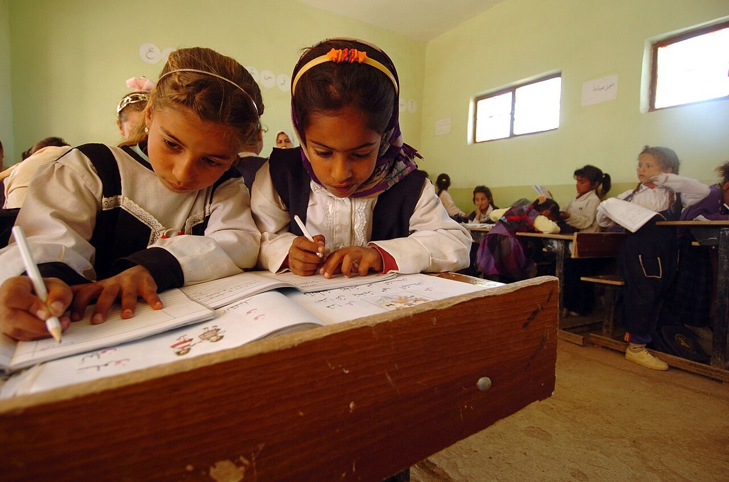
GRADE 7 · LESSON 1
Worldfriends: Tell Us About You
Worldfriends: o‘zing haqingda ayt
Unit 1. Reading: ‘Worldfriends’
U.S. Navy photo by Photographer's Mate 1st Class Brien Aho · Public domain
sozlar.com

Slide 2
LESSON AIMS
Bugungi maqsad
1
Give their name, age, town and school year in English
2
Use ten of the friendship and family phrases from the reading (best friend, close friend, only child, share a room…)
3
Complete a tick/cross table and choose the correct answer A, B or C
4
Say who they want to be friends with and why: 'I choose … because …'

Slide 3
BOOK TASK · 10 MINUTES
Book tasks — Laser A1+, pp. 6–7
Open your books. Read the four profiles and do the tasks.
1
p.6 Get ready! Look at the photos and say the words: brother · sister · town · pets · friends.
2
ex.1 Read quickly and put a tick (✓) or a cross (✗): brothers · sisters · pets.
3
ex.2 Choose the correct answer A, B or C (four questions).
4
ex.3 Choose the person you want to be friends with and say why.
5
p.7 Wordpower Write one letter in each gap: best, close, country, share, chat online, only child.

Slide 4
VOCABULARY
A. Personal information (1/2)
📝️
a profile
profil (o‘zing haqingda ma’lumot)
Dilnoza wrote a short profile for the school website.
🤝️
meet new people
yangi odamlar bilan tanishmoq
At summer camp you can meet new people from other cities.
🌍️
all over the world
butun dunyo bo‘ylab
Our school has pen friends all over the world.
🗺️
be from
…dan bo‘lmoq, …lik bo‘lmoq
Our new English teacher is from Bukhara.
🏳️
a country
mamlakat, davlat
Which country is your pen friend from?

Slide 5
VOCABULARY
A. Personal information (2/2)
🏙️
a city
shahar (katta)
Tashkent is the biggest city in Uzbekistan.
🏘️
a town
kichik shahar, shaharcha
My grandparents live in a small town near Namangan.
🏫️
be in Year 7
7-sinfda o‘qimoq
My cousin is in Year 7 at our school.
🪪️
a surname
familiya
My surname is Karimova, and my first name is Lola.
🔤️
spell
harflab aytmoq
Can you spell your name for me, please?

Slide 6
VOCABULARY
B. Friends (1/2)
⭐️
a best friend
eng yaqin do‘st
Malika is my best friend — we sit together in every lesson.
💛️
a close friend
qadrdon do‘st
A close friend always keeps your secrets.
👫️
be friends
do‘st bo‘lmoq
Bek and I are friends, and we play football after school.
💬️
chat online
internetda yozishmoq
In the evening I chat online with my cousin in Moscow.

Slide 7
VOCABULARY
B. Friends (2/2)
🗣️
tell each other
bir-biriga aytmoq
Best friends tell each other everything.
⏳️
spend time
vaqt o‘tkazmoq
I spend time with my friends at the weekend.
😔️
lonely
yolg‘iz (o‘zini yolg‘iz his qiladigan)
Our new classmate felt lonely on his first day.

Slide 8
VOCABULARY
C. Family and home (1/2)
👧️
an only child
yagona farzand
Lola is an only child, so she often plays with her cousins.
👨‍👩‍👧‍👦
a big family
katta oila
My uncle has a big family with six children.
🐶️
a pet
uy hayvoni
Have you got a pet at home?
🛏️
share a room
bir xonada yashamoq
I share a room with my younger brother.
🏠️
live together
birga yashamoq
My parents and my grandparents live together in one big house.

Slide 9
VOCABULARY
C. Family and home (2/2)
🌳️
the country
qishloq (shahar tashqarisi)
We have a small house in the country with a big garden.
🔊️
noisy
shovqinli
Our flat is very noisy when my cousins visit.
🎉️
a lot of fun
juda qiziqarli
Playing with my little brothers is a lot of fun.
💼️
a job
ish, ish joyi
My older brother has got a job in Tashkent.

Slide 10
VOCABULARY
D. Free time and dreams (1/2)
📚️
reading
kitob o‘qish
I like reading adventure stories in bed.
🎧️
listening to music
musiqa tinglash
Listening to music helps me relax after school.
🎨️
drawing
rasm chizish
My sister is very good at drawing animals.
🎮️
play computer games
kompyuter o‘yinlarini o‘ynamoq
My brother and I play computer games on Saturdays.
📺️
watch TV
televizor ko‘rmoq
We watch TV together after dinner.

Slide 11
VOCABULARY
D. Free time and dreams (2/2)
🧳️
travel
sayohat qilmoq
One day I want to travel to Japan.
✈️
see the world
dunyoni ko‘rmoq
My dream is to see the world with my family.
🚌️
visit
borib ko‘rmoq, mehmonga bormoq
Every summer we visit our aunt in Fergana.
❤️
favourite
sevimli
Art is my favourite subject.

Slide 12
TODAY'S WORDS IN CONTEXT
My Worldfriends profile (1/2)
Hi! I'm Dilnoza and I'm twelve years old. I live in Samarkand and I'm in Year 7 at school. My favourite subjects are English and art.
I've got two brothers, so I'm not an only child. We haven't got a big house and I share a room with my little brother — it's very noisy! My grandparents have got a house in the country and we go there every summer.
I've got lots of friends at school. My best friend is Malika. She's a close friend too, because I tell her everything. In the evening we chat online for half an hour.
Cover the word list. Can you understand the words in bold from the sentence?

Slide 13
TODAY'S WORDS IN CONTEXT
My Worldfriends profile (2/2)
I like reading and listening to music, but I don't like watching TV. One day I want to travel and meet friends all over the world. Let's be friends!
Cover the word list. Can you understand the words in bold from the sentence?

Slide 14
TODAY'S WORDS IN CONTEXT
Read and answer
1
How old is Dilnoza and where does she live?
2
Is she an only child?
3
Who does she share a room with?
4
Who is her best friend?
5
What does she not like doing?
6
Find two things she likes doing.

Slide 15
PAIRS · ESDA QOLDIMI?
Memory check — cover the Uzbek column
Juftingiz inglizchasini o‘qiydi, siz o‘zbekchasini aytasiz. So‘ng almashinasiz.
1
Say the English: eng yaqin do‘st · qadrdon do‘st · yagona farzand · uy hayvoni
2
Ask your partner: Where are you from? · Have you got a pet? · Do you share a room?
3
Say three things you like doing: reading · drawing · listening to music · watching TV
4
Write the three words you keep forgetting.

Slide 16
FOCUS
Reading a profile — where to look
• The first two sentences of a profile give the name, the age and the town.
• For the table (ex.1) look only for brothers, sisters and pets — do not read every word.
• Numbers help: two sisters, nine of us, Year 8.
• haven't got / don't have = a cross (✗) in the table.
• New word? Read the whole sentence first — an only child doesn't have brothers or sisters.

Slide 17
STRATEGY
Reading for specific information — three steps
1
Look at the photos and the names: four young people from four countries.
2
Read fast and find only what the task asks for.
3
Check: point to the line in the text that gives your answer.

Slide 18
PRONUNCIATION
Say it — don’t just read it
Say these words from the cards — mind the sounds in /…/:
profile /ˈprəʊfaɪl/
surname /ˈsɜːneɪm/
country /ˈkʌntri/
lonely /ˈləʊnli/
noisy /ˈnɔɪzi/
favourite /ˈfeɪvərɪt/
drawing /ˈdrɔːɪŋ/
all over the world /ˌɔːl ˌəʊvə ðə ˈwɜːld/
Spell your own name to your partner: 'D-I-L-N-O-Z-A'.

Slide 19
WHOLE CLASS
Practice — complete the sentence (1/2)
1
Your ________ ________ is your favourite friend. (b… f…)
2
A ________ friend is someone you love and trust. (c…)
3
An ________ ________ doesn't have brothers or sisters.
4
If you ________ a room, you use it with other people.
5
The ________ is the area with trees, flowers and animals outside a town.
6
When you talk to your friends on the internet, you ________ ________ with them.

Slide 20
WHOLE CLASS
Practice — complete the sentence (2/2)
7
'________ ________ ________?' 'Kadir Demir.' (What…)
8
'How do you ________ that?' 'K-A-D-I-R.'
9
'How ________ are you?' 'I'm thirteen.'
10
There are nine people in Sunil's home — he has got a ________ ________. (b… f…)
11
Joe lives in a small town, so it can get a bit ________.
12
I ________ Anna because she likes computer games too. (tanlayman)

Slide 21
PAIRS · 4 MINUTES
Speaking
Choose the person you want to be friends with on Worldfriends. Say why: 'I choose Anna because…'
Tell your partner three things about you: age, town, family.

Slide 22
PAIR / GROUP WORK · 6 MINUTES
Vocabulary activity
1
Match the beginnings (1-10) with the endings (a-j).
2
Read your complete sentences aloud.
3
Give the Uzbek meaning of the key word in each sentence.
4
When you finish, swap tables with the other group.

Slide 23
UZ
Qiyin joyi — o‘zbekcha
an only child — «yagona farzand», ya’ni aka-uka va opa-singli yo‘q; «yolg‘iz bola» emas.
the country — bu yerda «davlat» emas, «qishloq joy» degani: a house in the country; a country esa «mamlakat, davlat».
share a room — xonani birga ishlatmoq; live together — bir uyda birga yashamoq.
Yosh: I'm twelve yoki I'm twelve years old. «I have twelve years» — xato.
be in Year 7 (Britaniya) — AQShda be in the 7th Grade; ikkalasi ham bizdagi 7-sinf.

Slide 24
HOMEWORK
Uy vazifasi
1
Laser A1+ Workbook pp. 4–5, ex. 1–3.
2
Learn the 35 items (sections A–D) with the flashcards: sozlar.com/vocab/cards/?set=grade7-lesson1
3
Add three sentences about your friends to the profile you wrote in lesson 7 (Shaxsiy profil yozish).

Slide 25
IMAGE CREDITS
Rasmlar manbasi
cover
U.S. Navy photo by Photographer's Mate 1st Class Brien Aho · Public domain · https://commons.wikimedia.org/w/index.php?curid=8197120

Slide 26
Uchta so‘z — ertaga ham esingizda qoladi
Juftingizga ayting, so‘ng daftaringizga yozib qo‘ying.
sozlar.com/vocab/cards/?set=grade7-lesson1

