Slide 1
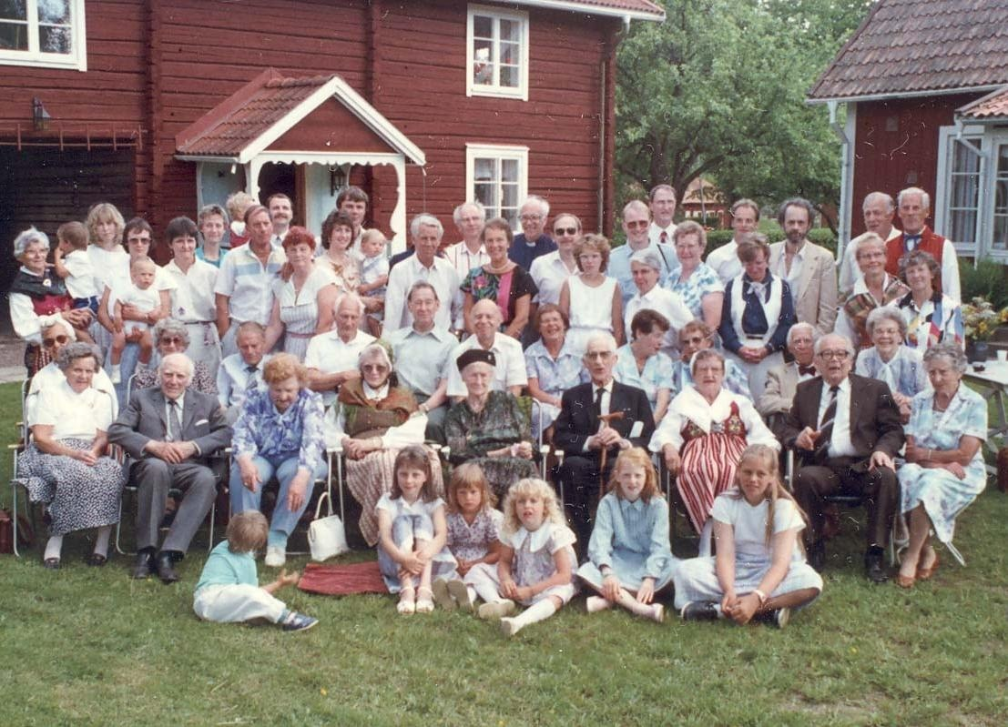
GRADE 10 · LESSON 1
Family Ties: Whose Family Is Like Yours?
Oila rishtalari: kimning oilasi senikiga o‘xshaydi?
Unit 1. Family ties. Reading: In my day…
Family assistant (Demitz files, acquired by FamSAC) · Public domain
sozlar.com

Slide 2
LESSON AIMS
Bugungi maqsad
1
Scan five short comments and match them to questions
2
Use the family words from the comments (a stepfather, a previous marriage, biological parents, get on, keep in touch…)
3
Answer true / false / not stated and justify the answer from the text
4
Give an opinion with 'to be honest', 'as far as I'm concerned', 'at least'

Slide 3
BOOK TASK · 10 MINUTES
Book tasks — Laser B1+, pp. 6–7
Open your books. Read Jenny's post and the five comments.
1
ex.1 Whose family sounds most like yours? Say why in one sentence.
2
ex.2 True (T), false (F) or not stated (N) — six statements.
3
ex.3 Answer six questions with a word or short phrase from the comments.
4
ex.4 Word box Complete the eight sentences with words from the article (the first letter is given).
5
Have your say! Advantages and disadvantages of being an only child; sharing a room or not.

Slide 4
VOCABULARY
A. Family members and family situations (1/3)
👨‍👩‍👧‍👦
a large family
katta oila
Nodira comes from a large family: she has four brothers and two sisters.
🧩️
complicated
murakkab, chigal
My cousin’s family situation is a bit complicated, but everyone is happy.
👨️
a stepfather
o‘gay ota
Sardor lives with his mum and his stepfather, who is very kind to him.
👩️
a stepmum
o‘gay ona
Lola spends every Sunday with her dad and her stepmum.

Slide 5
VOCABULARY
A. Family members and family situations (2/3)
💍️
a previous marriage
oldingi nikoh
My uncle has a grown-up son from a previous marriage.
👶️
have a baby
farzand ko‘rmoq
My aunt and uncle have just had a baby girl called Oysha.
🧬️
biological parents
tug‘ishgan ota-ona
Some adopted children decide to look for their biological parents.
❤️
real parents
haqiqiy ota-ona
For Kamola, the people who brought her up are her real parents.

Slide 6
VOCABULARY
A. Family members and family situations (3/3)
👪️
the rest of the family
oilaning qolgan a’zolari
My parents and I live in Tashkent, but the rest of the family lives in Khiva.
🌏️
on the other side of the world
dunyoning narigi chekkasida
My uncle works on the other side of the world, in Australia.
🧒️
a cousin
amakivachcha, xolavachcha, ammavachcha, tog‘avachcha
My cousin Dilshod is the same age as me, so we are in the same class.
👴️
grandparents
bobo va buvi
My grandparents on my mum’s side live in a village near Bukhara.

Slide 7
VOCABULARY
B. Living together (1/2)
🏠️
live together
birga yashamoq
Three generations live together in our big house in Namangan.
📍️
live nearby
yaqin joyda yashamoq
My grandparents live nearby, so I see them almost every day.
⬆️
the flat upstairs
yuqori qavatdagi kvartira
Our cousins live in the flat upstairs, so we visit each other all the time.
🛏️
have a bedroom to yourself
alohida yotoq xonasiga ega bo‘lmoq
Now that my sister is married, I have a bedroom to myself.

Slide 8
VOCABULARY
B. Living together (2/2)
🚪️
share a room
bitta xonada birga yashamoq
Aziz and his little brother share a room, so it’s never quiet.
😔️
lonely
yolg‘iz, yolg‘izlikdan siqilgan
Without brothers or sisters, Malika sometimes feels lonely at home.
📅️
spend the weekend with
dam olish kunlarini …bilan o‘tkazmoq
I usually spend the weekend with my grandparents in the village.

Slide 9
VOCABULARY
C. Getting on (and not getting on) (1/2)
🤝️
get on
chiqishmoq, til topishmoq, ahil bo‘lmoq
Do you get on with your cousins, or do you argue a lot?
😤️
complain
nolimoq, shikoyat qilmoq
My brother is always complaining that I spend too long in the bathroom.
😠️
get annoyed with somebody
birovdan jahli chiqmoq
I get annoyed with my sister when she reads my messages.
🎧️
borrow things without asking
so‘ramasdan narsa olib turmoq
My little brother often borrows things without asking and never gives them back.
⚖️
treat everyone the same
hammaga bir xil munosabatda bo‘lmoq
Our grandmother treats everyone the same, so none of her grandchildren feels left out.

Slide 10
VOCABULARY
C. Getting on (and not getting on) (2/2)
🫂️
feel part of the family
o‘zini oila a’zosidek his qilmoq
Our new sister-in-law already feels part of the family.
💐️
be grateful for
…uchun minnatdor bo‘lmoq
I’m really grateful for my parents’ help with my studies.
📱️
keep in touch
aloqani uzmaslik, aloqada bo‘lmoq
We keep in touch with our relatives in Kazan by video call.
👋️
meet in person
yuzma-yuz uchrashmoq
We often chat online, but next summer we will finally meet in person.
💞️
love each other
bir-birini yaxshi ko‘rmoq
My brothers argue a lot, but they really love each other.

Slide 11
VOCABULARY
D. Discussing families
📚️
do a project
loyiha ustida ishlamoq
Our class is doing a project on Uzbek family traditions.
📊️
advantages and disadvantages
afzalliklari va kamchiliklari
What are the advantages and disadvantages of living with your grandparents?

Slide 12
TODAY'S WORDS IN CONTEXT
Two comments on Jenny's post (1/2)
Hi Jenny! I'm Aziza from Namangan. My family is a bit complicated too. My parents are divorced and my mum remarried two years ago, so I live with her, my stepfather and my little half brother, Timur. My dad lives in another city and I stay with him in the holidays. We still get on really well — to be honest, I'm grateful for that.
I share a room with Timur, so it's never quiet! He borrows my things without asking and I sometimes get annoyed with him. But he's four, so my mum says, 'Anything he asks for, he gets!' At least he goes to bed at eight!
Cover the word list. Can you understand the words in bold from the sentence?

Slide 13
TODAY'S WORDS IN CONTEXT
Two comments on Jenny's post (2/2)
Hello from Tashkent! I'm Javlon. There are only three of us: my mum, my dad and me — I'm an only child. My grandparents live nearby, so it's never lonely, and my cousins live in the flat upstairs. The rest of my family live on the other side of the world, in Canada.
I sometimes wish I had a brother, but I have a bedroom to myself and my parents treat me like an adult. As far as I'm concerned, that's the biggest advantage of being an only child. Have your say! What do you think?
Cover the word list. Can you understand the words in bold from the sentence?

Slide 14
TODAY'S WORDS IN CONTEXT
Read and answer
1
Who does Aziza live with?
2
Why is Aziza's room never quiet?
3
How does Aziza feel about her parents' divorce now?
4
Where does Javlon's family live?
5
What does Javlon wish?
6
What advantage of being an only child does Javlon give?

Slide 15
PAIRS · ESDA QOLDIMI?
Memory check — esda qoldi-mi?
Juftingiz o‘zbekchasini aytadi, siz inglizchasini aytasiz; so‘ng almashinasiz.
1
o‘gay ota · o‘gay ona · oldingi nikoh · farzand ko‘rmoq
2
tug‘ishgan ota-ona · haqiqiy ota-ona · hammaga bir xil munosabatda bo‘lmoq
3
so‘ramasdan narsa olib turmoq · birovdan jahli chiqmoq · nolimoq
4
Write the three words you keep forgetting.

Slide 16
FOCUS
True, false or NOT STATED?
• True — matnda aynan shu ma’no bor (boshqa so‘zlar bilan bo‘lsa ham).
• False — matn buning teskarisini aytadi.
• Not stated — matn bu haqda hech narsa demaydi: o‘zingizdan qo‘shmang.
• Har javob uchun matndagi qatorni ko‘rsating — «menimcha» yetarli emas.
• Ehtiyot bo‘ling: Masha is younger than her sister — matnda my older sister deyilgan, demak to‘g‘ri.

Slide 17
STRATEGY
Scanning five short comments — three steps
1
Read the question first and underline the key word (pet · weekend · sister).
2
Find the comment that talks about it — ismlar va joy nomlari yordam beradi.
3
Copy a word or short phrase from the text — to‘liq gap yozish shart emas.

Slide 18
PRONUNCIATION
Say it — don’t just read it
Urg‘uga e’tibor bering:
COMplicated /ˈkɒmplɪkeɪtɪd/
STEPfather /ˈstepfɑːðə/
PREvious /ˈpriːviəs/
bioLOGical /ˌbaɪəˈlɒdʒɪkl/
upSTAIRS /ˌʌpˈsteəz/
GRATEful /ˈɡreɪtfl/
anNOYED /əˈnɔɪd/
adVANtages /ədˈvɑːntɪdʒɪz/
«-ed» tugashi: complicated /ɪd/, annoyed /d/.

Slide 19
WHOLE CLASS
Practice — complete the sentence (1/2)
1
I've got four brothers and three sisters — we're a ________ ________.
2
My mum remarried last year, so now I live with her and my ________.
3
My dad has a new wife now. My ________ is really kind and helps me with my homework.
4
Angie is my stepfather's daughter from a ________ ________.
5
Alicia was adopted as a baby, and she has never met her ________ parents. (tug‘ishgan)
6
As far as I'm ________, my mum and dad are my real parents.

Slide 20
WHOLE CLASS
Practice — complete the sentence (2/2)
7
Our parents ________ us all the same. (bir xil munosabatda)
8
She's always ________ that I play my music too loud. (nolimoq)
9
I often get ________ with my sister because she borrows my things.
10
My mum ________ in touch with them by phone and email.
11
I've never met any of them ________ ________. (yuzma-yuz)
12
________ ________ I have a bedroom to myself! (hech bo‘lmasa)

Slide 21
GROUPS OF THREE · 6 MINUTES
Speaking
Have your say! What are the advantages and disadvantages of being an only child?
Is it better to share a room with a brother or sister, or to have your own room? Why?

Slide 22
PAIR / GROUP WORK · 5 MINUTES
Vocabulary activity
1
Match the beginnings (1-10) with the endings (a-j).
2
Read your complete sentences aloud.
3
Give the Uzbek meaning of the key word in each sentence.
4
When you finish, swap tables with the other group.

Slide 23
UZ
Qiyin joyi — o‘zbekcha
stepfather / stepmum — o‘gay ota/ona; a previous marriage — oldingi nikoh: a son from a previous marriage.
the rest of the family — oilaning qolgan a’zolari; fe’l ko‘plikda ham keladi: the rest of my family live in Canada.
biological parents — tug‘ishgan ota-ona; real parents — Alicia uchun uni tarbiyalab o‘stirgan ota-ona.
get annoyed with — with predlogi bilan; complain that… — that bilan.
lonely — yolg‘izlikdan siqilgan; alone (yonida hech kim yo‘q) bilan chalkashtirmang.

Slide 24
HOMEWORK
Uy vazifasi
1
Learn the 31 items (sections A–D) with the flashcards: sozlar.com/vocab/cards/?set=grade10-lesson1
2
Laser B1+ Workbook p. 4, ex. 1–2 (ish daftari bo‘lsa).
3
Write a comment to Jenny's post about your own family (five sentences).

Slide 25
IMAGE CREDITS
Rasmlar manbasi
cover
Family assistant (Demitz files, acquired by FamSAC) · Public domain · https://commons.wikimedia.org/wiki/File:Kaj_Family_reunion_group_1988.jpg

Slide 26
Uchta so‘z — ertaga ham esingizda qoladi
Juftingizga ayting, so‘ng daftaringizga yozib qo‘ying.
sozlar.com/vocab/cards/?set=grade10-lesson1

