Slide 1
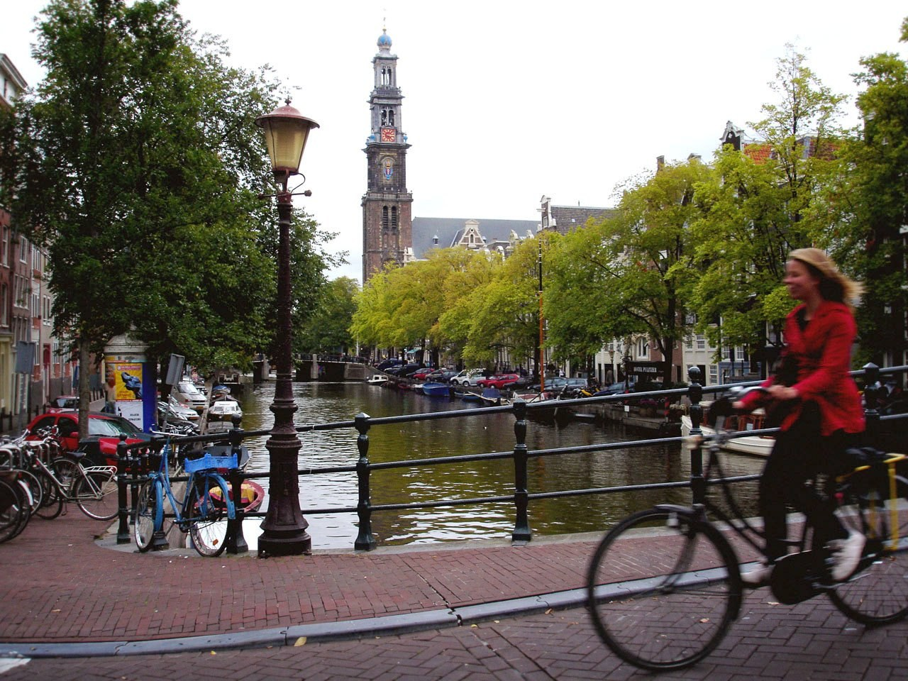
GRADE 8 · LESSON 1
A Typical School Day
Oddiy maktab kuni
Unit 1. The Youth of Today. A typical school day
Flickr (niputaid) · CC BY 2.0
sozlar.com

Slide 2
LESSON AIMS
Bugungi maqsad
1
Understand a blog entry and four comments from different countries
2
Answer true/false and short-answer questions about times and numbers
3
Use ten blog and school-day phrases (ring, choose, drive, blog, spend, send, check…)
4
Describe their own typical school day in six sentences

Slide 3
BOOK TASK · 10 MINUTES
Book tasks — Laser A2, pp. 6–7
Open your books. Read Lizzie's blog and the four comments.
1
p.6 Get ready! Choose the correct word: get up / out of bed · have / do a shower · brush / clear your teeth · ride / drive a bike · look / check your email · do / play football.
2
ex.1 Write a word from the box in each gap (seven of twelve words).
3
ex.2 KET: true or false — six statements about Lizzie, Alex, Linda, Yuri and Helen.
4
ex.3 Write a word, number or short answer: 1–5 in class, 6–10 for homework.
5
p.7 Wordpower — 2-darsda (27.08) o‘tilgan; bir daqiqa og‘zaki takrorlang.

Slide 4
VOCABULARY
A. Getting ready in the morning (1/3)
⏰️
an alarm clock
budilnik
My alarm clock is on the table next to my bed.
🔔️
ring
jiringlamoq
On school days my alarm clock rings at half past six.
🛏️
get out of bed
karavotdan turmoq
It’s cold in winter, so I don’t want to get out of bed in the morning.
🚿️
have a quick shower
tezgina dush qabul qilmoq
After football practice I have a quick shower at home.

Slide 5
VOCABULARY
A. Getting ready in the morning (2/3)
👕️
get dressed
kiyinmoq
My little brother can’t get dressed without Mum’s help.
👔️
a school uniform
maktab formasi
Our school uniform is a white shirt and dark blue trousers.
🤔️
choose what to wear
nima kiyishni tanlamoq
At the weekend it takes me ages to choose what to wear.
🪜️
go downstairs
zinadan pastga tushmoq
I go downstairs and say good morning to my grandma.

Slide 6
VOCABULARY
A. Getting ready in the morning (3/3)
🥣️
cereal
xlopya (nonushtalik yorma)
My sister has cereal with milk for breakfast every day.
🍞️
toast
qizartirilgan non (tost)
Dad makes toast with butter and honey on Sunday mornings.
🪥️
brush your teeth
tish yuvmoq
I brush my teeth twice a day, in the morning and before bed.
📧️
check your email
elektron pochtani tekshirmoq
Before school I quickly check my email on Dad’s laptop.

Slide 7
VOCABULARY
B. Getting to school and the school day (1/3)
🚲️
ride a bike
velosiped minmoq, velosipedda yurmoq
My little sister is learning to ride a bike in the park.
🚗️
drive somebody to school
birovni maktabga mashinada olib bormoq
When it rains, my uncle drives me to school in his car.
🏫️
get to school
maktabga yetib bormoq
I usually get to school ten minutes before the first lesson.
⏳️
last
davom etmoq (vaqt)
At our school lessons last for forty-five minutes.

Slide 8
VOCABULARY
B. Getting to school and the school day (2/3)
☕️
a break
tanaffus
We have a twenty-minute break after the third lesson.
🛝️
the playground
maktab hovlisi (o‘yin maydonchasi)
During the break the younger children play in the playground.
🍎️
a snack
yengil tamaddi
I always take a small snack to school, usually an apple.
🥤️
a vending machine
savdo avtomati
There is a vending machine with water and juice near the gym.

Slide 9
VOCABULARY
B. Getting to school and the school day (3/3)
🍽️
the school canteen
maktab oshxonasi
The school canteen serves plov every Thursday.
🥪️
bring your own sandwiches
o‘zi bilan buterbrod olib kelmoq
On the class trip we all bring our own sandwiches and drinks.
🍲️
a hot meal
issiq ovqat
In winter I always buy a hot meal at lunchtime.

Slide 10
VOCABULARY
C. After school and in the evening (1/2)
🏃️
do sport
sport bilan shug‘ullanmoq
After lessons we do sport in the school gym.
📷️
a photography club
fotografiya to‘garagi
Malika takes great pictures because she goes to a photography club.
📚️
do homework
uy vazifasini bajarmoq
I do my homework at the kitchen table before dinner.
💻️
spend time online
internetda vaqt o‘tkazmoq
My parents don’t let me spend time online after nine o’clock.

Slide 11
VOCABULARY
C. After school and in the evening (2/2)
📱️
send a text message
SMS yubormoq
I send a text message to Mum when I leave school.
🍛️
have supper
kechki ovqatni yemoq
Our family has supper together at about seven o’clock.
🏘️
a neighbour
qo‘shni
Our neighbour Aziza often plays with my little sister.
💃️
a dance class
raqs mashg‘uloti
Nilufar has a dance class on Tuesday and Thursday evenings.

Slide 12
VOCABULARY
D. Blogs
📝️
a blog
blog (internetdagi kundalik)
My cousin writes a blog about life in Samarkand.
🗒️
a blog entry
blogdagi yozuv
Today’s blog entry is about our school concert.
💬️
post a comment
izoh qoldirmoq
You can post a comment under every blog entry.
📅️
typical
odatiy, oddiy
A typical school day for me starts at half past six.

Slide 13
TODAY'S WORDS IN CONTEXT
My typical school day — Nodira's blog (1/2)
Welcome to my blog! My alarm clock rings at half past six. I get out of bed, have a quick shower and go downstairs. We wear a uniform, so I don't have to choose what to wear.
I put my books in my bag and ride my bike to school. When it rains, my mum drives me. I get to school at 8.15 and the first lesson starts at half past eight. Lessons last for 45 minutes and we have a twenty-minute break. During the break we play in the playground or buy snacks from the vending machine.
Cover the word list. Can you understand the words in bold from the sentence?

Slide 14
TODAY'S WORDS IN CONTEXT
My typical school day — Nodira's blog (2/2)
At one o'clock I buy a hot meal in the canteen, but my friend Kamila brings her own sandwiches. After the last lesson we do sport or activities — I'm in the photography club.
I go home at half past four and do my homework first. Then I write my blog, spend an hour online and send text messages to my friends. We have supper at seven. Is your day different? Post your comments below!
Cover the word list. Can you understand the words in bold from the sentence?

Slide 15
TODAY'S WORDS IN CONTEXT
Read and answer
1
What time does Nodira's alarm clock ring?
2
How does she go to school when it rains?
3
How long does each lesson last?
4
Who brings her own sandwiches?
5
Which club is Nodira in?
6
What does she do first when she gets home?

Slide 16
PAIRS · ESDA QOLDIMI?
Memory check — esda qoldi-mi?
Juftingiz o‘zbekchasini aytadi, siz inglizchasini aytasiz.
1
budilnik jiringlaydi · pastga tushmoq · nima kiyishni tanlamoq
2
tanaffus · yengil tamaddi · savdo avtomati · issiq ovqat
3
blogdagi yozuv · izoh qoldirmoq · SMS yubormoq · internetda vaqt o‘tkazmoq
4
Write the three phrases you keep forgetting.

Slide 17
FOCUS
Reading for times and numbers
• Savolda What time / How long / How many times bo‘lsa, matndan faqat raqam qidiring.
• last — bu yerda «oxirgi» emas, «davom etmoq»: Lessons last for 40 minutes.
• from … to … — boshlanish va tugash vaqti: from 11 to 11.20.
• a twenty-minute break — tire bilan yozilganda minute ko‘plikda emas.
• True/false: matndagi gapni toping, so‘ngra taqqoslang — xotiradan javob bermang.

Slide 18
STRATEGY
Scanning a blog — three steps
1
Look at the photo, the date and the title: whose day is it?
2
Find the part of the text: morning · school · evening.
3
Copy the time or the number exactly as it is in the text.

Slide 19
PRONUNCIATION
Say it — don’t just read it
Qiyin so‘zlarni ayting — urg‘uga e’tibor bering:
cereal /ˈsɪəriəl/
typical /ˈtɪpɪkl/
neighbour /ˈneɪbə/
a school uniform /ə skuːl ˈjuːnɪfɔːm/
the school canteen /ðə skuːl kænˈtiːn/
a vending machine /ə ˈvendɪŋ məˌʃiːn/
a photography club /ə fəˈtɒɡrəfi klʌb/
brush your teeth /brʌʃ jɔː tiːθ/
canteen, machine, photography — urg‘u ikkinchi bo‘g‘inda; cereal, typical, neighbour — birinchisida.

Slide 20
WHOLE CLASS
Practice — complete the sentence (1/2)
1
What time does your alarm clock ________? (jiringlamoq)
2
Does Lizzie ________ what to wear in the morning? (tanlamoq)
3
Does Lizzie's dad ________ her to school? (mashinada olib bormoq)
4
Do you write your ________ every day? (kundalik onlayn yozuv)
5
How long do you ________ online every day? (vaqt o‘tkazmoq)
6
How many text messages does he ________ every day?

Slide 21
WHOLE CLASS
Practice — complete the sentence (2/2)
7
How many times a day do you c________ your email?
8
Lessons ________ for forty minutes at Lizzie's school.
9
During the break we play in the ________. (maktab hovlisi)
10
Some kids bring their own ________, but Lizzie buys a hot meal.
11
We buy snacks from the ________ ________. (avtomat)
12
On Thursdays Lizzie goes to a ________ ________ from 7.30 to 9.30.

Slide 22
PAIRS · 5 MINUTES
Speaking
Tell your partner about your morning: five sentences with times.
Compare: 'Lizzie gets to school at 8.45, but I get to school at…'

Slide 23
PAIR / GROUP WORK · 5 MINUTES
Vocabulary activity
1
Match the beginnings (1-10) with the endings (a-j).
2
Read your complete sentences aloud.
3
Give the Uzbek meaning of the key word in each sentence.
4
When you finish, swap tables with the other group.

Slide 24
UZ
Qiyin joyi — o‘zbekcha
last — «davom etmoq»: The lesson lasts 45 minutes. «Oxirgi» ma’nosi boshqa: the last lesson.
spend — vaqt haqida «o‘tkazmoq»: I spend an hour online; pul haqida «sarflamoq».
check your email — pochtani tekshirmoq, yangi xatlarni ko‘rib chiqmoq: I check my email before school.
supper — yengil kechki ovqat; dinner — kunning asosiy ovqati.
drive — mashina haydash; kimnidir olib borish ham: My mum drives me to school.

Slide 25
HOMEWORK
Uy vazifasi
1
Laser A2 Workbook pp. 4–5, ex. 1–3; darslik p.7 ex.3 ning 6–10-savollari.
2
Learn the 35 items (sections A–D) with the flashcards: sozlar.com/vocab/cards/?set=grade8-lesson1
3
Write your own blog entry about a typical school day (six sentences with times).

Slide 26
IMAGE CREDITS
Rasmlar manbasi
cover
Flickr (niputaid) · CC BY 2.0 · https://commons.wikimedia.org/wiki/File:Ciclismo_en_Amsterdam.jpg

Slide 27
Uchta so‘z — ertaga ham esingizda qoladi
Juftingizga ayting, so‘ng daftaringizga yozib qo‘ying.
sozlar.com/vocab/cards/?set=grade8-lesson1

