Slide 1
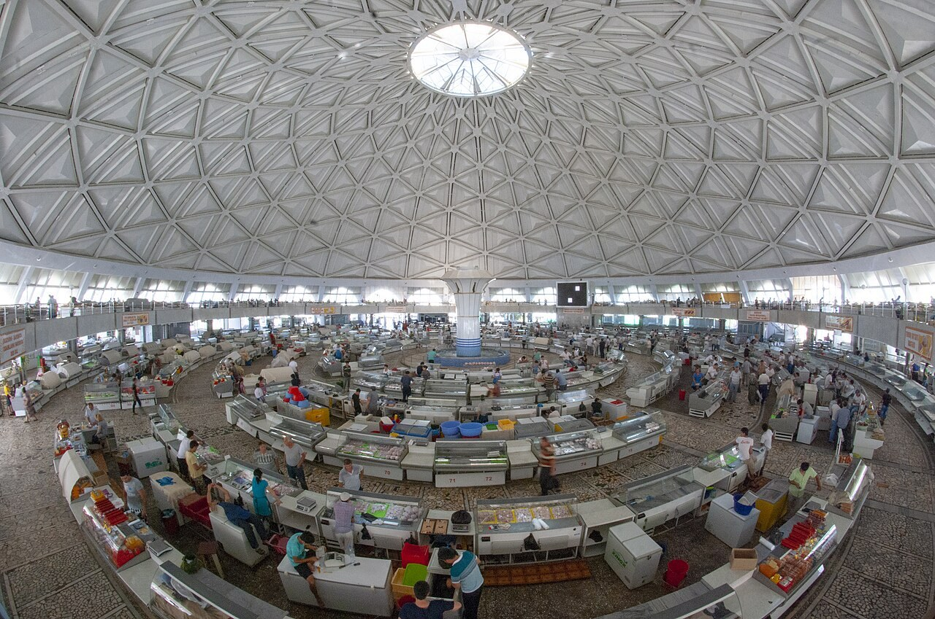
GRADE 7 · LESSON 19
Grammar: Pronouns
Olmoshlar: me, myself, this, those
Grammar: pronouns
Theklan · CC BY-SA 4.0
sozlar.com

Slide 2
LESSON AIMS
Bugungi maqsad
1
Find the pronouns in the Look! box and choose the correct one, A, B or C (p. 29 ex. 1)
2
Write the correct object or reflexive pronoun in eight sentences (ex. 2)
3
Complete the shop dialogue with seven pronouns (ex. 3)
4
Act out a short shop dialogue with this / that / these / those

Slide 3
GRAMMAR
Form — Grammar database 6 (p. 147)
OBJECT (after a verb)
REFLEXIVE (-self / -selves)
I
me
myself
you
you
yourself · (plural) yourselves
he
him
himself
she
her
herself
it
it
itself
we
us
ourselves
they
them
themselves
Demonstrative: near the speaker — this (one) · these (many); far from the speaker — that (one) · those (many).

Slide 4
BOOK TASK · 14 MINUTES
Book tasks — Laser A1+, p. 29
Books open, word list closed. Try alone first, then check with Grammar database 6 (p. 147).
1
Look! — underline the pronouns in the five sentences. Which noun does each one replace?
2
ex.1 — Choose the correct word, A, B or C (six sentences).
3
ex.2 — Write the correct pronoun in each gap. Use the word in bold (eight sentences).
4
ex.3 — Complete the shop dialogue: me · yourself · I · those · you · this · myself.
5
Fast finishers — Quick check on p. 147 (five more items).

Slide 5
CHECK AND TEACH · 7 MINUTES
Answer key — Laser A1+, p. 29
1
ex.1 1 A them · 2 A us · 3 A this · 4 B those · 5 C myself · 6 A yourself
2
ex.2 1 me · 2 yourself · 3 these · 4 himself
3
ex.2 5 her · 6 herself · 7 that · 8 itself
4
ex.3 1 me · 2 I · 3 yourself · 4 those · 5 you · 6 myself · 7 this
5
Quick check (p. 147) 1 her · 2 itself · 3 These · 4 that · 5 ourselves (accept us)
6
Ask WHY: same person → -self; near → this / these; far → that / those.

Slide 6
FOCUS
Which pronoun? — six rules
QOIDA
QOIDA
Subject fe’ldan oldin: She lives here. Object fe’l yoki predlogdan keyin: I know her. Come with us.
Otni qayta takrorlamang — olmosh qo‘ying: Jasur is my friend. I play with him.
-self / -selves — ega va to‘ldiruvchi BIR odam: I taught myself. Boshqa odam bo‘lsa: Mum taught me.
you bitta odam → yourself; ko‘p odam → yourselves.
this / these — yaqinda (here), that / those — uzoqda (over there).
this / that + bitta narsa, these / those + ko‘p narsa: this shoe — these shoes.

Slide 7
VOCABULARY
A. Things in the shop (1/3)
🖌️
a paintbrush
mo‘yqalam
This paintbrush is too thin. Can you show me those thick ones?
🧹️
a brush
cho‘tka, supurgi
Can you pass me that brush? I want to clean the floor myself.
🪚️
a saw
arra
Grandpa is making himself a new chair with a saw.
👛️
a purse
hamyon
I can’t find my purse. Can you help me look for it?
💍️
a diamond ring
olmos uzuk
Look at that diamond ring in the window! How much is it?

Slide 8
VOCABULARY
A. Things in the shop (2/3)
🛍️
a shopping bag
xarid sumkasi
Is this shopping bag yours? — No, mine is that red one over there.
🫖️
a teapot
choynak
Grandma likes that blue teapot over there. She wants to buy it.
🧦️
socks
paypoq
Are those socks yours? They’re under your bed!
👔️
a manager
boshqaruvchi, mudir (menejer)
Can I speak to the manager? I want to ask her a question.
🔨️
a hammer
bolg‘a
I’m making myself a bookshelf, so I need a hammer and some nails.

Slide 9
VOCABULARY
A. Things in the shop (3/3)
☕️
a cup
piyola, chashka
Grandma buys herself four cups for her new teapot.
👟️
a pair of shoes
bir juft poyabzal (tufli)
Can you show me that pair of shoes in the window? I want to try them on.
🏷️
the price
narx
What’s the price of that teapot? Can you tell me?

Slide 10
VOCABULARY
B. Things in the classroom (1/2)
📓️
an exercise book
daftar
Is this your exercise book? It hasn’t got a name on it.
🗄️
a cupboard
shkaf, javon
The paints are in that cupboard over there. Help yourselves!
🗑️
a bin
chiqindi qutisi
Please put those papers in the bin by the door.

Slide 11
VOCABULARY
B. Things in the classroom (2/2)
🖥️
an interactive whiteboard
interaktiv doska
Our teacher shows us films on the interactive whiteboard.
🖍️
coloured pencils
rangli qalamlar
Are these your coloured pencils? Can I use them?
⬛️
a blackboard
sinf doskasi
Look at that blackboard — the teacher is writing on it.

Slide 12
VOCABULARY
C. Doing things yourself (1/2)
🍛️
help yourself
marhamat, o‘zingiz oling
There’s plov on the table — help yourself!
🩹️
cut yourself
biror joyini kesib olmoq
Careful! Don’t cut yourself on that broken glass.
🤕️
hurt yourself
lat yemoq, o‘zini jarohatlamoq
Are you OK? Did you hurt yourself?
🎸️
teach yourself
mustaqil o‘rganmoq
You can teach yourself to play the guitar with online videos.

Slide 13
VOCABULARY
C. Doing things yourself (2/2)
🧳️
look after yourself
o‘ziga ehtiyot bo‘lmoq
Look after yourself on the school trip, Ali!
🪞️
look at yourself
o‘ziga qaramoq (ko‘zguda)
Look at yourself in the mirror — you’ve got chocolate on your face!
🎂️
by myself
o‘zim, hech kimning yordamisiz
I made this cake by myself — nobody helped me!

Slide 14
PRONUNCIATION
Say it — don’t just read it
Hard words: the p in cupboard is silent; -self is stressed.
a cupboard
/ˈkʌbəd/
a purse
/pɜːs/
a saw
/sɔː/
a diamond ring
/ˈdaɪəmənd rɪŋ/
a manager
/ˈmænɪdʒə/
an interactive whiteboard
/ˌɪntərˈæktɪv ˈwaɪtbɔːd/
coloured pencils
/ˈkʌləd ˈpensəlz/
look after yourself
/lʊk ˈɑːftə jɔːˈself/
Say it: CUP-board (no p!) · MA-na-ger · help your-SELF · and remember: this /ɪ/ is short, these /iː/ is long.

Slide 15
WHOLE CLASS
Practice — complete the sentence (1/2)
1
I can’t find my keys. Can you help ________? (I)
2
Ouch! Ali cut ________ with the knife. (he = Ali)
3
Our grandparents often visit ________ at the weekend. (we)
4
Malika, did you make this cake ________? (you = Malika)
5
These shoes are too small. I can’t wear ________. (they)
6
Is ________ your phone here in my hand? (t…, one)

Slide 16
WHOLE CLASS
Practice — complete the sentence (2/2)
7
The children are enjoying ________ at the party. (they)
8
I like ________ jeans here — how much are they? (t…, many)
9
We painted the room ________ — nobody helped us. (we)
10
Can you see ________ dog over there? It’s huge! (t…, one)

Slide 17
PAIR / GROUP WORK · 6 MINUTES
Vocabulary activity
1
Match the beginnings (1-10) with the endings (a-j).
2
Read your complete sentences aloud.
3
Give the Uzbek meaning of the key word in each sentence.
4
When you finish, swap tables with the other group.

Slide 18
PAIRS · 6 MINUTES
Speaking
In the shop: A is the shop assistant, B is the customer. Buy a teapot, some socks or a pair of shoes. Use: Can you show me …? How much is this? How much are they? I like that one / those over there.
Whose is it? Put three things on the desk (an exercise book, coloured pencils, a cup): Is this your exercise book? — No, it isn’t. I think it’s his. Give it to him!
Tell your partner two things you can do by yourself and one thing you can’t: I can make breakfast by myself.

Slide 19
TODAY'S WORDS IN CONTEXT
At the market with Grandma (1/2)
It’s Saturday morning. Grandma and I are at the market. “I need a new teapot,” she says. “Can you help me?”
We stop at a small shop. “Good morning! Can you show us some teapots?” Grandma asks. The shop assistant smiles at her. “Of course. These blue ones here are very popular.”
Grandma looks at them. “Hmm. I like that one over there. How much is it?” “It’s eighty thousand som.” “And what’s the price of those cups next to it?” “Ten thousand som each. Help yourself — have a look.”
Cover the word list. Can you understand the words in bold from the sentence?

Slide 20
TODAY'S WORDS IN CONTEXT
At the market with Grandma (2/2)
I’m hungry, so I buy myself a hot samsa. Grandma takes out her purse and buys herself the teapot and four cups. She puts them in her shopping bag. “Now we can have tea together,” she says. We’re really enjoying ourselves!
Cover the word list. Can you understand the words in bold from the sentence?

Slide 21
TODAY'S WORDS IN CONTEXT
Read and answer
1
Where are Grandma and the writer?
2
What does Grandma need?
3
Which teapot does Grandma like — the blue ones here or the one over there?
4
What does the writer buy?
5
Find three reflexive pronouns in the last paragraph.

Slide 22
PAIRS · ESDA QOLDIMI?
Memory check — change the word
Men gapni aytaman, siz otni olmosh bilan almashtirasiz.
1
Grandma loves the blue teapot. → Grandma loves …
2
Give the shopping bag to Dad. → Give it to …
3
Ali made a shelf with a hammer. Nobody helped Ali. → Ali made it …
4
the coloured pencils over there → … coloured pencils
5
the cup here in my hand → … cup

Slide 23
UZ
Qiyin joyi — o‘zbekcha
me, him, her, us, them — o‘zbekchadagi «meni, uni, bizni…» (tushum kelishigi): I know him — «men uni bilaman».
-self — «o‘zi»: harakat o‘ziga qaytadi. He hurt himself — «u o‘zini jarohatladi».
Ko‘plikda -selves: ourselves, yourselves, themselves (✗ themself).
this / these — «bu / bular» (yaqinda), that / those — «anavi / anavilar» (uzoqda).
Help yourself! — mehmonga «Marhamat, oling!» degani.

Slide 24
HOMEWORK
Uy vazifasi
1
Workbook pp. 21–22, ex. 1–4 (kalendar reja).
2
Learn the 26 items with the flashcards: sozlar.com/vocab/cards/?set=grade7-lesson19
3
Write six sentences about your family with me / him / her / us / them and two with -self (for example: teach yourself, hurt yourself).

Slide 25
IMAGE CREDITS
Rasmlar manbasi
cover
Theklan · CC BY-SA 4.0 · https://commons.wikimedia.org/wiki/File:Chorsu_Market_general_view.jpg

Slide 26
Uchta so‘z — ertaga ham esingizda qoladi
Juftingizga ayting, so‘ng daftaringizga yozib qo‘ying.
sozlar.com/vocab/cards/?set=grade7-lesson19

