Slide 1
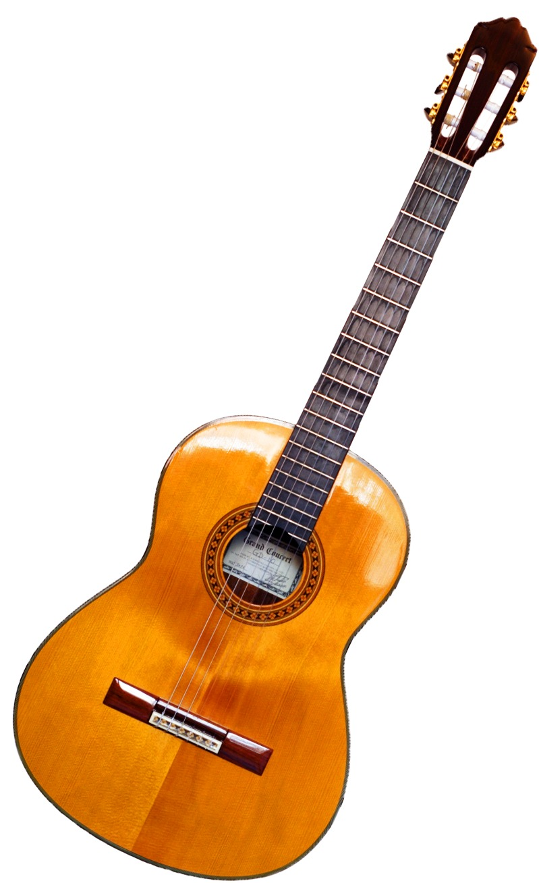
GRADE 10 · LESSON 19
Grammar Clinic: Present Perfect Review
Present perfect simple va continuous takrori
Grammar clinic: Present perfect tense review
Martin Möller · CC BY-SA 2.0 de
sozlar.com

Slide 2
LESSON AIMS
Bugungi maqsad
1
Match three sentences to their uses and decide if four statements are true or false (ex. 1–2)
2
Correct three mistakes and find the correct sentence (ex. 3)
3
Complete twelve gaps with the present perfect simple or continuous (ex. 4–5)
4
Ask and answer How long have you been …? questions about their own hobbies

Slide 3
GRAMMAR
Form — present perfect simple and continuous
PRESENT PERFECT SIMPLE
PRESENT PERFECT CONTINUOUS
+
I/we/they have (’ve) played · he/she has (’s) played
I/we/they have been playing · he/she has been playing
−
I haven’t played · she hasn’t played
I haven’t been playing · she hasn’t been playing
?
Have you played? · How many … has she …?
Have you been playing? · How long has she been …?
⏱
just, already, yet, ever, never, so far, This is the first time
for, since, all morning, for ages, How long …?
Stative verbs (know, own, owe, believe) and ever / never are not used in the continuous: I’ve never read any of his books (Grammar database p. 172).

Slide 4
BOOK TASK · 17 MINUTES
Book tasks — Laser B1+, p. 26
Books open, word list closed. Try alone first — then check with Grammar database pp. 171–172.
1
ex.1 — Match sentences 1–3 from the article (pp. 24–25) to explanations a–c.
2
ex.2 — Decide if the statements are true (T) or false (F).
3
ex.3 — Correct the mistakes. One sentence has no mistakes. Which one?
4
ex.4 — Present perfect simple or continuous: six sentences.
5
ex.5 — The free library blog: join · make · plan · read · think · write.

Slide 5
CHECK AND TEACH · 6 MINUTES
Answer key — Laser B1+, p. 26 (1/2)
1
ex.1 1 b · 2 a · 3 c
2
ex.2 1 T · 2 T · 3 F (recent activity, not long ago) · 4 T
3
ex.3 1 I saw Matt last week · 2 I haven’t played Monopoly for a long time
4
ex.3 3 correct (no mistakes) · 4 This is the first time I’ve built a model plane
5
ex.4 1 ’ve been playing · 2 has never met · 3 Have you been following
6
ex.4 4 ’ve been practising · 5 ’ve been waiting · 6 has taken up

Slide 6
CHECK AND TEACH · 6 MINUTES
Answer key — Laser B1+, p. 26 (2/2)
7
ex.5 1 have been planning · 2 have joined · 3 have read · 4 has written
8
ex.5 5 have been thinking · 6 haven’t made

Slide 7
FOCUS
Simple, continuous yoki past simple?
QOIDA
QOIDA
Present perfect simple — natija yoki tajriba muhim; How many?: Peter has written five books. Jan has read the book (hozir biladi).
Present perfect continuous — jarayon va davomiylik; How long?: I’ve been studying English for six years.
Yaqinda tugagan jarayon + hozirgi iz: My fingers are sore because I’ve been practising.
Aniq o‘tgan vaqt (last week, in June, yesterday) — past simple: I saw Matt last week.
Holat fe’llari (know, own, owe) va ever / never — faqat simple: Luke has never met…
This is the first time + present perfect: This is the first time I’ve built a model plane.

Slide 8
VOCABULARY
A. Hobbies and practice (1/3)
🗂️
sort out
tartibga solmoq, saralamoq
I’ve been sorting out my stamp album all afternoon.
🏂️
snowboarding
snoubord (qorda taxtada uchish)
Jan has read a book about snowboarding, so ask her for advice.
🥋️
a karate club
karate to‘garagi
Matt has been a member of the karate club since September.
🎲️
a board game
stol o‘yini
We haven’t played a board game together for a long time.

Slide 9
VOCABULARY
A. Hobbies and practice (2/3)
✈️
a model plane
samolyot modeli
My brother has built three model planes this year.
🎼️
the xylophone
ksilofon (cholg‘u asbobi)
My little sister has been learning the xylophone since May.
🥁️
practise
mashq qilmoq
Aziz has been practising the drums every evening this week.
🦵️
sore
og‘riyotgan, zirqirayotgan
My legs are sore because I’ve been running all morning.

Slide 10
VOCABULARY
A. Hobbies and practice (3/3)
🩼️
break your leg
oyog‘ini sindirmoq
Timur has broken his leg, so he can’t play in the match.
🎤️
take part in
…da qatnashmoq
I’ve never taken part in a school concert before.
🏆️
win a competition
musobaqada g‘olib bo‘lmoq
Our chess team has won two competitions this year.

Slide 11
VOCABULARY
B. The free library blog (1/2)
📚️
a local library
mahalla kutubxonasi
My friends and I have opened a free local library for our street.
📝️
join a blog
blogga a’zo bo‘lmoq
About thirty people have joined our blog since Monday.
⬆️
upload a review
taqrizni saytga joylamoq
We’ve already uploaded a review of every book we’ve read.
✍️
write a review
taqriz yozmoq
Have you ever written a review of a book you loved?

Slide 12
VOCABULARY
B. The free library blog (2/2)
📖️
borrow a book
kitobni vaqtincha olib turmoq
Dilshod has borrowed a book from our library twice this month.
🌍️
expand
kengaytirmoq
We’ve been thinking about how to expand the library to other towns.
📮️
post a book
kitobni pochta orqali jo‘natmoq
Have you ever posted a book to a friend in another city?
🤔️
make a decision
qaror qabul qilmoq
Our club hasn’t made a decision about the summer trip yet.

Slide 13
VOCABULARY
C. Films and online life (1/2)
⌛️
wait for ages
juda uzoq kutmoq
Where are you? I’ve been waiting for ages outside the cinema!
🍿️
look forward to
…ni intiqlik bilan kutmoq
I’ve been looking forward to this film for weeks.
🎬️
star in a film
filmda bosh rol o‘ynamoq
My favourite actor has starred in more than twenty films.

Slide 14
VOCABULARY
C. Films and online life (2/2)
🎞️
a film club
kino klubi
I’ve been a member of the school film club for two years.
👤️
set up an account
akkaunt ochmoq
I’ve just set up an account for our book club — will you follow it?
💵️
owe
qarzdor bo‘lmoq
I’ve owed Aziz some money for two weeks — I must pay him back.

Slide 15
VOCABULARY
D. Feelings
😩️
exhausted
holdan toygan, juda charchagan
You look exhausted! — I’ve been cycling for two hours.
😳️
guilty
o‘zini aybdor his qilgan
You look guilty. What have you done with my phone?
😮‍💨
relieved
yengil tortgan, ko‘ngli joyiga tushgan
You look relieved! — Yes, I’ve just finished my last exam.
😴️
sleepy
uyqusi kelgan
You look sleepy. — I’ve been reading all night.
😟️
worried
xavotirdagi, tashvishli
You look worried. — I haven’t heard from my brother all day.

Slide 16
PRONUNCIATION
Say it — don’t just read it
Qiyin so‘zlar: xylophone — x = /z/, guilty — u aytilmaydi, owe = /əʊ/:
xylophone
/ˈzaɪləfəʊn/
practise
/ˈpræktɪs/
sore
/sɔː/
exhausted
/ɪɡˈzɔːstɪd/
guilty
/ˈɡɪlti/
relieved
/rɪˈliːvd/
worried
/ˈwʌrid/
owe
/əʊ/
Weak forms — say it fast: How long have /həv/ you been /bɪn/ waiting?

Slide 17
WHOLE CLASS
Practice — complete the sentence (1/2)
1
I ________ Matt last week, when we were at the karate club. (see)
2
Sarah hasn’t played football ________ she broke her leg.
3
This is the first time I’ve ________ a model plane. (build)
4
I’ve been ________ tennis, so I’m quite tired. (play)
5
Luke says he has ________ met anybody who plays the xylophone. (= not ever)
6
We’ve been waiting ________ an hour and our dance teacher still isn’t here!

Slide 18
WHOLE CLASS
Practice — complete the sentence (2/2)
7
About twenty people have ________ the blog already. (join)
8
My dad has ________ up a new hobby — cooking! (take)
9
How ________ has Ellie been waiting? — For ages.
10
We haven’t made a final decision ________. (negative: until now)

Slide 19
PAIR / GROUP WORK · 5 MINUTES
Vocabulary activity
1
Match the beginnings (1-10) with the endings (a-j).
2
Read your complete sentences aloud.
3
Give the Uzbek meaning of the key word in each sentence.
4
When you finish, swap tables with the other group.

Slide 20
PAIRS · 5 MINUTES
Speaking
Pairs: ask three How long have you been …? questions (learning English, living in your town, doing your hobby). Answer with for or since.
Solutions p.24 ex.8: A says You look exhausted / hot / worried. B explains with the present perfect continuous: I’ve been running.
Find someone who has never … / has already … this week — walk round the class and ask Have you ever …?

Slide 21
TODAY'S WORDS IN CONTEXT
Three months with a guitar
I’ve been learning the guitar for three months now. My uncle gave me his old guitar in June, and I’ve played it almost every day since then.
So far I’ve learnt eight songs, but I haven’t played in front of anyone yet. My fingers are sore today because I’ve been practising all morning.
On Friday our school club is having a concert, and it will be the first time I’ve ever taken part in one! My friend Aziz has been playing the drums since he was ten, and he has already won two competitions. I’ve never been so worried — but I’ve been looking forward to Friday for weeks.
Cover the word list. Can you understand the words in bold from the sentence?

Slide 22
TODAY'S WORDS IN CONTEXT
Read and answer
1
How long has the writer been learning the guitar?
2
Why are the writer’s fingers sore today?
3
Why is ‘gave’ in the past simple, not the present perfect?
4
Find two completed actions with a number (How many?).
5
What hasn’t the writer done yet?

Slide 23
PAIRS · ESDA QOLDIMI?
Memory check — simple or continuous?
Men gapni boshlayman, siz davom ettiring va nega shu shaklni tanlaganingizni ayting.
1
My fingers are sore because I … the guitar all afternoon. (practise)
2
Our karate club … three competitions so far. (win)
3
How long … you … for the bus? (wait)
4
I … my leg last winter when I went snowboarding. (break)
5
This is the first time I … part in a concert. (take)

Slide 24
UZ
Qiyin joyi — o‘zbekcha
Present perfect continuous — o‘zbekchada ko‘pincha «-yapman» + …dan beri: I’ve been studying English for six years — «olti yildan beri ingliz tilini o‘rganyapman».
for — muddat (for an hour, for ages); since — boshlanish nuqtasi (since 7.30, since she broke her leg).
Aniq vaqt bor joyda (last week, yesterday, in June) — faqat past simple.
Holat fe’llari (know, own, owe, believe) davomli bo‘lmaydi: I’ve known him, ✗ I’ve been knowing emas.
How many? → simple (has written five books); How long? → ko‘pincha continuous.

Slide 25
HOMEWORK
Uy vazifasi
1
Laser B1+ Workbook p. 20, ex. 1–3.
2
Learn the 30 items with the flashcards: sozlar.com/vocab/cards/?set=grade10-lesson19
3
Write six sentences about your hobbies: two with for, two with since, one with already, one with yet.

Slide 26
IMAGE CREDITS
Rasmlar manbasi
cover
Martin Möller · CC BY-SA 2.0 de · https://commons.wikimedia.org/wiki/File:GuitareClassique5.png

Slide 27
Uchta so‘z — ertaga ham esingizda qoladi
Juftingizga ayting, so‘ng daftaringizga yozib qo‘ying.
sozlar.com/vocab/cards/?set=grade10-lesson19

