Slide 1
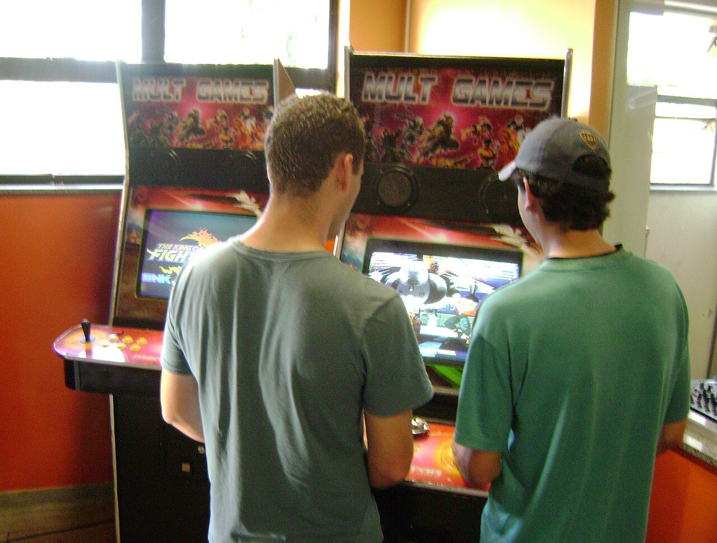
GRADE 10 · LESSON 18
Word Box: Hobbies
Word Box: xobbilar — so‘zlar va fikr bildirish
Word box: Hobbies
Andrevruas · CC BY-SA 3.0
sozlar.com

Slide 2
LESSON AIMS
Bugungi maqsad
1
Match four linking words with their function (ex. 2)
2
Complete seven Word box sentences from the first letter (ex. 4)
3
Form ten words from the same word family (worksheet Part A)
4
Discuss the Have your say! questions using at least three preference phrases

Slide 3
BOOK TASK · 5 MINUTES
Book task — Laser B1+, p. 25, ex. 2
Match with the words: a For instance, … · b which means … · c However, … · d At first, …
1
to talk about what happened in the beginning → ?
2
to introduce a result → ?
3
to introduce a contrast → ?
4
to introduce an example → ?

Slide 4
BOOK TASK · 8 MINUTES
Word box — Laser B1+, p. 25, ex. 4 (1–4)
Use words from the article. The first letter is given.
1
One day, my collection of butterflies might be quite v________.
2
I don’t know if I can a________ to buy any new stamps for my collection.
3
I prefer t________ songs to modern pop songs.
4
It might sound a bit w________, but in my free time I like to study grammar.

Slide 5
BOOK TASK · 8 MINUTES
Word box — Laser B1+, p. 25, ex. 4 (5–7)
Use words from the article. The first letter is given.
5
I like music that has a strong r________.
6
I’d like to try gymnastics, but I know I would keep losing my b________!
7
Let’s go down to the v________ a________ and play Alien Invasion.

Slide 6
VOCABULARY
A. Word box: words and families (1/2)
💎️
valuable
qimmatbaho, qadrli
Grandad’s old stamp album is now really valuable.
🏷️
value
qiymat, qadr
The value of a rare stamp can grow every year.
🌟️
invaluable
bebaho, juda foydali
Advice from an experienced coach is invaluable for a beginner.

Slide 7
VOCABULARY
A. Word box: words and families (2/2)
🏡️
a tradition
an’ana
Playing chess with Grandad on Sundays is a family tradition.
💃️
rhythmic
ritmik, bir maromdagi
The rhythmic sound of the drums made everyone dance.
🛹️
lose your balance
muvozanatni yo‘qotmoq
He lost his balance on the skateboard and fell over.

Slide 8
VOCABULARY
B. Describing hobbies (1/3)
🎮️
addictive
o‘ziga bog‘lab qo‘yadigan
Computer games can be very addictive.
⏳️
time-consuming
ko‘p vaqt oladigan
Building a robot is fun, but it’s very time-consuming.
🥵️
exhausting
holdan toydiradigan, juda charchatadigan
A three-hour dance class is exhausting!
🎣️
relaxing
hordiq beradigan, tinchlantiruvchi
Sitting by the river with a fishing rod is really relaxing.

Slide 9
VOCABULARY
B. Describing hobbies (2/3)
🧗️
challenging
mashaqqatli (lekin qiziqarli)
Rock climbing is challenging, but I love it.
🏅️
rewarding
qoniqish beradigan, mamnuniyat bag‘ishlaydigan
Teaching younger children to play chess is very rewarding.
🧭️
appeal to sb
kimgadir yoqmoq, o‘ziga tortmoq
Geocaching appeals to me because I love being outdoors.
📷️
be into sth
…ga qiziqmoq, …ning ishqibozi bo‘lmoq
My cousin is really into photography.

Slide 10
VOCABULARY
B. Describing hobbies (3/3)
☕️
not my cup of tea
didimga to‘g‘ri kelmaydi
Opera is not my cup of tea — it’s too slow for me.
😌️
for pleasure
zavq uchun, ko‘ngil uchun
Grandad doesn’t sell his stamps — he collects them just for pleasure.
🥦️
healthy
sog‘liq uchun foydali
Cycling to school every day is a healthy habit.

Slide 11
VOCABULARY
C. Other free-time activities (1/2)
🎂️
bake cakes
tort pishirmoq
On Saturdays my sister and I bake cakes for the family.
🧑‍🤝‍🧑
hang out with friends
do‘stlar bilan vaqt o‘tkazmoq
After school I usually hang out with friends in the park.
🧵️
make your own clothes
o‘z kiyimini o‘zi tikmoq
Malika makes her own clothes on her grandmother’s sewing machine.
📹️
make video blogs
videoblog yuritmoq
My friend makes video blogs about cooking.
📱️
use social media
ijtimoiy tarmoqlardan foydalanmoq
Many teenagers use social media for hours every day.

Slide 12
VOCABULARY
C. Other free-time activities (2/2)
💻️
watch videos online
internetda video ko‘rmoq
I watch videos online to learn new guitar chords.
📰️
read magazines
jurnal o‘qimoq
Grandad reads magazines about fishing and old cars.
💬️
text your friends
do‘stlarga xabar yozmoq
Please don’t text your friends during the lesson!
🧘️
keep fit
sog‘lom va baquvvat bo‘lib yurmoq
My mum goes to yoga classes to keep fit.

Slide 13
TODAY'S WORDS IN CONTEXT
Grandad’s hobbies and mine (1/2)
My grandad has a stamp album that he started when he was ten. At first, it was just a few cheap stamps from letters. Now some of them are really valuable, which means he keeps the album in a safe place. He says its value is not in money, though — every stamp is a memory.
I love music, but I can’t afford a real drum kit, so I play on an app. Grandad prefers traditional songs to modern pop — he says my music has too much rhythm and not enough melody. I think that sounds a bit weird!
Cover the word list. Can you understand the words in bold from the sentence?

Slide 14
TODAY'S WORDS IN CONTEXT
Grandad’s hobbies and mine (2/2)
We don’t agree about everything. For instance, I love the video arcade in the shopping centre, but it doesn’t appeal to him at all: “Too noisy — and too addictive!” he says. And he’d rather go fishing than play any game. However, last summer he tried my skateboard. He lost his balance after three metres, and we both laughed for ten minutes.
I’m not really into fishing — it’s time-consuming and quiet. But I don’t mind sitting next to him by the river — it’s surprisingly relaxing. Maybe that is our family tradition.
Cover the word list. Can you understand the words in bold from the sentence?

Slide 15
TODAY'S WORDS IN CONTEXT
Read and answer
1
Why does Grandad keep his album in a safe place?
2
Why does the writer play the drums on an app?
3
What kind of songs does Grandad prefer?
4
What happened when Grandad tried the skateboard?
5
Why isn’t the writer really into fishing?

Slide 16
PAIRS · ESDA QOLDIMI?
Memory check — so‘zni toping
Men ta’rifni aytaman, siz bugungi so‘zni ayting (birinchi harf yordam beradi).
1
worth a lot of money → v…
2
takes a lot of your time → t…-c…
3
very, very tiring → e…
4
hard to stop doing → a…
5
makes you feel calm → r…

Slide 17
FOCUS
Word box: besh tuzoq
• afford — can / can’t afford bilan: I can’t afford to buy it, I can’t afford a new bike.
• prefer A to B — than EMAS: I prefer tea to coffee. Lekin I’d rather … than …
• valuable (qimmatbaho) va invaluable (bebaho, juda foydali) — ikkalasi ham IJOBIY, in- bu yerda inkor emas!
• rhythm — /ˈrɪðəm/: rh dagi h aytilmaydi, th = /ð/, y = /ɪ/.
• lose / keep your balance — fe’l bilan birga yodlang.

Slide 18
PRONUNCIATION
Say it — don’t just read it
rhythmic — rh dagi h aytilmaydi, th = /ð/; exhausting — h aytilmaydi; katta harf — urg‘u.
RHYTHmic /ˈrɪðmɪk/
exHAUSTing /ɪɡˈzɔːstɪŋ/
VALuable /ˈvæljuəbl/
inVALuable /ɪnˈvæljuəbl/
adDICtive /əˈdɪktɪv/
CHALlenging /ˈtʃælɪndʒɪŋ/
reWARDing /rɪˈwɔːdɪŋ/
traDItion /trəˈdɪʃn/

Slide 19
WHOLE CLASS
Practice — complete the sentence (1/2)
1
My little brother can’t stop playing that phone game — it’s really ________.
2
I prefer traditional songs ________ modern pop songs.
3
I’d like to try gymnastics, but I know I would keep losing my ________!
4
Skiing sounds exciting, but it doesn’t ________ to me because I hate the cold.
5
I’d ________ go to the cinema than stay at home.
6
I’m not really ________ computer games.

Slide 20
WHOLE CLASS
Practice — complete the sentence (2/2)
7
Emails can be sent instantly, ________ means that people aren’t buying stamps.
8
At ________, computers were seen as strange machines used by big businesses.

Slide 21
PAIR / GROUP WORK · 8 MINUTES
Vocabulary activity
1
Part A — write the correct form of the word in CAPITALS (10 items).
2
Part B — complete each phrase with ONE word from the box.
3
Work alone first, then compare with your partner and explain your choice.

Slide 22
GROUPS OF THREE · 8 MINUTES
Speaking
Have your say! Which hobbies in the article are the most / least interesting? Why?
Would you consider taking any of them up? Why? / Why not?
Use: It appeals to me because… / I’m not really into… / It’s not my cup of tea. / I’d find it relaxing / exhausting / rewarding…

Slide 23
UZ
Qiyin joyi — o‘zbekcha
time-consuming (ko‘p vaqt oladigan) va exhausting (juda charchatadigan) — salbiy; qiyin, lekin qiziq = challenging, foydali va mamnun qiladigan = rewarding.
prefer A to B, lekin would rather A than B — ikki xil tuzilma.
I’m into + OT / -ING: I’m into fishing — «qiziqaman».
which means — oldingi butun gapga ishora qiladi, oldidan vergul qo‘yiladi.
not my cup of tea va it doesn’t appeal to me — muloyim «menga yoqmaydi».

Slide 24
HOMEWORK
Uy vazifasi
1
Learn the 26 words with the flashcards: sozlar.com/vocab/cards/?set=grade10-lesson18
2
Write 10 sentences about your hobbies, including all 7 Word box words and three adjectives from today’s list (relaxing, rewarding …).

Slide 25
IMAGE CREDITS
Rasmlar manbasi
cover
Andrevruas · CC BY-SA 3.0 · https://commons.wikimedia.org/wiki/File:Fliperama.jpg

Slide 26
Uchta so‘z — ertaga ham esingizda qoladi
Juftingizga ayting, so‘ng daftaringizga yozib qo‘ying.
sozlar.com/vocab/cards/?set=grade10-lesson18

