Slide 1
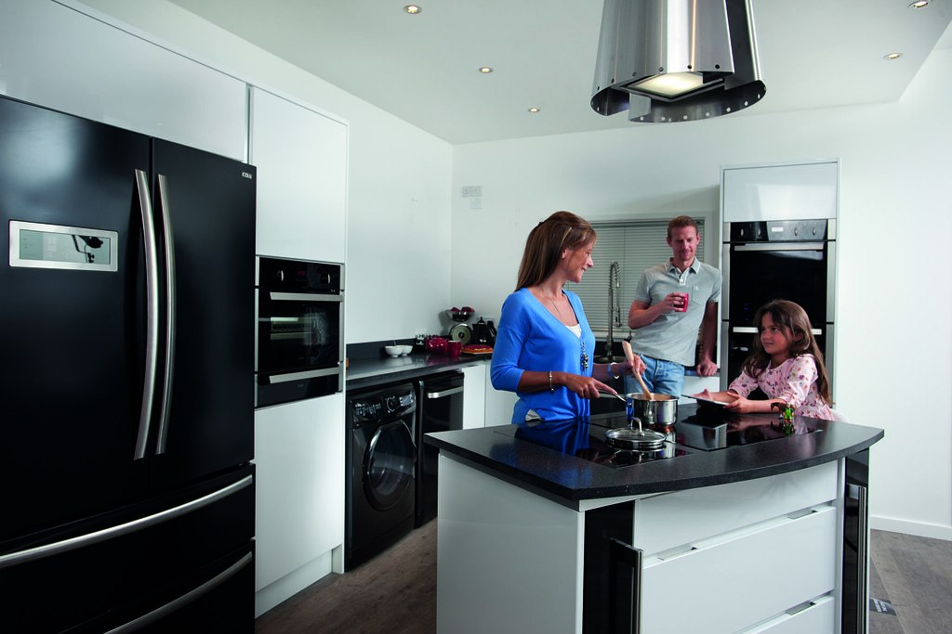
GRADE 7 · LESSON 18
Talking about What People Are Doing
Odamlar hozir nima qilayotgani haqida gapirish
Speaking: talking about what people are doing at the moment
CDAappliances · CC BY 2.0
sozlar.com

Slide 2
LESSON AIMS
Bugungi maqsad
1
Write five people and where you think they are now (p. 28 ex. 1)
2
Tell a partner what each person is doing with I think / maybe / probably (ex. 2)
3
Say what you and your family are doing at 8 a.m. and at 8 p.m. (ex. 3)
4
Find the two words that sound the same: we’re, where, were, wear (SoundSpot)

Slide 3
BOOK TASK · 5 MINUTES
Book task — Laser A1+, p. 28, ex. 1
Five people you know — where are they now? (Not from your English class!)
1
Mum — Where? At work (namuna)
2
____________ — Where? ____________
3
____________ — Where? ____________
4
____________ — Where? ____________
5
____________ — Where? ____________
6
____________ — Where? ____________ Ideas: at school · at home · at the shops · on the bus

Slide 4
VOCABULARY
A. Places: where people are (1/2)
💼️
at work
ishda
Mum isn’t at home. She’s at work — she’s writing an email.
🏫️
at school
maktabda
My little brother is at school. He’s having an English lesson now.
🏠️
at home
uyda
Grandpa is at home today. He’s reading a book in his room.
🛒️
at the shops
do‘konda, xaridda
Dad is at the shops. He’s buying bread and milk.
🏥️
at the hospital
kasalxonada
My aunt is a nurse. She’s at the hospital right now.

Slide 5
VOCABULARY
A. Places: where people are (2/2)
🏀️
at the sports centre
sport majmuasida
Bekzod is at the sports centre. Maybe he’s playing basketball.
🍳️
in the kitchen
oshxonada
Grandma is in the kitchen. She’s making tea for everybody.
🛋️
in the living room
zalda, umumiy xonada
My parents are in the living room. They’re watching the news.
🌳️
in the garden
bog‘da, hovlida
Grandpa is in the garden. He’s picking apples.
🚌️
on the bus
avtobusda
My sister is on the bus. She’s going to her music lesson.

Slide 6
VOCABULARY
B. Things people are doing now (1/2)
✉️
write an email
elektron xat yozmoq
Dad is at his desk. He’s writing an email to his boss.
➗️
have a maths lesson
matematika darsida bo‘lmoq
It’s ten o’clock, so my brother is having a maths lesson.
🎒️
get ready for school
maktabga tayyorlanmoq
My sister is in her room. She’s getting ready for school.
🚗️
drive to work
ishga mashinada bormoq
It’s eight o’clock. Mum is driving to work now.
🥚️
make breakfast
nonushta tayyorlamoq
It’s seven o’clock, and Grandma is making breakfast for us.

Slide 7
VOCABULARY
B. Things people are doing now (2/2)
📞️
talk on the phone
telefonda gaplashmoq
My sister is talking on the phone with her best friend.
🚏️
wait for the bus
avtobus kutmoq
Look! Aziz is waiting for the bus in the rain.
📷️
take a photo
suratga olmoq
Dad is taking a photo of the mountains.
🎨️
paint a picture
rasm chizmoq (bo‘yoq bilan)
My little sister is painting a picture of our cat.
🎹️
play the piano
pianino chalmoq
Listen! My sister is playing the piano in her room.

Slide 8
VOCABULARY
C. Jobs at home (1/2)
🍲️
cook dinner
kechki ovqat pishirmoq
Something smells great! Dad is cooking dinner in the kitchen.
🧽️
wash the dishes
idish-tovoq yuvmoq
Right now my brother is washing the dishes after dinner.
🧹️
sweep the floor
polni supurmoq
My brother is sweeping the floor in the kitchen.
🧺️
do the washing
kir yuvmoq
Grandma is doing the washing in the bathroom.

Slide 9
VOCABULARY
C. Jobs at home (2/2)
👕️
do the ironing
dazmol qilmoq, kiyim dazmollamoq
Mum is doing the ironing and listening to the radio.
✨️
clean the house
uyni tozalamoq, yig‘ishtirmoq
It’s Saturday, and we’re all cleaning the house together.
🛍️
do the shopping
bozor-o‘char qilmoq
Dad isn’t here. He’s doing the shopping at the market.
🪴️
water the plants
gullarga suv quymoq
My sister is watering the plants on the balcony.

Slide 10
BOOK TASK · 7 MINUTES
Book task — Laser A1+, p. 28, ex. 2
Tell your partner what you think each person is doing at the moment.
1
Namuna: My mum is working. She’s writing an email.
2
Use the Phrase Bank: I think … · Maybe he’s … · She’s probably …
3
Your partner asks: Where’s your …? What’s she doing?
4
Swap: A talks about five people, then B.

Slide 11
FOCUS
Phrase Bank — talking about what people are doing
• Kim qayerda: My mum is at work. Grandma is in the kitchen.
• Kim nima qilyapti: My dad is cooking dinner. Lisa is getting ready for school.
• Aniq bilmasangiz: I think my mum is writing an email. Maybe he’s playing football. He’s probably sleeping.
• Juftingiz so‘raydi: Where’s your brother now? What’s he doing?
• Vaqtni ayting: It’s eight o’clock in the morning. I’m having a shower.

Slide 12
PRONUNCIATION
Say it — don’t just read it
SoundSpot (p. 28 ex. 1): say the four words. Which TWO sound the same? Tick them.
we’re
where
were
wear
We’re wearing the same clothes!
Where were you?
SoundSpot ex. 2: repeat the two sentences — slowly first, then fast.

Slide 13
TEACHER · CHECK AFTER EX. 1
SoundSpot — answer key
1
ex.1 where and wear sound the same: /weə/.
2
we’re /wɪə/ and were /wɜː/ sound different.
3
ex.2 We’re /wɪə/ wearing /ˈweərɪŋ/ the same clothes! · Where /weə/ were /wɜː/ you?
4
The book CD (tracks 9–10) is not available: say the words yourself, or play the word audio on the lesson page.

Slide 14
WHOLE CLASS
Practice — complete the sentence (1/2)
1
Dad isn’t at home. He’s at ________. (w…)
2
Lisa is getting ________ for school. (r…)
3
My dad is in the kitchen. He’s ________ dinner. (cook)
4
It’s hot today, so Mum is ________ the plants in the garden. (water)
5
My brother is at school. He’s having a maths ________. (l…)
6
There’s sand everywhere! Dad is ________ the floor. (sweep)

Slide 15
WHOLE CLASS
Practice — complete the sentence (2/2)
7
I think Grandma is ________ the washing. (do)
8
________ were you yesterday? — At the shops. (W…)
9
Look! We’re ________ the same T-shirts! (wear)
10
Bekzod isn’t at home. He’s at the sports ________. (c…)

Slide 16
PAIR / GROUP WORK · 6 MINUTES
Vocabulary activity
1
Match the beginnings (1-10) with the endings (a-j).
2
Read your complete sentences aloud.
3
Give the Uzbek meaning of the key word in each sentence.
4
When you finish, swap tables with the other group.

Slide 17
PAIRS · 7 MINUTES
Speaking
Ex.3: imagine it is 8 o’clock in the morning. Say what you and your five people from ex.1 are doing now.
Now it is 8 o’clock in the evening. Your partner guesses first: I think your dad is cooking dinner. Answer: Yes, he is. / No, he isn’t. He’s …
Tell the class about one person: My sister is at home. She’s probably watering the plants.

Slide 18
TODAY'S WORDS IN CONTEXT
Eight o’clock in the evening at our house
It’s eight o’clock in the evening. I’m at home, and I’m writing this in my bedroom. Where is everybody?
My dad is in the kitchen. He’s cooking dinner — I think it’s plov, because it smells great! My little sister Zarina is setting the table.
My mum isn’t at home. She’s a doctor, and she’s at work at the hospital tonight. I think she’s talking to a patient right now.
Grandma is watching TV in the living room. Grandpa is sitting next to her, but he isn’t watching. He’s probably sleeping!
And my brother Bekzod? He’s at the sports centre. Maybe he’s playing basketball. He’s always late for dinner! — Madina, 12
Cover the word list. Can you understand the words in bold from the sentence?

Slide 19
TODAY'S WORDS IN CONTEXT
Read and answer
1
Where is Madina, and what is she doing?
2
What is Dad cooking?
3
Why isn’t Mum at home?
4
Is Grandpa watching TV?
5
Where is Bekzod, and what is he doing?

Slide 20
PAIRS · ESDA QOLDIMI?
Memory check — what are they doing?
Men joyni aytaman, siz u yerdagi odam nima qilayotganini aytasiz.
1
in the kitchen → My dad is …
2
at school → My sister is …
3
at work → My mum is …
4
on the bus → My brother is …
5
in the garden → My grandpa is …

Slide 21
UZ
Qiyin joyi — o‘zbekcha
at work, at school, at home — artiklsiz: «ishda, maktabda, uyda»; in the kitchen, on the bus — artikl bilan.
Aniq bilmasangiz I think, maybe yoki probably qo‘shing: He’s probably sleeping — «u, ehtimol, uxlayapti».
I think — oddiy zamonda: I think my dad is cooking (✗ I am think).
have ovqat, dush va dars bilan «-yapti» bo‘la oladi: I’m having a shower, he’s having a maths lesson.
where — «qayerda», wear — «kiymoq», were — «edi(k)», we’re — «biz …miz». Yozilishi va ma’nosi har xil.

Slide 22
HOMEWORK
Uy vazifasi
1
Prepare 6–8 sentences about what your family members are doing now (kalendar reja).
2
Learn the 28 items with the flashcards: sozlar.com/vocab/cards/?set=grade7-lesson18
3
Read Madina’s text again and listen to the audio on the lesson page.

Slide 23
IMAGE CREDITS
Rasmlar manbasi
cover
CDAappliances · CC BY 2.0 · https://www.flickr.com/photos/148434301@N05/33568346845

Slide 24
Uchta so‘z — ertaga ham esingizda qoladi
Juftingizga ayting, so‘ng daftaringizga yozib qo‘ying.
sozlar.com/vocab/cards/?set=grade7-lesson18

