Slide 1
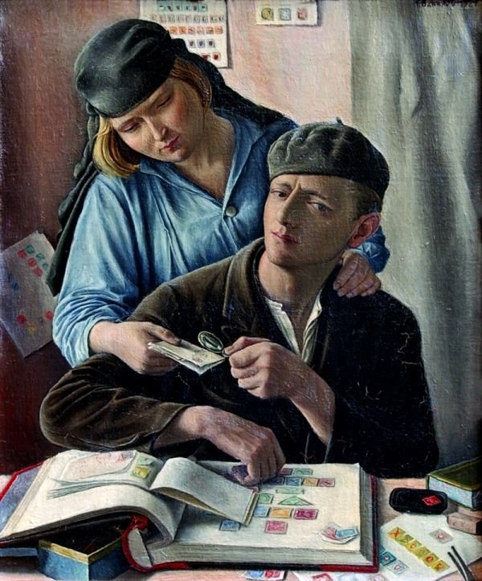
GRADE 10 · LESSON 17
Unit 3 Reading: Hobbies past and present
3-bo‘lim. O‘qish: xobbilar — o‘tmishda va hozir
Unit 3. Killing time Reading: Hobbies past and present
François Barraud · Public domain
sozlar.com

Slide 2
LESSON AIMS
Bugungi maqsad
1
Answer the Start thinking! questions about their own hobbies
2
Find and underline all the hobbies in the article (ex. 1)
3
Put six missing sentences back into the article, using clue words (ex. 3)
4
Explain how three hobbies have changed since their grandparents’ time

Slide 3
BOOK TASK · 14 MINUTES
Book tasks — Laser B1+, pp. 24–25
Unit 3 Killing Time — Reading (audio 1.07).
1
Start thinking! Do you have any hobbies? Do you collect anything? What sort of things do people collect?
2
ex.1 Read the article «Hobbies Past and Present». Underline all the hobbies which are mentioned.
3
ex.3 Six sentences have been removed. Choose from A–G the one which fits each gap (1–6). One sentence is extra.
4
Tip: read the sentence BEFORE and AFTER each gap — look for they / these / that and linking words.

Slide 4
VOCABULARY
A. Hobbies and collecting (1/3)
🎨️
a hobby
xobbi, sevimli mashg‘ulot
My favourite hobby is drawing cartoons of my friends.
🪙️
collect
yig‘moq, to‘plamoq
My cousin collects old coins from different countries.
🗃️
a collection
to‘plam, kolleksiya
Grandpa keeps his collection of postcards in a big blue box.
🔍️
a collector
kolleksioner
A collector paid a lot of money for the old stamp.

Slide 5
VOCABULARY
A. Hobbies and collecting (2/3)
📮️
stamp collecting
pochta markalarini yig‘ish
Stamp collecting was very popular fifty years ago.
🛋️
leisure time
bo‘sh vaqt, hordiq vaqti
What do you like doing in your leisure time?
🆕️
take up
(yangi mashg‘ulot) bilan shug‘ullana boshlamoq
Last year my mother took up painting, and now she paints every weekend.
♟️
a pastime
mashg‘ulot, ermak
Chess is a popular pastime in our neighbourhood.

Slide 6
VOCABULARY
A. Hobbies and collecting (3/3)
🦋️
rare
noyob, kamyob
He found a rare butterfly in the mountains near Chimgan.
🔥️
be in demand
talabgir bo‘lmoq, talab katta bo‘lmoq
Good English teachers are in demand all over the world.
💸️
afford
(pulga) qurbi yetmoq
I can’t afford a new camera, so I’m saving my money.
🖼️
a work of art
san’at asari
This old carpet is a real work of art.

Slide 7
VOCABULARY
B. Hobbies then and now (1/2)
💥️
have an impact on
…ga ta’sir ko‘rsatmoq
Smartphones have had an impact on the way we spend free time.
🏺️
since ancient times
qadim zamonlardan beri
People have collected beautiful things since ancient times.
📼️
have had its day
o‘z davrini o‘tab bo‘lmoq, eskirmoq
The CD player has had its day — everyone streams music now.
⛵️
build models
modellar yasamoq
My brother likes to build models of famous ships.
😎️
show off
ko‘z-ko‘z qilmoq, maqtanmoq
He loves to show off his new bike to his friends.

Slide 8
VOCABULARY
B. Hobbies then and now (2/2)
🏆️
put sth on display
ko‘rgazmaga qo‘ymoq
Our school put the pupils’ robots on display in the hall.
🪕️
traditional
an’anaviy
My grandmother loves traditional Uzbek songs.
🤪️
weird
g‘alati
My friend has a weird hobby — he collects old keys.
😵️
be confused by
…dan boshi qotmoq
My grandma was confused by the buttons on the game controller.

Slide 9
VOCABULARY
C. Computers and online hobbies (1/2)
🎬️
entertainment
ko‘ngilochar mashg‘ulot
For many families, television is the main entertainment in the evening.
🌐️
run a website
veb-sayt yuritmoq
My cousin runs a website about football cards.
💬️
communicate with
…bilan muloqot qilmoq
We communicate with our pen friends in Korea by email.
💭️
come to mind
xayolga kelmoq
When I think of hobbies, chess is the first thing that comes to mind.

Slide 10
VOCABULARY
C. Computers and online hobbies (2/2)
🧑‍🏫
get advice from experts
mutaxassislardan maslahat olmoq
On this chess forum you can get advice from experts for free.
🎣️
equipment
jihozlar, anjomlar
Fishing equipment can be quite expensive.
🚀️
take sth to the next level
…ni yangi bosqichga olib chiqmoq
A good coach can take your hobby to the next level.
🎮️
play computer games
kompyuter o‘yinlarini o‘ynamoq
My brother plays computer games for an hour after he finishes his homework.

Slide 11
VOCABULARY
D. Hobbies that never change
⏳️
fill your free time
bo‘sh vaqtni to‘ldirmoq
Many young people fill their free time with sport and music.
🥁️
rhythm
ritm
This song has a strong rhythm — it’s great for dancing.
🤸️
do gymnastics
gimnastika bilan shug‘ullanmoq
My little sister does gymnastics three times a week at the sports school.
🕹️
a video arcade
o‘yin avtomatlari zali
After school we sometimes play racing games at the video arcade.
🗺️
a treasure hunt
xazina qidirish o‘yini
Geocaching is a modern treasure hunt that you play with a smartphone.

Slide 12
FOCUS
Gapped text: bo‘shliqqa gapni qanday topamiz?
• Avval butun matnni o‘qing — har xatboshining asosiy fikrini bilib oling.
• Bo‘shliqdan OLDINGI va KEYINGI gapni o‘qing: yangi gap ikkalasiga ham ulanishi kerak.
• Olmoshlar izi: they, these, that — kimni, nimani ko‘rsatyapti? (They proudly put these on display → modellar).
• Bog‘lovchilar izi: However (zidlik), For instance (misol), At first (boshida), That in turn means (natija).
• Oxirida ortiqcha gapni tekshiring: u hech bir bo‘shliqqa to‘g‘ri kelmasligi kerak.

Slide 13
BOOK TASK · PAIRS
Ex.3 — find the clues
What comes before and after each gap? Which sentence (A–G) fits?
1
Gap 1: «…collecting valuable things since ancient times.» ___ «When stamps appeared…»
2
Gap 2: «…people aren’t buying stamps like they used to.» ___ «Rare stamps are still in demand…»
3
Gap 3: «…built plastic models of planes, boats and cars.» ___ «Young people are still making…»
4
Gap 4: «…since they were invented in the middle of the twentieth century.» ___ «Gradually, however…»
5
Gap 5: «…a huge amount of information on it on the internet.» ___ «Today’s teenagers…»
6
Gap 6: «…activities that their parents and grandparents enjoyed.» ___ «Fishing is as popular…»

Slide 14
PRONUNCIATION
Say it — don’t just read it
Urg‘u qayerda? Katta harf — urg‘uli bo‘g‘in (leisure — «leyjer» emas, /ˈleʒə/):
LEIsure /ˈleʒə/
colLECtion /kəˈlekʃn/
enterTAINment /ˌentəˈteɪnmənt/
eQUIPment /ɪˈkwɪpmənt/
traDItional /trəˈdɪʃənl/
RHYthm /ˈrɪðəm/
gymNAStics /dʒɪmˈnæstɪks/
arCADE /ɑːˈkeɪd/

Slide 15
WHOLE CLASS
Practice — complete the sentence (1/2)
1
Stamp collecting as a hobby of millions of young people has had its ________.
2
Rare stamps are still in ________ — many collectors want to buy them and pay a lot.
3
Young people are still making and showing ________ these models.
4
They proudly put these models on ________ in their bedrooms (= so everyone could see them).
5
We couldn’t ________ a holiday abroad this summer, so we stayed at home.
6
On Navruz our neighbours cook ________ dishes like sumalak, just as their grandparents did.

Slide 16
WHOLE CLASS
Practice — complete the sentence (2/2)
7
Stamp collecting is one of the first things that come to ________ when people think about hobbies.
8
In the 1980s the video ________ was the most exciting place in town for teenagers.

Slide 17
PAIR / GROUP WORK · 5 MINUTES
Vocabulary activity
1
Match the beginnings (1-10) with the endings (a-j).
2
Read your complete sentences aloud.
3
Give the Uzbek meaning of the key word in each sentence.
4
When you finish, swap tables with the other group.

Slide 18
PAIRS · 4 MINUTES
Speaking
Start thinking! Do you have any hobbies? Do you collect anything? What sort of things do people collect?
Which hobby in the article has changed the most? Which has not changed at all?
Ask your parents tonight: what did they do in their leisure time at your age? Guess first with your partner.

Slide 19
TODAY'S WORDS IN CONTEXT
Hobbies then and now (1/3)
In the twentieth century, more and more people had leisure time, and many of them took up a hobby. For millions of children that hobby was stamp collecting. Stamps were cheap and colourful, and a big collection was something to be proud of. Some old stamps are worth a lot of money even today.
But email has had an impact on this popular pastime. Messages now travel instantly, so people buy fewer stamps. Rare stamps are still in demand, but for most young people stamp collecting has had its day.
Cover the word list. Can you understand the words in bold from the sentence?

Slide 20
TODAY'S WORDS IN CONTEXT
Hobbies then and now (2/3)
Generations of boys and girls built models of planes and cars and put them on display in their bedrooms. Teenagers still show off their models, but the nature of the hobby has changed: old models were simple wood or plastic ones with few moving parts, but modern models are computerised and move like robots.
Cover the word list. Can you understand the words in bold from the sentence?

Slide 21
TODAY'S WORDS IN CONTEXT
Hobbies then and now (3/3)
Computers came into homes gradually. Today they give us entertainment and new hobbies: people run websites, communicate with friends around the world and get advice from experts. In the past, young people had to rely on people they knew or a local library. Some things, though, never change — and geocaching, a modern treasure hunt played with a smartphone, is very similar to letterboxing, a game people played about 150 years ago.
Cover the word list. Can you understand the words in bold from the sentence?

Slide 22
TODAY'S WORDS IN CONTEXT
Read and answer
1
Why did many people take up a hobby in the twentieth century?
2
Why do fewer people collect stamps today?
3
How have models changed?
4
Where did young people learn about their hobby in the past?
5
What old game is geocaching similar to?

Slide 23
PAIRS · ESDA QOLDIMI?
Memory check — o‘tmishmi yoki hozirmi?
Men iborani aytaman, siz aytasiz: bu PAST, PRESENT yoki IKKALASI haqida?
1
collect beautiful things since ancient times → ?
2
run a website → ?
3
put models on display → ?
4
get advice from experts online → ?
5
stamp collecting has had its day → ?

Slide 24
UZ
Qiyin joyi — o‘zbekcha
leisure time = free time, lekin rasmiyroq; leisure sanalmaydi.
afford deyarli doim can / can’t bilan: We can’t afford a holiday abroad, I can’t afford to buy it (✗ afford buying).
equipment sanalmaydi: a lot of equipment, a piece of equipment (✗ equipments).
has had its day — «o‘z zamonini o‘tab bo‘ldi», eskirgan narsa haqida.
a pastime — vaqtni yoqimli o‘tkazish uchun qilinadigan mashg‘ulot, a hobby ga yaqin: Fishing is my dad’s favourite pastime.

Slide 25
HOMEWORK
Uy vazifasi
1
Laser B1+ p.25 Word box ex.4: find the 7 words in the article and underline them.
2
Learn the 34 words with the flashcards: sozlar.com/vocab/cards/?set=grade10-lesson17
3
Write 8 sentences about hobbies then and now, using 8 words from today’s list.

Slide 26
IMAGE CREDITS
Rasmlar manbasi
cover
François Barraud · Public domain · https://commons.wikimedia.org/wiki/File:François_Barraud_-_Le_Philatéliste.jpg

Slide 27
Uchta so‘z — ertaga ham esingizda qoladi
Juftingizga ayting, so‘ng daftaringizga yozib qo‘ying.
sozlar.com/vocab/cards/?set=grade10-lesson17

