Slide 1
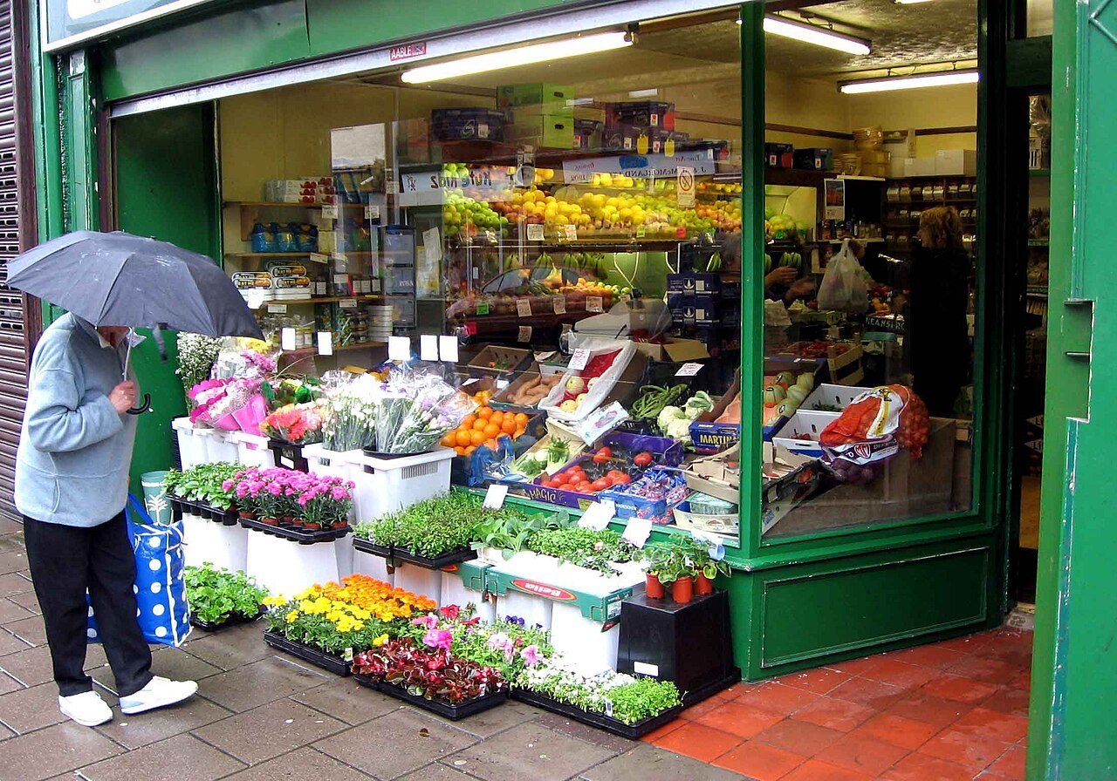
GRADE 7 · LESSON 17
Grammar: Stative Verbs
Grammatika: holat fe’llari (stative verbs)
Grammar: stative verbs
Dave souza · CC BY-SA 2.5
sozlar.com

Slide 2
LESSON AIMS
Bugungi maqsad
1
Complete the Learn this! box (a–e) and seven sentences with the correct tense (Solutions p.34 ex.3–4)
2
Complete a text-message chat with nine verbs (Solutions p.34 ex.5)
3
Sort fourteen shape and size words and describe an object for a partner to guess (Laser p.27 Wordpower)
4
Choose what three customers buy and complete six sentences (Laser p.27 Listening ex.1–2)

Slide 3
GRAMMAR
Form — present simple and present continuous
PRESENT SIMPLE
PRESENT CONTINUOUS
+
My sister hates football.
I’m reading a comic.
−
He doesn’t like fish.
I’m not watching TV.
?
Do you want an apple?
Are you listening?
Solutions p. 34 Learn this! (a–e): which tense goes with each use? Decide in ex.3 — then we check.

Slide 4
BOOK TASK · 12 MINUTES
Book tasks — Solutions Elementary, p. 34
Read Billy and Claire’s phone conversation (ex.2). Word list closed — try alone first.
1
ex.2 — Answer: What does Claire want to buy? Where is Joel? What does Billy invite Claire to do?
2
ex.3 — Complete the Learn this! box (a–e): present simple or present continuous?
3
ex.4 — Complete seven sentences, then match each one with rules a–e.
4
ex.5 — Text messages: buy · do · know · look · look · love · get · prefer · read.
5
Fast finishers / homework — Grammar Builder 3D, p.128 ex.6 (one simple, one continuous in each pair).

Slide 5
CHECK AND TEACH · 6 MINUTES
Answer key — Solutions Elementary, pp. 34 and 128
1
ex.2 1 a new top · 2 at home — he hates shopping · 3 to go to the cinema on Saturday
2
ex.3 a present simple · b present continuous · c present continuous · d present simple · e present simple
3
ex.4 1 ’s raining (b) · 2 are learning (c) · 3 Do … know (e) · 4 live (d) · 5 play (a)
4
ex.4 6 don’t understand (e) · 7 does … help (a)
5
ex.5 1 are … doing · 2 ’m looking · 3 loves · 4 know · 5 prefers · 6 buys · 7 reads · 8 Are … getting · 9 ’m looking
6
p.128 ex.6 1a Are … having · 1b Do … have · 2a ’m not wearing · 2b doesn’t wear · 3a stops · 3b is stopping

Slide 6
FOCUS
Holat fe’llari — nega «I’m wanting» xato?
QOIDA
QOIDA
Holat fe’llari harakatni emas, HOLATni bildiradi: his-tuyg‘u (like, love, hate, prefer), istak (want, need), fikr va bilim (know, understand, believe, mean).
Ular odatda continuous bo‘lmaydi, hatto «hozir» bo‘lsa ham: I want a drink now.
Present simple — odat va fakt: Joel never comes with me. Tigers live in India.
Present continuous — hozir yoki shu kunlarda: I’m looking for a new top.
Ikki ma’noli fe’llar: I think it’s small (fikr) / I’m thinking about it (jarayon); I have a bike / I’m having lunch.
look: You look tired (ko‘rinasan) / I’m looking for my keys (qidiryapman).

Slide 7
BOOK TASK · 3 MINUTES
Wordpower — Laser A1+, p. 27
ex.1: Complete the table — SHAPE or SIZE (small or big)? circular, small and big are done: sort the other fourteen.
1
small · circular · big · flat · gigantic · rectangular · huge · square · large
2
thick · little · narrow · round · thin · tiny · triangular · wide
3
ex.2 — Describe an object for your partner to guess (in the Speaking stage).

Slide 8
VOCABULARY
A. Likes and needs
👍️
like
yoqtirmoq
My brother doesn’t like loud music, so he’s wearing headphones.
😖️
hate
yomon ko‘rmoq, nafratlanmoq
Joel hates shopping, so he never comes with us.
🏀️
prefer
afzal ko‘rmoq
Football is OK, but I prefer basketball.
🥕️
need
kerak bo‘lmoq, muhtoj bo‘lmoq
I need some carrots for the soup.

Slide 9
VOCABULARY
B. Thinking, knowing and senses (1/2)
💭️
think (= have an opinion)
deb o‘ylamoq, deb hisoblamoq
I think this T-shirt is too small for you.
👂️
hear
eshitmoq
Shh! Do you hear that? Somebody is playing the piano next door.
🧠️
know
bilmoq
Do you know that boy over there? He’s in my class.
🤔️
believe
ishonmoq
I don’t believe you! Nobody can swim ten kilometres.

Slide 10
VOCABULARY
B. Thinking, knowing and senses (2/2)
📖️
mean
anglatmoq, ma’noni bildirmoq
What does ‘gigantic’ mean? — It means very, very big.
📝️
remember
esida bo‘lmoq, eslamoq
I don’t remember his phone number. Can you help me?
🤝️
agree
rozi bo‘lmoq, fikriga qo‘shilmoq
I don’t agree with you — I think the film is great.
😴️
look (= seem)
ko‘rinmoq (tashqi ko‘rinishdan)
Are you OK? You look tired today.

Slide 11
VOCABULARY
C. Shapes (1/2)
🔵️
round
dumaloq
We need a round table for our big family.
⭕️
circular
doira shaklidagi, aylana
The park has a circular path around the lake.
🟩️
square
kvadrat shaklidagi
I prefer square plates — they look modern.

Slide 12
VOCABULARY
C. Shapes (2/2)
🚪️
rectangular
to‘g‘ri to‘rtburchak shaklidagi
Our classroom has a big rectangular board on the wall.
🔺️
triangular
uchburchak shaklidagi
My little brother loves triangular sandwiches.
📺️
flat
yassi, tekis
I love my new tablet — it’s thin and flat.

Slide 13
VOCABULARY
D. Size (1/2)
🧳️
large
katta
I need a large bag for all these books.
🌱️
little
kichkina, kichkinagina
My grandma has a little garden behind her house.
🏢️
huge
ulkan, juda katta
The new shopping centre is huge! I don’t know where the shoe shop is.
🚢️
gigantic
bahaybat, juda ulkan
Look at that gigantic ship! I don’t believe it!
🐜️
tiny
jajji, juda kichkina
An ant is a tiny insect, but it’s very strong.

Slide 14
VOCABULARY
D. Size (2/2)
📚️
thick
qalin
This dictionary is very thick — it has two thousand pages.
🥞️
thin
yupqa
I prefer thin pancakes with honey.
🚶️
narrow
tor
Our street is very narrow, so big buses don’t go there.
🌉️
wide
keng
The river is very wide here, so we need a bridge.

Slide 15
VOCABULARY
E. In the shop (1/2)
🧑‍💼
a shop assistant
sotuvchi
The shop assistant is helping a customer at the moment.
💷️
cost
turmoq (narxi haqida)
How much does this T-shirt cost? — Twelve pounds.
💡️
suggest
taklif qilmoq, maslahat bermoq
The assistant suggests a cheaper T-shirt in a bigger size.
📕️
a bestseller
eng ko‘p sotilayotgan kitob (bestseller)
This book is a bestseller — everybody is reading it at the moment.

Slide 16
VOCABULARY
E. In the shop (2/2)
🍅️
tasty
mazali
I don’t like this soup — it isn’t very tasty.
🏬️
a department store
univermag, katta do‘kon
Try the department store — the clothes there don’t cost much.
📗️
a novel
roman (badiiy kitob)
My sister loves this novel — she’s reading it for the third time.
🎁️
a birthday present
tug‘ilgan kun sovg‘asi
I want to buy a birthday present for my best friend.

Slide 17
TASK 1 · EXAM FORMAT
Listening — choose A, B or C
Listen once. All three options are mentioned — choose what the speaker really says.
1
Conversation 1 (Laser p.27 ex.1): What does the customer buy?
A a pink skirt
B a pink T-shirt
C jeans
2
Conversation 2: What does the customer buy?
A tomatoes
B carrots
C bananas
3
Conversation 3: What does the customer buy?
A a football book
B Sun at Night
C The Second Man

Slide 18
TASK 2 · DETAILS
Second listening — complete the sentences
Listen again. Write a word, number or short phrase in each gap.
1
The customer is trying to find something for her friend for her ________.
2
At first, the customer thinks the T-shirt is too ________.
3
The assistant says Italian tomatoes are expensive but very ________.
4
The assistant suggests the customer goes to the ________.
5
The assistant says that Sun at Night is a ________.
6
The Second Man is a story about two ________ in London.

Slide 19
PRONUNCIATION
Say it — don’t just read it
Uzun so‘zlarda urg‘u qayerda? (Wordpower va holat fe’llari)
rectangular /rekˈtæŋɡjələ/
triangular /traɪˈæŋɡjələ/
circular /ˈsɜːkjələ/
gigantic /dʒaɪˈɡæntɪk/
narrow /ˈnærəʊ/
huge /hjuːdʒ/
prefer /prɪˈfɜː/
believe /bɪˈliːv/
prefer — urg‘u IKKINCHI bo‘g‘inda: pre-FER.

Slide 20
TEACHER · CHECK
Answer key — Laser A1+, p. 27
1
Wordpower ex.1 SHAPE: circular, flat, rectangular, square, round, triangular
2
Wordpower ex.1 SIZE (small): small, little, tiny, narrow, thin
3
Wordpower ex.1 SIZE (big): big, gigantic, huge, large, wide, thick
4
Listening ex.1 (our script): 1 B (T-shirt) · 2 B (carrots) · 3 C (The Second Man)
5
Listening ex.2 (our script): 1 (her) birthday · 2 small · 3 tasty · 4 supermarket · 5 bestseller · 6 (two) brothers (in London)
6
Listening keys fit OUR script only — the book CD 8 may differ. Hand out the vocabulary sheet after the listening.

Slide 21
WHOLE CLASS
Practice — complete the sentence (1/2)
1
Listen! Somebody ________ at the door. (knock)
2
My grandma ________ old songs. She sings them all the time! (love)
3
I ________ a new ruler — mine is broken. (need)
4
Sorry, I ________ this question. Can you explain it? (not / understand)
5
Look! Those children ________ in the snow. (play)
6
________ the answer to question 5? (you / know)

Slide 22
WHOLE CLASS
Practice — complete the sentence (2/2)
7
‘Do you like tea?’ ‘It’s OK, but I ________ juice.’ (prefer)
8
Mum ________ dinner right now, so she can’t come to the phone. (cook)
9
How much ________ this T-shirt ________? (cost)
10
My friends ________ for me at the moment — I must go! (wait)

Slide 23
PAIR / GROUP WORK · 4 MINUTES
Vocabulary activity
1
Match the beginnings (1-10) with the endings (a-j).
2
Read your complete sentences aloud.
3
Give the Uzbek meaning of the key word in each sentence.
4
When you finish, swap tables with the other group.

Slide 24
PAIRS · 5 MINUTES
Speaking
Laser p.27 Wordpower ex.2: describe an object (a bus, a lamp, a cake, a phone, a key, a balloon). Your partner guesses: Is it a TV? — Yes, it is!
Use state verbs in your clues: It looks … · We need it to … · Everybody knows it.
Laser p.27 ex.3 Talk about you: What are your favourite shops — is there a department store near you? Do you buy things on the internet? What is a good birthday present for your best friend?

Slide 25
LISTENING SCRIPT — USE AFTER THE TASKS
Listening script — three customers (1/3)
Conversation 1. In a clothes shop.
Assistant: Hello. Can I help you?
Customer: Yes, please. I’m trying to find something for my friend for her birthday. She loves pink.
Assistant: What about this pink skirt? It’s very popular this summer.
Customer: Hmm, I don’t think she wears skirts. What about this pink T-shirt? Oh, but I think it’s too small. She’s quite tall.
Assistant: We’ve got it in a bigger size. Here you are. And these jeans are on special offer.
Customer: No, thanks. She’s got lots of jeans. I prefer the T-shirt. How much does it cost?
Assistant: Twelve pounds.
Customer: Great. I’ll take it.
Conversation 2. At the grocer’s.
Show the script only after the listening tasks are checked.

Slide 26
LISTENING SCRIPT — USE AFTER THE TASKS
Listening script — three customers (2/3)
Customer: Hello. I want to make soup tonight. How much are the tomatoes?
Assistant: These Italian tomatoes are three pounds a kilo. They’re expensive, but they’re very tasty.
Customer: Three pounds! I don’t have a lot of money today.
Assistant: Well, the carrots are cheap this week — only fifty pence a kilo.
Customer: Good. I need some carrots for the soup. A kilo, please. Oh, and have you got any bananas? My little brother loves them.
Assistant: Sorry, we haven’t got any bananas today. Why don’t you go to the supermarket? It’s next to the bank.
Customer: OK, thanks. Just the carrots, then.
Conversation 3. In a bookshop.
Show the script only after the listening tasks are checked.

Slide 27
LISTENING SCRIPT — USE AFTER THE TASKS
Listening script — three customers (3/3)
Customer: Excuse me. I’m looking for a book for my dad. He likes stories about cities.
Assistant: Do you know Sun at Night? It’s a bestseller — everybody is reading it at the moment.
Customer: Hmm, I think he’s got it. And he doesn’t want any more football books — he’s got hundreds! What’s this one?
Assistant: That’s The Second Man. It’s a story about two brothers in London.
Customer: Oh, he loves London! How much is it?
Assistant: Eight pounds.
Customer: Perfect. I’ll take it.
Show the script only after the listening tasks are checked.

Slide 28
LISTENING SCRIPT — USE AFTER THE TASKS
Listen and answer
1
After reading the script: find four state verbs in Conversation 1 (not in the continuous).
2
Why does the customer say ‘I need some carrots’, not ‘I’m needing’?
3
Everybody is reading it at the moment. Why the present continuous?
4
Why can’t the second customer buy bananas?

Slide 29
PAIRS · ESDA QOLDIMI?
Memory check — simple or continuous?
Men gapni boshlayman, siz to‘g‘ri shakl bilan tugating va sababini ayting.
1
I … (need) a large bag for my books.
2
Look! The shop assistant … (wrap) a birthday present.
3
She … (not remember) my phone number.
4
… you … (agree) with me?
5
How much … this novel … (cost)?

Slide 30
UZ
Qiyin joyi — o‘zbekcha
Holat fe’llari «-yap» bilan tarjima qilinsa ham inglizchada simple: «tushunyapman» — I understand; ✗ I’m understanding.
want, need, like, love, hate, prefer — istak va his: I want it now; ✗ I’m wanting.
know, believe, mean — bilim va fikr: Do you know him?; ✗ Are you knowing.
think: «menimcha» — I think; «o‘ylayapman» (jarayon) — I’m thinking about it.
have: «menda bor» — I have; «tushlik qilyapman» — I’m having lunch.

Slide 31
HOMEWORK
Uy vazifasi
1
Laser A1+ Workbook p. 20, ex. 1–2. Note: the Workbook Listening on p. 20 needs CD Track 3, which we don’t have — skip it.
2
Grammar Builder 3D, Solutions p. 128 ex. 6 (if you didn’t do it in class).
3
Learn the 35 items with the flashcards: sozlar.com/vocab/cards/?set=grade7-lesson17
4
Write six sentences about you and your family: three with state verbs (I like, I need, my dad knows…) and three about what you are doing this week.

Slide 32
IMAGE CREDITS
Rasmlar manbasi
cover
Dave souza · CC BY-SA 2.5 · https://commons.wikimedia.org/wiki/File:Gourock_greengrocers_ext.jpg

Slide 33
Uchta so‘z — ertaga ham esingizda qoladi
Juftingizga ayting, so‘ng daftaringizga yozib qo‘ying.
sozlar.com/vocab/cards/?set=grade7-lesson17

