Slide 1
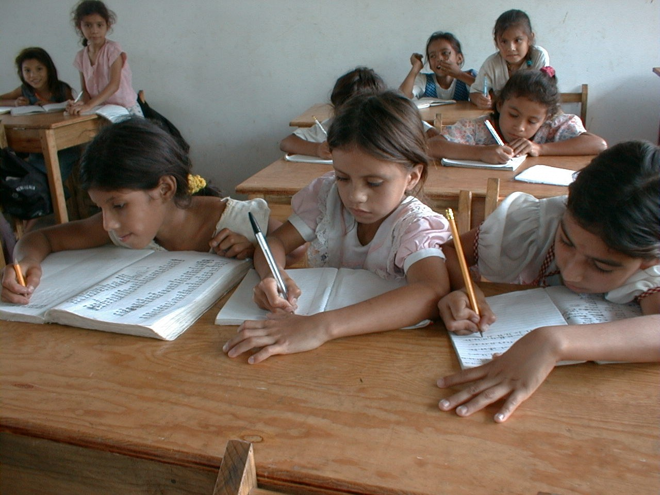
GRADE 8 · LESSON 16
Grammar Review: Units 1–2
Grammatika takrori: 1–2-bo‘lim
Grammar review (Unit 1-2)
Zack Clark · Public domain
sozlar.com

Slide 2
LESSON AIMS
Bugungi maqsad
1
Choose present simple or present continuous (p. 23 ex. 5)
2
Write the past simple of regular verbs, including -y → -ied and doubling (ex. 6)
3
Use ten common irregular past forms (ex. 7)
4
Make negatives with didn't + infinitive

Slide 3
VOCABULARY
A. Routines: present simple (1/2)
🏫️
get to school
maktabga yetib bormoq
I usually get to school ten minutes before the first lesson.
🌙️
go to bed
uxlashga yotmoq
On school nights I go to bed at about ten o’clock.
🍳️
have breakfast
nonushta qilmoq
We have breakfast together in the kitchen at seven.
🍛️
have supper
kechki ovqatni yemoq
Our family has supper together at about seven o’clock.

Slide 4
VOCABULARY
A. Routines: present simple (2/2)
📺️
watch TV
televizor ko‘rmoq
We watch TV together after supper on Friday evenings.
🐕️
walk the dog
itni sayrga olib chiqmoq
Every evening I walk the dog in the park.
👵️
visit my grandparents
bobom va buvimnikiga bormoq
We usually visit my grandparents in the village on Sundays.
🙆️
get up
o‘rnidan turmoq (yotoqdan)
My grandfather gets up at five and goes for a walk.

Slide 5
VOCABULARY
B. Right now: present continuous (1/2)
🎧️
listen to music
musiqa tinglamoq
Right now my sister is listening to music in her room.
🍲️
have lunch
tushlik qilmoq
Malika is having lunch with her cousins at the moment.
🏀️
play basketball
basketbol o‘ynamoq
Jasur is playing basketball in the school yard now.
⏳️
at the moment
ayni paytda, hozir
At the moment I’m learning to swim.

Slide 6
VOCABULARY
B. Right now: present continuous (2/2)
⏱️
right now
hozirning o‘zida
Don’t call Aziza — she’s doing her homework right now.
🫂️
a best friend
eng yaqin do‘st
My best friend is learning Korean at the moment.
🧒️
a cousin
amakivachcha, xolavachcha
My cousin Rustam is staying with us this week.
👖️
trousers
shim
He’s wearing a white shirt and grey trousers.

Slide 7
VOCABULARY
C. Past simple: regular verbs (1/2)
🏠️
stay at home
uyda qolmoq
It was cold and rainy, so I stayed at home all day.
🎮️
play video games
video o‘yin o‘ynamoq
My little brother played video games for two hours yesterday.
🎾️
play tennis
tennis o‘ynamoq
Nodira played tennis with her dad on Sunday morning.
🎻️
learn to play an instrument
cholg‘u chalishni o‘rganmoq
Last year Bekzod decided to learn to play an instrument.

Slide 8
VOCABULARY
C. Past simple: regular verbs (2/2)
✅️
pass an exam
imtihondan o‘tmoq
I studied every day and passed the exam!
📅️
last week
o‘tgan hafta
Our teacher showed us a new board game last week.
🕰️
a year ago
bir yil oldin
We moved to Tashkent a year ago.
📜️
in the past
ilgari, avvallari
In the past my dad played football for a team in Andijan.

Slide 9
VOCABULARY
D. Past simple: irregular verbs (1/3)
🍿️
see a film
film ko‘rmoq
We saw a film about a boy and his dog.
🎤️
go to a concert
konsertga bormoq
Last summer our class went to a concert in the city park.
📚️
have a lot of homework
uy vazifasi ko‘p bo‘lmoq
I couldn’t play football because I had a lot of homework.
👫️
have friends round
do‘stlarni uyga chaqirmoq
On Wednesday we had friends round and watched a football match.

Slide 10
VOCABULARY
D. Past simple: irregular verbs (2/3)
🛹️
go skateboarding
skeytbordda uchishga bormoq
Yesterday I went skateboarding in the park with my cousin.
🌃️
last night
kecha kechqurun
Last night I read a comic until ten o’clock.
🥱️
fall asleep
uxlab qolmoq
My little brother fell asleep on the sofa during the film.
📧️
an email
elektron xat
I got a long email from my cousin in Samarkand this morning.

Slide 11
VOCABULARY
D. Past simple: irregular verbs (3/3)
🌆️
spend the evening
oqshomni o‘tkazmoq
Last night I spent the evening with my grandparents.
🎟️
a ticket
chipta
I bought two tickets for the concert on Saturday.
🍽️
go out to a restaurant
restoranga borib ovqatlanmoq
For my mum’s birthday we went out to a restaurant in the centre.

Slide 12
TODAY'S WORDS IN CONTEXT
Three tenses in one day (1/2)
Every school day Kamola gets up early. She usually has breakfast at seven and she goes to bed late only at the weekend. She plays volleyball twice a week and she hardly ever misses a training session — this is her routine, so we use the present simple.
But look at her now! It's four o'clock and she is doing her homework. Her brother is playing football in the yard, her mother is having lunch, and her father is watching TV. All of this is happening right now, so we use the present continuous.
Cover the word list. Can you understand the words in bold from the sentence?

Slide 13
TODAY'S WORDS IN CONTEXT
Three tenses in one day (2/2)
And yesterday? Kamola studied for a test, watched a short film and decided to call her cousin. She wanted to go out, but it rained, so she stayed at home. These are regular verbs: we just add -ed.
Some verbs change completely. Yesterday she went to the library, took two books, saw her friend there and they had a long talk. Her friend bought a notebook and gave it to her. These are the irregular verbs — you have to learn them one by one.
Cover the word list. Can you understand the words in bold from the sentence?

Slide 14
TODAY'S WORDS IN CONTEXT
Read and answer
1
Which tense do we use for a routine?
2
Which tense do we use for something happening now?
3
Find four regular past forms in the text.
4
Find four irregular past forms in the text.
5
Why is 'is doing her homework' not the present simple?
6
How do we make the past of regular verbs?

Slide 15
PAIRS · ESDA QOLDIMI?
Memory check — fe’l jadvali
O‘qituvchi birikmani aytadi, siz uni o‘tgan zamonda aytasiz (see a film → saw a film).
1
see a film · go to a concert · have friends round · fall asleep · spend the evening · buy a ticket
2
stay at home · play tennis · pass an exam · walk the dog · watch TV · listen to music
3
Inkorini ayting: he / not / watch TV last night.

Slide 16
FOCUS
Qaysi zamon? Uch savol
QOIDA
QOIDA
Har kuni / odatda / haftasiga ikki marta → present simple: He plays football every Thursday.
Hozir / ayni damda → present continuous: I am reading a book at the moment.
Kecha / o‘tgan hafta → past simple: We watched TV last night.
To‘g‘ri fe’l: -ed. Imlo: study → studied, stop → stopped, like → liked.
Inkor: didn't + fe’lning ODDIY shakli — didn't watch, didn't come (❌ didn't watched).

Slide 17
STRATEGY
Fe’lni tanlash — uch qadam
1
Vaqt so‘zini toping: every day? now? last night?
2
Zamonni tanlang shu so‘zga qarab.
3
Shaklni yozing: -s / am-is-are + -ing / -ed yoki noto‘g‘ri shakl.

Slide 18
BOOK TASK · 14 MINUTES
Book task — Laser A2, p. 23
Faqat grammatika mashqlari; lug‘at qismi 15-darsda o‘tildi.
1
ex.5 Present simple yoki present continuous (6 ta gap).
2
ex.6 Past simple: to‘g‘ri fe’llar (5 ta gap).
3
ex.7 «Before the internet» matni — 12 ta noto‘g‘ri fe’l.
4
Matn takrorni ham beradi: internetdan oldingi hayot.

Slide 19
PRONUNCIATION
Say it — don’t just read it
-ed uch xil o‘qiladi:
watched TV /wɒtʃt ˌtiːˈviː/
passed an exam /pɑːst ən ɪɡˈzæm/
walked the dog /wɔːkt ðə dɒɡ/
played tennis /pleɪd ˈtenɪs/
stayed at home /steɪd ət həʊm/
listened to music /ˈlɪsnd tə ˈmjuːzɪk/
visited my grandparents /ˈvɪzɪtɪd maɪ ˈɡrænpeərənts/
Qoida: t yoki d bilan tugagan fe’ldan keyin /ɪd/ qo‘shiladi.

Slide 20
WHOLE CLASS
Practice — complete the sentence (1/2)
1
I ________ (read) a great book at the moment.
2
He ________ (play) football every Thursday evening.
3
What time ________ ________ ________ (you / get up) on Sundays?
4
We ________ ________ (not / go) to school on Saturdays.
5
Dad ________ ________ (not / watch) TV right now.
6
I ________ (ask) my mum and dad but they said no.

Slide 21
WHOLE CLASS
Practice — complete the sentence (2/2)
7
Tony ________ (want) to go skateboarding but the weather was bad.
8
We ________ ________ (not / watch) TV last night.
9
She ________ (study) for two hours and then ________ (stop).
10
Before the internet people ________ (write) letters and ________ (take) them to the post office.
11
No-one ________ (buy) things online because there ________ (not / be) any websites!
12
When kids ________ (do) projects, they ________ (go) to the library.

Slide 22
PAIRS
Speaking
Juftlikda: «Hozir nima qilyapsan?» va «Odatda shu payt nima qilasan?» — ikki zamonni yonma-yon ishlating.
«Kecha» o‘yini: juftingiz birikmani aytadi (go to a concert), siz o‘tgan zamonda gap tuzasiz (I went to a concert last week).

Slide 23
PAIR / GROUP WORK · 6 MINUTES
Vocabulary activity
1
Match the beginnings (1-10) with the endings (a-j).
2
Read your complete sentences aloud.
3
Give the Uzbek meaning of the key word in each sentence.
4
When you finish, swap tables with the other group.

Slide 24
UZ
Qiyin joyi — o‘zbekcha
Bu dars YANGI so‘z bermaydi — kartalar 1–13-darslardan takror, har birining misoli shu uch zamonda.
present simple — odat va umumiy holat; present continuous — aynan hozir sodir bo‘layotgan ish.
O‘tgan zamon inkori: didn't + oddiy shakl. Fe’l ikki marta o‘zgarmaydi.
Noto‘g‘ri fe’llarni yodlash kerak — qoidasi yo‘q. 9-darsdagi o‘nta eng kerakligidan boshlang.

Slide 25
HOMEWORK
Uy vazifasi
1
1–2-bo‘lim grammatikasini takrorlang: present simple, present continuous, past simple (kalendar reja).
2
Shu zamonlarda 10 ta gap yozing (kalendar reja).
3
Learn the 35 items with the flashcards: sozlar.com/vocab/cards/?set=grade8-lesson16

Slide 26
IMAGE CREDITS
Rasmlar manbasi
cover
Zack Clark · Public domain · https://commons.wikimedia.org/wiki/File:School_girls_write_in_their_exercise_books,_San_Ramón,_Choluteca,_Honduras.jpg

Slide 27
Uchta so‘z — ertaga ham esingizda qoladi
Juftingizga ayting, so‘ng daftaringizga yozib qo‘ying.
sozlar.com/vocab/cards/?set=grade8-lesson16

