Slide 1
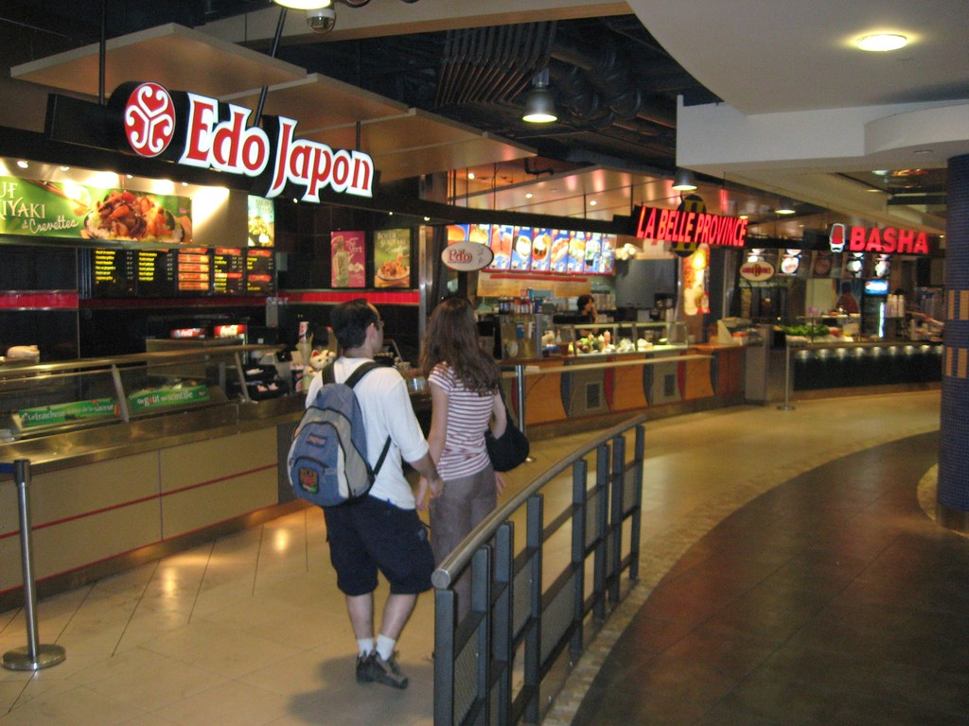
GRADE 7 · LESSON 16
Grammar: Present Continuous
Grammatika: Present Continuous (hozirgi davomli zamon)
Grammar: present continuous
Danny Haak · CC BY-SA 2.0
sozlar.com

Slide 2
LESSON AIMS
Bugungi maqsad
1
Find and correct the mistakes in eight sentences (ex. 1)
2
Write the verbs in the present continuous in eight sentences (ex. 2)
3
Complete Matt’s phone call with nine verbs (ex. 3)
4
Ask and answer Are you …ing? questions in a mime game

Slide 3
GRAMMAR
Form — present continuous
POSITIVE ( + )
NEGATIVE ( − )
I
I am (’m) having fun.
I am not (’m not) having fun.
she
She is (’s) having fun.
She isn’t having fun.
they
They are (’re) having fun.
They aren’t having fun.
?
Are you having fun? — Yes, I am.
Is he having fun? — No, he isn’t.
-ing: eat → eating · dance → dancing · stop → stopping. Signal words: now, right now, at the moment (Grammar database 5, p. 147).

Slide 4
BOOK TASK · 17 MINUTES
Book tasks — Laser A1+, p. 26
Books open, word list closed. Try alone first — then check with Grammar database 5, p. 147.
1
ex.1 — Tick (✓) the correct sentences. Underline the mistake in the others and correct it.
2
ex.2 — Write the verbs in the present continuous (eight sentences).
3
ex.3 — Matt is on the phone at the shopping centre. Complete the text with the verbs.
4
ex.3 verbs — come · go · stand · take · turn · wait · walk · wave · wear (some twice).

Slide 5
CHECK AND TEACH · 8 MINUTES
Answer key — Laser A1+, p. 26 (1/2)
1
ex.1 correct: 1, 7 · 2 Are you having · 3 Jim isn’t buying · 4 Are the boys waiting
2
ex.1 5 My mum is (mum’s) shopping · 6 People aren’t spending · 8 The shop is closing
3
ex.2 1 ’m having · 2 are building · 3 aren’t listening · 4 Are you looking
4
ex.2 5 ’s paying · 6 ’re wasting · 7 ’m talking · 8 Is he getting
5
ex.3 1 ’m waiting · 2 ’re standing · 3 ’m coming · 4 ’m taking · 5 ’m turning
6
ex.3 6 ’m walking · 7 ’m going · 8 ’m turning · 9 Are you wearing · 10 ’re waving

Slide 6
CHECK AND TEACH · 8 MINUTES
Answer key — Laser A1+, p. 26 (2/2)
7
Quick check (p. 147) 1 Tim’s doing · 2 Yes, I am · 3 are you doing · 4 Are · 5 it’s raining

Slide 7
FOCUS
Present continuous — qachon va qanday?
QOIDA
QOIDA
am / is / are + fe’l-ing — ayni damda bo‘layotgan ish: I’m having so much fun!
Shu kunlarda (vaqtincha) davom etayotgan ish: No crisps, thanks. I’m trying to eat healthy food.
Inkor: ’m not / isn’t / aren’t + -ing: They aren’t listening.
So‘roq: am / is / are oldinga chiqadi: Are you getting bored? Qisqa javobda -ing yo‘q: Yes, I am.
Signal so‘zlar: now, right now, at the moment, these days, Look!, Listen!
Imlo: eat → eating · dance → dancing · stop → stopping.

Slide 8
VOCABULARY
A. Money, time and everyday actions (1/2)
🏦️
save money
pul yig‘moq
I’m saving money for a new bike this year.
💸️
spend money
pul sarflamoq
My sister is spending money on clothes again!
💳️
pay for
haqini to‘lamoq
Dad is paying for our tickets at the cash desk.
⏳️
waste time
vaqtni behuda o‘tkazmoq
Come on! We’re wasting time and the film starts soon.

Slide 9
VOCABULARY
A. Money, time and everyday actions (2/2)
🏗️
build
qurmoq
They’re building a new school in our street.
🔒️
close
yopilmoq
Quick! The shop is closing in five minutes.
⏰️
hurry up
shoshilmoq, tezroq bo‘lmoq
Hurry up! Everybody is waiting for us.
💌️
invite
taklif qilmoq
Aziza is inviting all her friends to her birthday party.

Slide 10
VOCABULARY
B. Finding your way (1/2)
🔼️
take the escalator
eskalatorda chiqmoq (tushmoq)
We’re taking the escalator to the second floor.
⬅️
turn left
chapga burilmoq
The bus is turning left at the traffic lights.
🔄️
turn around
orqaga o‘girilmoq
Aziz is turning around to look at the shop window.
🚶️
walk past
yonidan o‘tib ketmoq
I’m walking past the toy shop now.

Slide 11
VOCABULARY
B. Finding your way (2/2)
↩️
go the wrong way
noto‘g‘ri tomonga ketmoq
Oh no, we’re going the wrong way — the cinema is behind us.
🧍️
stand
tik turmoq
Bobur is standing next to the lift.
👋️
wave
qo‘l silkitmoq
Look! Grandpa is waving at us from the window.
🏃️
come
kelmoq
Wait for me — I’m coming!

Slide 12
VOCABULARY
C. Free time and actions (1/2)
💃️
dance
raqsga tushmoq
Look! Those girls are dancing on the stage.
🎤️
sing
qo‘shiq aytmoq
My little sister is singing in the bathroom again!
😊️
smile
jilmaymoq
Why are you smiling? What’s funny?
🛑️
stop
to‘xtamoq
The bus is stopping — let’s get off!
🥁️
play the drums
baraban chalmoq
My brother is playing the drums — it’s so noisy!

Slide 13
VOCABULARY
C. Free time and actions (2/2)
☀️
sit in the sun
quyoshda o‘tirmoq
The cats are sitting in the sun in the garden.
🌞️
shine
porlamoq, charaqlamoq
The sun is shining — let’s go to the park!
👜️
hold
ushlab turmoq
I’m holding your bag — don’t worry!
⛸️
skate
konkida uchmoq
The children are skating on the ice in the park.
⛷️
ski
chang‘ida uchmoq
We’re skiing in Chimgan this week.

Slide 14
VOCABULARY
D. Now and these days
🕐️
at the moment
ayni paytda
At the moment Malika is reading in the library.
⏱️
right now
hozirning o‘zida
I can’t talk right now — I’m having lunch.
📅️
these days
shu kunlarda
These days I’m reading a great book about space.

Slide 15
PRONUNCIATION
Say it — don’t just read it
-ing oxiri /ɪŋ/ — «g» alohida eshitilmaydi; walk dagi «l» o‘qilmaydi:
coming /ˈkʌmɪŋ/
waving /ˈweɪvɪŋ/
building /ˈbɪldɪŋ/
skiing /ˈskiːɪŋ/
shining /ˈʃaɪnɪŋ/
smiling /ˈsmaɪlɪŋ/
hurry up /ˌhʌri ˈʌp/
walk past /ˌwɔːk ˈpɑːst/
Say it fast: What are you doing? /ˈwɒt ə jə ˈduːɪŋ/

Slide 16
WHOLE CLASS
Practice — complete the sentence (1/2)
1
Listen! Somebody ________ the drums in the music room. (play)
2
My parents ________ money for our summer holiday. (save)
3
Look! The children ________ on the frozen lake. (skate)
4
________ the escalator to the cinema? (you / take)
5
Dilshod ________ his pocket money — he’s saving it for a bike! (not / spend)
6
Why ________ at me? Is there something on my face? (you / smile)

Slide 17
WHOLE CLASS
Practice — complete the sentence (2/2)
7
We ________ in the sun in the garden right now. (sit)
8
The shops ________ yet — it’s only six o’clock. (not / close)
9
‘Is your sister singing?’ ‘No, she ________. She’s talking on the phone.’
10
These days my uncle ________ a new house for his family. (build)

Slide 18
PAIR / GROUP WORK · 5 MINUTES
Vocabulary activity
1
Match the beginnings (1-10) with the endings (a-j).
2
Read your complete sentences aloud.
3
Give the Uzbek meaning of the key word in each sentence.
4
When you finish, swap tables with the other group.

Slide 19
PAIRS, THEN THE WHOLE CLASS · 4 MINUTES
Speaking
Mime game (Solutions p.32 ex.7): mime an action — dance, sing, play the drums, skate, ski. Your partner guesses: Are you dancing? — Yes, I am. / No, I’m not.
Fast finishers: Grammar database p.147 Quick check — choose the correct word or phrase (5 items).
Ask your partner three questions: Are you sitting near the window? Are you holding a pen? Are you smiling?

Slide 20
TODAY'S WORDS IN CONTEXT
Messages from the shopping centre
Malika: Hi, Aziz! Where are you? We’re waiting for you outside the bookshop.
Aziz: Sorry! I’m coming. I’m standing in a long queue at the grocer’s — Mum wants some apples.
Malika: OK. Kamola is here too. She’s wearing her new red jacket. We’re eating ice cream.
Aziz: Lucky you! Is Bobur coming too?
Malika: No, he isn’t. He’s doing his homework at home.
Aziz: OK. Now I’m walking past the toy shop… and I’m taking the escalator. Can you see me? I’m waving!
Malika: Yes, I can see you! Hurry up! The film starts in ten minutes.
Cover the word list. Can you understand the words in bold from the sentence?

Slide 21
TODAY'S WORDS IN CONTEXT
Read and answer
1
Where are Malika and Kamola waiting?
2
Why is Aziz late?
3
What is Kamola wearing?
4
What is Bobur doing?
5
Find one question and one short answer in the present continuous.

Slide 22
PAIRS · ESDA QOLDIMI?
Memory check — what’s happening?
Men o‘zbekcha aytaman, siz inglizcha present continuous bilan aytasiz.
1
Men hozir kelyapman. → I …
2
U (qiz) qo‘l silkityapti. → She …
3
Ular pul sarflashmayapti. → They …
4
Sen raqsga tushyapsanmi? → …?
5
stop → ? · shine → ? · ski → ?

Slide 23
UZ
Qiyin joyi — o‘zbekcha
Present continuous o‘zbekchadagi «-yap» ga yaqin: I’m reading — «o‘qiyapman».
am / is / are tushib qolmaydi: I am going; ✗ I going.
So‘roqda do ishlatilmaydi: Are you having fun?; ✗ Do you having fun?
Qisqa javobda -ing yo‘q: Yes, I am. / No, she isn’t.; ✗ Yes, I am having.
Imlo: -e tushadi (dancing), qisqa unli + undosh ikkilanadi (stopping, running).

Slide 24
HOMEWORK
Uy vazifasi
1
Laser A1+ Workbook pp. 19–20, ex. 1–4.
2
Learn the 29 items with the flashcards: sozlar.com/vocab/cards/?set=grade7-lesson16
3
Write six sentences: what three people in your family are doing right now, and what they aren’t doing.

Slide 25
IMAGE CREDITS
Rasmlar manbasi
cover
Danny Haak · CC BY-SA 2.0 · https://commons.wikimedia.org/wiki/File:Food_court_edo_japan_la_belle_province_basha.jpg

Slide 26
Uchta so‘z — ertaga ham esingizda qoladi
Juftingizga ayting, so‘ng daftaringizga yozib qo‘ying.
sozlar.com/vocab/cards/?set=grade7-lesson16

