Slide 1
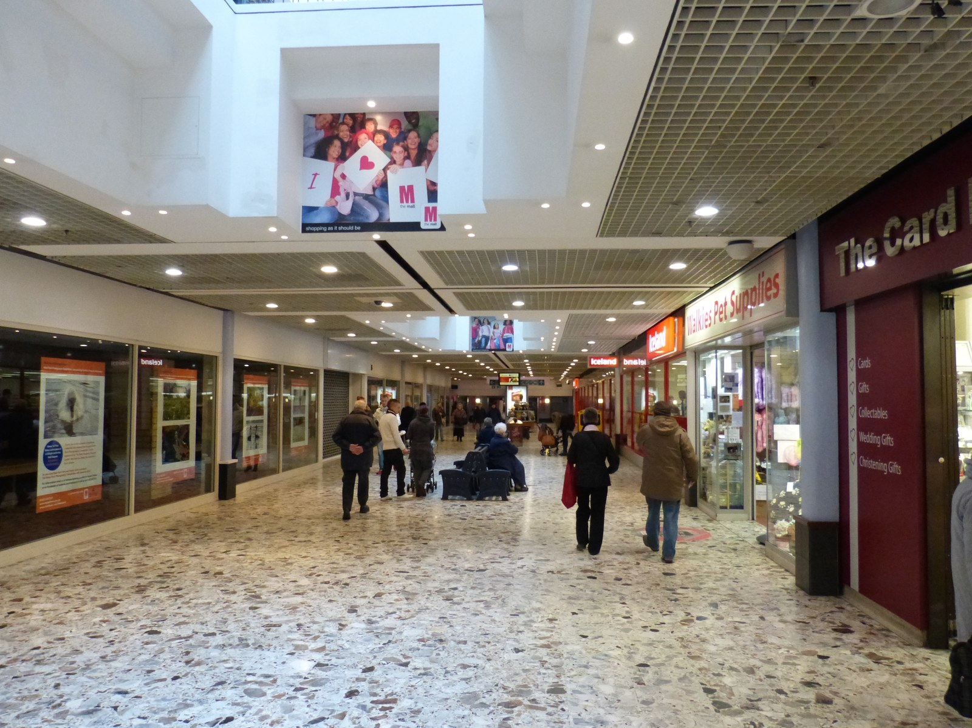
GRADE 7 · LESSON 15
Unit 3. Reading: Going shopping
3-bo‘lim. O‘qish: Xarid qilish
Unit 3. Reading: Going shopping
Les Chatfield from Brighton, England · CC BY 2.0
sozlar.com

Slide 2
LESSON AIMS
Bugungi maqsad
1
Match eight shops with the things you buy there (ex. 1)
2
Answer four 'Who?' questions about the dialogue (G or L)
3
Decide if six statements about the dialogue are true or false
4
Say which statement about shopping they agree with and why (ex. 3)

Slide 3
VOCABULARY
A. Shops (1/3)
📚️
a bookshop
kitob do‘koni
I buy my school books at the bookshop near our house.
🥩️
a butcher’s
qassob do‘koni
Mum buys meat at the butcher’s on Saturdays.
👗️
a clothes shop
kiyim do‘koni
There’s a new clothes shop in our shopping centre.
💐️
a florist’s
gul do‘koni
Let’s buy some roses for Mum at the florist’s.

Slide 4
VOCABULARY
A. Shops (2/3)
🍎️
a grocer’s
oziq-ovqat do‘koni
We buy apples and tomatoes at the grocer’s.
🎸️
a music shop
musiqa do‘koni
Jasur wants a new guitar from the music shop.
👟️
a shoe shop
poyabzal do‘koni
I need new trainers. Let’s go to the shoe shop.
🧸️
a toy shop
o‘yinchoq do‘koni
My little brother loves the toy shop — he wants everything!

Slide 5
VOCABULARY
A. Shops (3/3)
🏬️
a shopping centre
savdo markazi
There are fifty shops in the new shopping centre.
🛒️
a supermarket
supermarket
We buy milk and bread at the supermarket.
🥖️
a baker’s
novvoyxona
Grandma buys fresh bread at the baker’s every morning.

Slide 6
VOCABULARY
B. At the shopping centre (1/2)
👥️
a customer
xaridor
The shop is full of customers on Saturday.
🚶️
busy
gavjum, odam ko‘p
The market is very busy on Sunday mornings.
🛗️
a lift
lift
Let’s take the lift to the top floor.
🪜️
an escalator
eskalator
The escalator goes up to the cinema.
🏢️
a floor
qavat
The food court is on the top floor of the building.

Slide 7
VOCABULARY
B. At the shopping centre (2/2)
🪑️
a bench
o‘rindiq, skameyka
We sit on a bench and eat ice cream.
🏷️
a special offer
maxsus taklif, aksiya
There’s a special offer: two T-shirts for the price of one!
🔖️
a sale
chegirmali savdo
I buy my winter coat in the January sale.
😮‍💨
rest
dam olmoq
My feet hurt. Let’s sit down and rest for a minute.

Slide 8
VOCABULARY
C. Buying things (1/2)
💎️
expensive
qimmat
This watch is very expensive.
🪙️
cheap
arzon
The bananas are cheap at the market today.
🔍️
look for
qidirmoq
I always look for cheap books at the market.
💰️
sell
sotmoq
That shop sells phones and laptops.

Slide 9
VOCABULARY
C. Buying things (2/2)
🎨️
match
mos kelmoq, yarashmoq
Your bag matches your shoes!
📏️
a size
o‘lcham
These shoes are the wrong size — can I try a bigger pair?
👖️
try on
kiyib ko‘rmoq
Can I try on these jeans, please?

Slide 10
VOCABULARY
D. How do you feel?
🥳️
enjoy yourself
maza qilmoq, zavqlanmoq
We always enjoy ourselves at the shopping centre.
🥱️
get tired
charchab qolmoq
I always get tired after two hours of shopping.
😴️
get bored
zerikib qolmoq
My brother gets bored in clothes shops.
🍔️
get hungry
qorni ochib qolmoq
We always get hungry after shopping, so we go to a café.

Slide 11
TODAY'S WORDS IN CONTEXT
Grace and Lily go shopping (1/2)
Grace: I'm having so much fun! It's great to be out shopping. Thanks for coming with me.
Lily: That's OK. I don't normally like shopping very much, but I'm enjoying myself. I'm getting some good ideas for my dad's birthday next week. The music shop has a CD he wants, and there are one or two good books in the bookshop.
Grace: The shopping centre's busy, isn't it? There are so many customers in every shop! I'm feeling a bit tired now.
Lily: Me too. Here's a bench. Let's sit down for a minute and rest. Now, what are we looking for?
Cover the word list. Can you understand the words in bold from the sentence?

Slide 12
TODAY'S WORDS IN CONTEXT
Grace and Lily go shopping (2/2)
Grace: Well, I need some clothes for Jacob's party. Everything is so expensive, though, and I don't have a lot of money. And you need new shoes.
Lily: Yes. The ones I have are fine, but they don't match my skirt. I'm looking for some red ones.
Cover the word list. Can you understand the words in bold from the sentence?

Slide 13
TODAY'S WORDS IN CONTEXT
Read and answer
1
Who doesn't usually enjoy shopping?
2
Who is looking for things for someone else?
3
Why does Grace worry about the clothes?
4
Why does Lily need new shoes?

Slide 14
PAIRS · ESDA QOLDIMI?
Memory check — which shop?
Men narsani aytaman, siz do‘konni ayting.
1
meat → ?
2
flowers → ?
3
a CD → ?
4
a teddy bear → ?
5
trainers → ?

Slide 15
FOCUS
Two things to notice on p. 25
• get + sifat = «…ib qolmoq», ya’ni boshlanish: get tired, get bored, get hungry.
• Do‘kon nomlarida 's: the butcher's, the florist's, the grocer's — «qassobning do‘koni» degani.
• enjoy yourself — o‘zlik olmoshi bilan: I enjoy myself, she enjoys herself.
• Let's + fe’l — taklif: Let's sit down.

Slide 16
BOOK TASK · 15 MINUTES
Book tasks — Laser A1+, pp. 24–25
Unit 3: Going shopping.
1
p.24 ex.1 — narsani do‘kon bilan moslang (8 ta do‘kon).
2
Dialogni o‘qing va G (Grace) yoki L (Lily) deb yozing.
3
p.25 ex.2 — gaplar to‘g‘ri (T) yoki noto‘g‘ri (F)?
4
p.25 ex.3 — «Talk about you»: qaysi fikrga qo‘shilasiz?
5
Wordpower! — 7 ta so‘zning harflarini to‘ldiring.

Slide 17
PRONUNCIATION
Say it — don’t just read it
Qiyin so‘zlar: do‘kon nomlaridagi ’s /z/ yoki /s/ bo‘lib o‘qiladi; busy dagi «u» — /ɪ/:
butcher’s /ˈbʊtʃəz/
florist’s /ˈflɒrɪsts/
grocer’s /ˈɡrəʊsəz/
baker’s /ˈbeɪkəz/
busy /ˈbɪzi/
customer /ˈkʌstəmə/
escalator /ˈeskəleɪtə/
expensive /ɪkˈspensɪv/

Slide 18
WHOLE CLASS
Practice — complete the sentence (1/2)
1
You buy meat at the ________.
2
You buy flowers at the ________.
3
When a place is ________, there are lots of people in it.
4
The people in a shop who want to buy things are the ________.
5
Something that is ________ costs a lot to buy.
6
Something that is ________ doesn't cost a lot to buy.

Slide 19
WHOLE CLASS
Practice — complete the sentence (2/2)
7
The ________ isn't working today, so let's take the escalator.
8
I'm not getting bored, but I'm getting ________!

Slide 20
PAIR / GROUP WORK · OPTIONAL
Vocabulary activity
1
Match the beginnings (1-10) with the endings (a-j).
2
Read your complete sentences aloud.
3
Give the Uzbek meaning of the key word in each sentence.
4
When you finish, swap tables with the other group.

Slide 21
PAIRS
Speaking
Ex.3 — «Do you like shopping in shopping centres? Why?» juftlikda javob bering.
To‘rtta fikrdan qaysi biriga qo‘shilasiz? (I love shopping! / Shopping is OK, but… / I hate shopping!)
«Where do you buy…?» — juftingiz narsani aytadi, siz do‘konni.

Slide 22
UZ
Qiyin joyi — o‘zbekcha
Do‘kon nomlarida 's — «kimningdir do‘koni»: butcher's, florist's, grocer's.
get + sifat — holatning boshlanishi: get tired = charchay boshlamoq.
enjoy fe’li o‘zlik olmoshini talab qiladi: enjoy myself / yourself.
customer — xaridor, shop assistant — sotuvchi.

Slide 23
HOMEWORK
Uy vazifasi
1
Laser A1+ Workbook pp. 17–18 ex. 1–4.
2
Learn the 31 items with the flashcards: sozlar.com/vocab/cards/?set=grade7-lesson15
3
Write six sentences: where you buy five things, and one sentence about how you feel when you shop.

Slide 24
IMAGE CREDITS
Rasmlar manbasi
cover
Les Chatfield from Brighton, England · CC BY 2.0 · https://commons.wikimedia.org/w/index.php?curid=39319029

Slide 25
Uchta so‘z — ertaga ham esingizda qoladi
Juftingizga ayting, so‘ng daftaringizga yozib qo‘ying.
sozlar.com/vocab/cards/?set=grade7-lesson15

