Slide 1
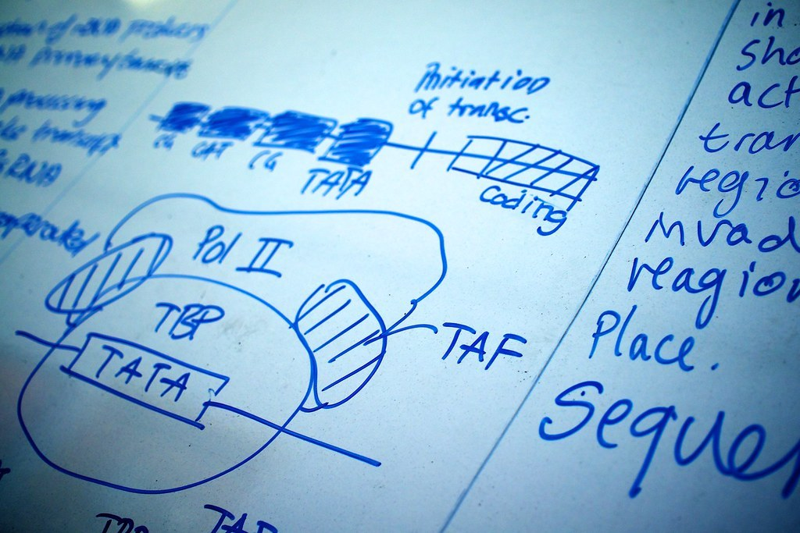
GRADE 10 · LESSON 15
Revision: Units 1–2
Takrorlash: 1–2-bo‘limlar
Review (Units 1-2)
p_a_h · CC BY 2.0
sozlar.com

Slide 2
LESSON AIMS
Bugungi maqsad
1
Choose the correct word in ten multiple-choice items (ex. 1)
2
Put verbs into the correct tense (ex. 2)
3
Form eight negative adjectives with the right prefix (ex. 4)
4
Complete five phrasal-verb sentences and five stative-verb sentences (ex. 6–7)

Slide 3
VOCABULARY
A. People and personality (1/2)
🎁️
generous
saxovatli, qo‘li ochiq
She is generous with her time as well as her money.
🚀️
ambitious
katta maqsadli, intiluvchan
She is ambitious and wants to run her own clinic one day.
👑️
arrogant
takabbur, manman
He became arrogant after winning the competition.
🌈️
optimistic
nikbin, kelajakka umid bilan qaraydigan
He stayed optimistic even after two bad results.

Slide 4
VOCABULARY
A. People and personality (2/2)
🍰️
selfish
xudbin, faqat o‘zini o‘ylaydigan
It is selfish to take the last piece of cake without asking.
🥳️
sociable
kirishimli, odamoxun
He is very sociable — he has friends in every group.
🧸️
adopted
asrab olingan, farzandlikka olingan
Their youngest son is adopted, but nobody in the family treats him differently.
📄️
divorced
ajrashgan
Kamron’s parents are divorced, but they both come to his school concerts.

Slide 5
VOCABULARY
B. Transport and travel (1/2)
🛏️
a cabin
kayuta (kemadagi xona)
Our cabin on the ship had two small beds.
⛴️
a ferry
parom
We took the ferry across the lake to the island.
🚕️
a taxi rank
taksilar to‘xtash joyi
There’s a taxi rank right outside the station.
💼️
a business trip
xizmat safari
My mum is in Moscow on a business trip this week.
🚉️
a platform
perron
The fast train to Andijan leaves from platform 2.

Slide 6
VOCABULARY
B. Transport and travel (2/2)
🪙️
a fare
yo‘l haqi, yo‘lkira
The bus fare in our town is very cheap.
🚍️
a coach
shaharlararo avtobus
We went to Samarkand by coach because it was cheaper than the train.
🛥️
a hovercraft
havo yostig‘idagi kema
A hovercraft can travel over water, sand and even ice.
🚲️
a pedal
pedal
My little sister’s feet can’t reach the pedals yet.
🚂️
fall off the tracks
relsdan chiqib ketmoq
The old toy train kept falling off the tracks.

Slide 7
VOCABULARY
C. Negative prefixes (1/2)
🚔️
illegal
noqonuniy, qonunga xilof
Selling these tickets outside the stadium is illegal.
⚖️
unfair
adolatsiz, nohaq
It is unfair to blame the whole team for one mistake.
🤥️
dishonest
insofsiz, rostgo‘y emas
It is dishonest to copy an answer and call it your own.
🙊️
impolite
odobsiz, beadab
It is impolite to interrupt when somebody is answering.

Slide 8
VOCABULARY
C. Negative prefixes (2/2)
💔️
unkind
mehrsiz, qo‘pol
That was an unkind thing to say to a new student.
🗑️
irrelevant
mavzuga aloqasiz
His answer was interesting but completely irrelevant to the question.
🚫️
incapable
qodir emas, qo‘lidan kelmaydigan
My grandfather is incapable of saying no to his grandchildren.
👓️
unattractive
ko‘rimsiz, jozibasiz
He felt unattractive in his old glasses, but his friends said he looked fine.

Slide 9
VOCABULARY
D. Phrasal verbs, stative verbs and prepositions (1/2)
🚪️
turn up
kelib qolmoq, (ko‘pincha kutilmaganda) paydo bo‘lmoq
She turned up an hour late and said nothing.
❗️
come up
(muammo, savol) kutilmaganda chiqib qolmoq
A problem came up, and we had to change the plan.
📖️
make up a story
hikoya to‘qib chiqarmoq
He made up a story about a lost dog to explain why he was late.
💬️
bring up a subject
(suhbatda) mavzuni ko‘tarmoq, gap ochmoq
At dinner my uncle brought up the subject of money again.
👅️
taste
ta’mi kelmoq, (qanday) ta’mli bo‘lmoq
This soup tastes of nothing — pass me the salt, please.

Slide 10
VOCABULARY
D. Phrasal verbs, stative verbs and prepositions (2/2)
💭️
remind sb of
kimgadir …ni eslatmoq
This old bus reminds me of the trips we would take to the village.
☝️
blame somebody for
kimnidir biror narsa uchun ayblamoq
Don’t blame the weather for your bad result.
🕵️
accuse somebody of
kimnidir biror ishda ayblamoq
The shopkeeper accused the boy of stealing sweets.
🧰️
deal with
eplamoq, hal qilmoq, (muammoni) bartaraf qilmoq
A good teacher knows how to deal with a noisy class.

Slide 11
TODAY'S WORDS IN CONTEXT
Two units in one page (1/2)
Unit 1 was about people. A generous person gives; a selfish one only thinks of himself. Someone modest never boasts, while an arrogant person thinks he is better than everyone. If you are sociable, you have many friends; if you are sensitive, words can hurt you.
Unit 2 was about transport. You wait on a platform, pay a fare, and hope the train does not fall off the tracks. A coach goes between cities, a ferry crosses the water, and a hovercraft lifts out of it. Taxis wait at a taxi rank.
Cover the word list. Can you understand the words in bold from the sentence?

Slide 12
TODAY'S WORDS IN CONTEXT
Two units in one page (2/2)
Two pieces of grammar came back again and again. First, negative prefixes: legal → illegal, fair → unfair, polite → impolite, relevant → irrelevant. Second, stative verbs — see, believe, understand, taste — which normally take the simple form, not the continuous.
And five phrasal verbs are worth learning by heart: people turn up without an invitation, problems come up in meetings, we try not to bring up difficult subjects, someone once came up with the idea of computer games, and Tony is always making up stories.
Cover the word list. Can you understand the words in bold from the sentence?

Slide 13
TODAY'S WORDS IN CONTEXT
Read and answer
1
What is the difference between a generous person and a selfish one?
2
Which two transport words in the text are about water?
3
Why can't you say 'I am believing you'?
4
Which phrasal verb means 'to invent a story'?

Slide 14
PAIRS · ESDA QOLDIMI?
Memory check — qaysi prefiks?
Men sifatni aytaman, siz inkor shaklini ayting.
1
legal → ?
2
fair → ?
3
honest → ?
4
polite → ?
5
relevant → ?

Slide 15
FOCUS
Uchta narsa imtihonda eng ko‘p xato qilinadi
• Inkor prefiks so‘zga qarab tanlanadi: il- (legal), ir- (relevant), im- (polite), in- (capable), un- va dis- qolganlariga.
• Holat fe’llari (see, believe, understand, know, taste, like) davomli shaklda KELMAYDI.
• trip / journey / travel — bu uchtasi ham «sayohat» emas: a business trip, a long journey, travel (umumiy, sanalmaydi).
• come up (paydo bo‘lmoq) va come up with (o‘ylab topmoq) — with ma’noni butunlay o‘zgartiradi.

Slide 16
BOOK TASK · 20 MINUTES
Book tasks — Laser B1+, pp. 22–23
Revision Units 1–2.
1
ex.1 — 10 ta test savoli (lug‘at).
2
ex.2 — fe’llarni to‘g‘ri zamonga qo‘ying.
3
ex.4 — 8 ta sifatni inkor qiling.
4
ex.5 — ta’rif bo‘yicha so‘zni toping.
5
ex.6–7 — frazal fe’llar va holat fe’llari.
6
ex.8 — ochiq bo‘shliqlar (bitta so‘z).

Slide 17
PRONUNCIATION
Say it — don’t just read it
Inkor prefiks urg‘uni O‘ZGARTIRMAYDI — urg‘u asosiy so‘zda qoladi. Qiyin so‘zlar — tinglang va takrorlang:
illegal /ɪˈliːɡl/
impolite /ˌɪmpəˈlaɪt/
irrelevant /ɪˈreləvənt/
incapable /ɪnˈkeɪpəbl/
arrogant /ˈærəɡənt/
ambitious /æmˈbɪʃəs/
sociable /ˈsəʊʃəbl/
hovercraft /ˈhɒvəkrɑːft/

Slide 18
WHOLE CLASS
Practice — complete the sentence (1/2)
1
People say my brother's ________ — he likes giving gifts to his friends.
2
Did you hear that a train fell off the ________ yesterday?
3
We waited on the ________ for over an hour before the train arrived.
4
A ________ is a kind of bus that travels between towns and cities.
5
Make this word negative: legal → ________.
6
Make this word negative: relevant → ________.

Slide 19
WHOLE CLASS
Practice — complete the sentence (2/2)
7
They accused him ________ cheating in the test, but he said it wasn't true.
8
What's in this soup? It ________ delicious! (taste)

Slide 20
PAIR / GROUP WORK · OPTIONAL
Vocabulary activity
1
Match the beginnings (1-10) with the endings (a-j).
2
Read your complete sentences aloud.
3
Give the Uzbek meaning of the key word in each sentence.
4
When you finish, swap tables with the other group.

Slide 21
PAIRS
Speaking
Juftlikda: bir-biringizni uchta sifat bilan tasvirlang (ijobiy!).
«Which means of transport have you used this year?» — javobni trip / journey bilan.
Bir talaba ta’rifni o‘qiydi (ex.5), ikkinchisi so‘zni topadi.

Slide 22
UZ
Qiyin joyi — o‘zbekcha
Inkor prefiks tovushga qarab tanlanadi: l oldidan il-, r oldidan ir-, m/p oldidan im-.
Holat fe’llari harakatni emas, HOLATNI bildiradi — shuning uchun davomli shakli yo‘q.
taste ikki xil: This soup tastes good (ta’mi — holat), I’m tasting the soup (tatib ko‘ryapman — harakat).
make up a story — to‘qib chiqarmoq; bring up a subject — mavzuni tilga olmoq (bring up «tarbiyalamoq» ham bo‘ladi).

Slide 23
HOMEWORK
Uy vazifasi
1
Laser B1+ Workbook p. 16 «Check your progress! Units 1–2».
2
Learn the 35 items with the flashcards: sozlar.com/vocab/cards/?set=grade10-lesson15
3
Write eight sentences: four with negative adjectives, four with the phrasal verbs.

Slide 24
IMAGE CREDITS
Rasmlar manbasi
cover
p_a_h · CC BY 2.0 · https://www.flickr.com/photos/64654599@N00/7211427788

Slide 25
Uchta so‘z — ertaga ham esingizda qoladi
Juftingizga ayting, so‘ng daftaringizga yozib qo‘ying.
sozlar.com/vocab/cards/?set=grade10-lesson15

