Slide 1
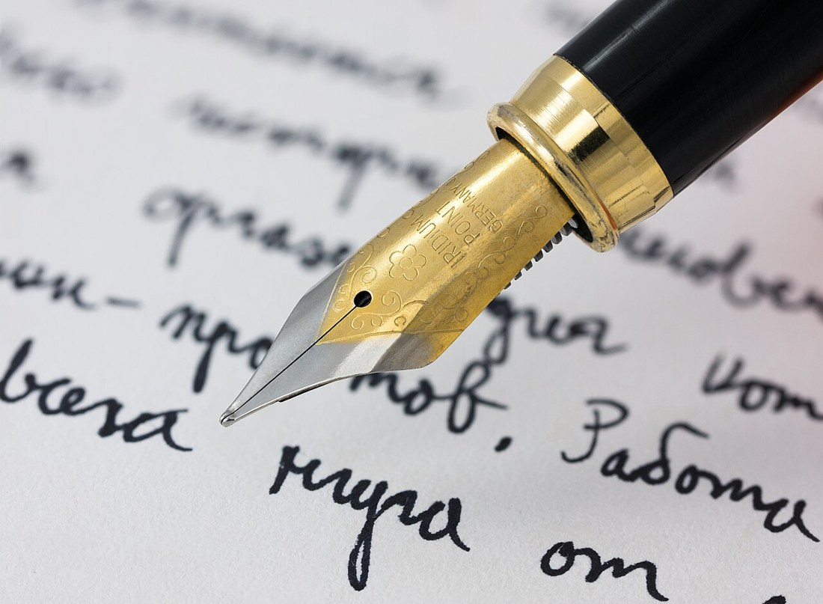
GRADE 10 · LESSON 14
Writing: An opinion essay
Yozish: fikr-mulohaza essesi
Writing: An essay
Petar Milošević · CC BY-SA 4.0
sozlar.com

Slide 2
LESSON AIMS
Bugungi maqsad
1
Complete the phrase bank with the missing words (ex. 3)
2
Say what each paragraph of the model essay does (ex. 6)
3
Make a four-paragraph plan for a new task (ex. 8)
4
Write the first sentence of paragraphs two and three

Slide 3
VOCABULARY
A. Public transport: problems and solutions (1/3)
🌫️
add to
(muammoni) kuchaytirmoq
More and more cars add to the noise and dirty air in our city.
💡️
offer a solution
yechim taklif qilmoq
Electric buses offer a solution to the problem of dirty air.
🏛️
the government
hukumat
The government plans to build three new metro lines.
👥️
the public
xalq, jamoatchilik
The new bus station will be open to the public from Monday.

Slide 4
VOCABULARY
A. Public transport: problems and solutions (2/3)
💰️
raise taxes
soliqlarni oshirmoq
Nobody is happy when the government decides to raise taxes.
🚌️
a service
xizmat, qatnov
The night bus service helps people who work late.
🏠️
leave the car at home
mashinani uyda qoldirmoq
On Fridays my dad leaves the car at home and takes the metro.
🎟️
free of charge
bepul
In some cities, buses for pupils are free of charge.

Slide 5
VOCABULARY
A. Public transport: problems and solutions (3/3)
⚡️
take action
chora ko‘rmoq
The city must take action to stop the long queues at bus stops.
🛑️
prevent
oldini olmoq
Speed cameras help to prevent accidents on busy roads.
🌍️
environmental damage
atrof-muhitga zarar
Old lorries cause serious environmental damage.

Slide 6
VOCABULARY
B. Writing an essay (1/2)
📝️
an essay
esse, insho
Our teacher asked us to write an essay about public transport.
💬️
a statement
fikr, da’vo
Do you agree with the statement that the car changed the world?
🙂️
agree with
…ning fikriga qo‘shilmoq
I agree with you — buses should be free for students.
🙁️
disagree with
…ga qarshi fikrda bo‘lmoq
Many drivers disagree with the idea of closing the city centre to cars.
👁️
a point of view
nuqtai nazar
In the second paragraph, give reasons for your point of view.

Slide 7
VOCABULARY
B. Writing an essay (2/2)
👍️
in favour of
…ning tarafdori, …ni yoqlab
Most of my classmates are in favour of free buses for pupils.
🧠️
an argument
dalil, asos
Each argument in your essay needs a clear example.
🔑️
the main idea
asosiy fikr
The first sentence of a paragraph gives the main idea.
🗣️
state your opinion
o‘z fikrini bildirmoq
In the last paragraph, state your opinion clearly.
🗂️
summarise
umumlashtirmoq, qisqacha aytib bermoq
At the end, summarise your main points in two sentences.

Slide 8
VOCABULARY
C. Adding points
1️⃣
to begin with
avvalo
To begin with, the metro is much faster than the bus.
🥇️
in the first place
birinchidan
In the first place, tickets for students should be cheaper.
🥈️
secondly
ikkinchidan
Secondly, more buses would mean shorter queues.
➕️
what is more
ustiga-ustak, bundan ham muhimi
What is more, trains are more comfortable than buses.
📎️
in addition
bundan tashqari, qo‘shimcha ravishda
In addition, cycling to school keeps you fit.

Slide 9
VOCABULARY
D. Result, contrast and conclusion (1/2)
🔗️
because of this
shu sababli
Petrol is expensive. Because of this, many families use the metro.
❄️
due to
…tufayli, …sababli
The train was late due to the heavy snow.
📈️
as a result
natijada
Fewer people drive now. As a result, the air in the city is cleaner.
⚖️
on the one hand
bir tomondan
On the one hand, taxis are fast; on the other hand, they are expensive.

Slide 10
VOCABULARY
D. Result, contrast and conclusion (2/2)
🔄️
however
biroq, ammo
Buses are cheap. However, they are often crowded in the morning.
🌂️
despite
…ga qaramay
Despite the rain, we walked to school.
🏁️
in conclusion
xulosa qilib aytganda
In conclusion, public transport must be cleaner and cheaper.
🧾️
to sum up
qisqasi, umuman olganda
To sum up, I believe the metro is the best way to travel in Tashkent.

Slide 11
TODAY'S WORDS IN CONTEXT
Model essay: people should use public transport more (1/2)
There is no doubt that traffic adds to pollution. Public transport offers a possible solution to the problem, since many people can be transported in one vehicle. The government has a responsibility to encourage the public to use buses and the underground more. However, there are a number of changes which need to be made.
In the first place, public transport should be made free. The government should raise taxes to pay for the service. If it was free, most people would decide to leave their cars at home and travel by bus or train.
Cover the word list. Can you understand the words in bold from the sentence?

Slide 12
TODAY'S WORDS IN CONTEXT
Model essay: people should use public transport more (2/2)
What is more, the service must be clean and reliable. People need to know that they can get to work on time. They also need to know that their journey will be comfortable.
To sum up, I would argue that a clean, reliable service which was free would encourage many people to use public transport. The government should take action now to prevent environmental damage.
Cover the word list. Can you understand the words in bold from the sentence?

Slide 13
TODAY'S WORDS IN CONTEXT
Read and answer
1
Does the writer agree or disagree with the statement?
2
What two changes does she ask for?
3
How would the government pay for a free service?
4
Which phrase opens her final paragraph?

Slide 14
PAIRS · ESDA QOLDIMI?
Memory check — qaysi guruh?
Men iborani aytaman, siz vazifasini ayting: birinchi fikr, qo‘shimcha fikr, natija, qarama-qarshilik yoki xulosa.
1
As a result, … → ?
2
On the one hand, … → ?
3
To begin with, … → ?
4
In addition, … → ?
5
In conclusion, … → ?

Slide 15
FOCUS
To‘rt xatboshi — to‘rt vazifa
• 1-xatboshi — mavzuni kiritadi va umumiy fikringizni aytadi.
• 2-xatboshi — birinchi dalil: In the first place…
• 3-xatboshi — ikkinchi dalil: What is more…
• 4-xatboshi — xulosa: To sum up, I would argue that…
• Har xatboshining BIRINCHI gapi asosiy fikrni beradi — oxirgisi emas.

Slide 16
BOOK TASK · 18 MINUTES
Book tasks — Laser B1+, pp. 20–21
An essay.
1
ex.3 — iboralar bankidagi bo‘shliqlarni to‘ldiring.
2
ex.4 — namunaviy esseni o‘qing: muallif qo‘shiladimi?
3
ex.5 — essedan ma’nodosh iboralarni toping (because, but, firstly…).
4
ex.6 — har xatboshi nima qiladi? (a yoki b)
5
ex.7–8 — yangi topshiriq va reja.
6
ex.10 — «Check it out!» ro‘yxati bo‘yicha o‘zingizni tekshiring.

Slide 17
PRONUNCIATION
Say it — don’t just read it
Kartadagi qiyin so‘zlar — tinglang va takrorlang (bog‘lovchidan keyin vergulda qisqa pauza):
the government /ðə ˈɡʌvənmənt/
environmental damage /ɪnˌvaɪrənˈmentl ˈdæmɪdʒ/
prevent /prɪˈvent/
a statement /ə ˈsteɪtmənt/
summarise /ˈsʌməraɪz/
in favour of /ɪn ˈfeɪvər əv/
due to /ˈdjuː tə/
however /haʊˈevə/

Slide 18
WHOLE CLASS
Practice — complete the sentence (1/2)
1
________ begin with, public transport is cheaper than a car.
2
What is ________, the service must be clean and reliable.
3
In ________ to this, fewer cars mean safer streets.
4
As a ________, the air in the city is cleaner.
5
On the ________ hand, the metro is quick; on the other hand, it is very crowded.
6
To sum ________, I would argue that a free service would help.

Slide 19
WHOLE CLASS
Practice — complete the sentence (2/2)
7
Many trains were cancelled ________ to the strong wind.
8
The city should take ________ to stop traffic jams near schools.

Slide 20
PAIR / GROUP WORK · OPTIONAL
Vocabulary activity
1
Match the beginnings (1-10) with the endings (a-j).
2
Read your complete sentences aloud.
3
Give the Uzbek meaning of the key word in each sentence.
4
When you finish, swap tables with the other group.

Slide 21
PAIRS
Speaking
Ex.1 — juftlikda: public transport nimalarni o‘z ichiga oladi? Ikkita afzallik, ikkita kamchilik.
«Do you agree with the statement?» — bir talaba qo‘shiladi, ikkinchisi qarshi dalil aytadi.
Ex.7 topshirig‘i uchun og‘zaki reja: qaysi fikr qaysi xatboshida?

Slide 22
UZ
Qiyin joyi — o‘zbekcha
Esse RASMIY uslubda yoziladi: qisqartma (don't) va so‘zlashuv so‘zlari yo‘q.
Despite va In spite of dan keyin OT keladi, Although dan keyin GAP.
Har xatboshining birinchi gapi — asosiy fikr (topic sentence).
To sum up va In conclusion — bir xil vazifa, takrorlamang.

Slide 23
HOMEWORK
Uy vazifasi
1
Laser B1+ Workbook: esse rejasi.
2
Learn the 34 items with the flashcards: sozlar.com/vocab/cards/?set=grade10-lesson14
3
Write an essay: «Public transport in my town» (120–150 words).

Slide 24
IMAGE CREDITS
Rasmlar manbasi
cover
Petar Milošević · CC BY-SA 4.0 · https://commons.wikimedia.org/wiki/File:Fountain_pen_writing_(literacy).jpg

Slide 25
Uchta so‘z — ertaga ham esingizda qoladi
Juftingizga ayting, so‘ng daftaringizga yozib qo‘ying.
sozlar.com/vocab/cards/?set=grade10-lesson14

