Slide 1
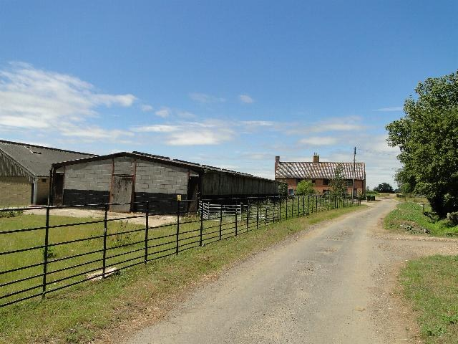
GRADE 7 · LESSON 13
Writing an informal email (1)
Norasmiy xat (email) yozish (1)
Writing: informal email (1)
Adrian S Pye · CC BY-SA 2.0
sozlar.com

Slide 2
LESSON AIMS
Bugungi maqsad
1
Put the eight parts of Paul's email into the correct order (ex. 1)
2
Say who the email is to and how it sounds (friendly, not serious)
3
Find examples of the four writing rules in the email (ex. 3)
4
Write a 50–70 word informal email about their own holiday

Slide 3
VOCABULARY
A. Writing an email (1/2)
📧️
an informal email
norasmiy elektron xat
Paul writes an informal email to his friend Mark.
📩️
an email address
elektron pochta manzili
Please write your email address on this card.
📤️
send an email
elektron xat yubormoq
I send an email to my cousin in London every week.
↩️
reply
javob bermoq (xatga)
Mark always replies to my emails very quickly.

Slide 4
VOCABULARY
A. Writing an email (2/2)
✍️
write back
javob yozmoq (xatga)
Please write back soon and tell me about your holiday.
👋️
say hello
salomlashmoq
In an email to a friend, we say hello with “Hi”.
🙌️
say goodbye
xayrlashmoq
At the end of the email, Paul says goodbye to Mark.
📰️
news
yangiliklar
Write to me soon and tell me all your news!

Slide 5
VOCABULARY
B. Animals on the farm (1/2)
🏡️
a farm
ferma
My uncle lives on a farm near Samarkand.
👨‍🌾
a farmer
fermer
The farmer gets up very early every morning.
🪿️
a goose (geese)
g‘oz
Two big white geese live near the farm gate.
🐓️
a cockerel
xo‘roz
Our cockerel wakes everybody up at five o’clock.

Slide 6
VOCABULARY
B. Animals on the farm (2/2)
🦃️
a turkey
kurka
The farmer has a big turkey with brown feathers.
🛖️
a barn
molxona, omborxona
In winter the cows sleep in the barn.
🚜️
a tractor
traktor
My uncle drives a red tractor on his farm.
🌾️
hay
pichan
In winter the cows and sheep eat hay in the barn.

Slide 7
VOCABULARY
C. A holiday on the farm (1/2)
🧳️
be on holiday
ta’tilda bo‘lmoq
This week we are on holiday in the mountains.
🤝️
help the farmer
fermerga yordam bermoq
Every morning the children help the farmer in the field.
🧺️
do jobs on the farm
fermada yumush qilmoq
In summer I do jobs on the farm with my uncle.

Slide 8
VOCABULARY
C. A holiday on the farm (2/2)
🧸️
play with the animals
hayvonlar bilan o‘ynamoq
Little children love to play with the animals at the farm.
🕘️
at about nine o’clock
taxminan soat to‘qqizda
On holiday I go to bed at about nine o’clock.
🍃️
fresh air
toza havo
There’s lots of fresh air on the farm, so I sleep well.

Slide 9
VOCABULARY
D. Tone and linking words
🤩️
great
ajoyib, zo‘r
The farm is great! I love it here.
😐️
serious
jiddiy
My dad is a serious man, but he’s very kind.
😢️
sad
xafa, g‘amgin
Laylo is sad because her holiday is over.
⏭️
then
keyin, so‘ng
We have breakfast. Then we go to school.
⏩️
after
-gandan keyin
After we have lunch, we play in the garden.

Slide 10
TODAY'S WORDS IN CONTEXT
Paul's email: I'm on holiday on a farm! (1/2)
Hi, Mark! How are you? I hope you're well! Are you on holiday?
I'm on holiday with my family on a farm! It's great! We get up at half past five every day and help the farmer milk the cows. Then we feed the other animals. There are lots of animals here — cows, horses, sheep, donkeys, goats, chickens, ducks, geese!
After we feed the animals, we have breakfast. Then we do jobs on the farm. I often collect the chickens' eggs and brush the horses.
Cover the word list. Can you understand the words in bold from the sentence?

Slide 11
TODAY'S WORDS IN CONTEXT
Paul's email: I'm on holiday on a farm! (2/2)
We have lunch at one o'clock. Then, in the afternoon, we play with the animals or sometimes ride horses. In the evening, I'm usually so tired that I go to bed early — at about nine o'clock!
Bye for now! Love, Paul
Cover the word list. Can you understand the words in bold from the sentence?

Slide 12
TODAY'S WORDS IN CONTEXT
Read and answer
1
What time do they get up on the farm?
2
What do they do before breakfast?
3
Which animals live on the farm? Name five.
4
Why does Paul go to bed early?

Slide 13
PAIRS · ESDA QOLDIMI?
Memory check — what comes next?
Men gap boshini aytaman, siz Then yoki After bilan davom ettiring.
1
We help the farmer in the morning. Then …
2
After we do jobs on the farm, …
3
We play with the animals. Then …
4
After I read my friend's email, …

Slide 14
FOCUS
Four rules of an informal email (p. 20)
• Do‘stga yozganda familiya ishlatilmaydi: Hi, Mark! — Hi, Mr Hunter emas.
• Doimiy ishlar uchun Present Simple: We get up at half past five.
• Adverbs of frequency qanchalik tez-tezligini ko‘rsatadi: often, sometimes, usually.
• Then va After — keyin nima bo‘lishini ko‘rsatadi.

Slide 15
BOOK TASK · 14 MINUTES
Book tasks — Laser A1+, p. 20
Project: writing an informal email (1).
1
ex.1 — xatning 8 qismini to‘g‘ri tartibga soling (Part 1–8).
2
ex.2 — xat kimga yozilgan? (father and son / brothers / friends) Ohangi qanday?
3
ex.3 — to‘rtta qoidaga misol toping va tagiga chizing.
4
Yozish — o‘z ta’tilingiz haqida qisqa xat (50–70 so‘z).

Slide 16
PRONUNCIATION
Say it — don’t just read it
Qiyin so‘zlar — tinglang va takrorlang (goose → geese: noto‘g‘ri ko‘plik):
goose /ɡuːs/ — geese /ɡiːs/
cockerel /ˈkɒkərəl/
turkey /ˈtɜːki/
barn /bɑːn/
tractor /ˈtræktə/
serious /ˈsɪəriəs/
email address /ˈiːmeɪl əˈdres/
reply /rɪˈplaɪ/

Slide 17
WHOLE CLASS
Practice — complete the sentence (1/2)
1
The farmer drives his ________ to the field every morning.
2
At night the horses sleep in the ________, and there is hay on the floor.
3
________ we feed the animals, we have breakfast.
4
Thanks for your email! I'm writing ________ to tell you about my holiday.
5
I love the farm — there's lots of ________ air here and I sleep well.
6
Bye for ________! Love, Paul

Slide 18
WHOLE CLASS
Practice — complete the sentence (2/2)
7
Hi, Mark! How are you? I ________ you're well!
8
Ducks and ________ swim in the pond on the farm.

Slide 19
PAIR / GROUP WORK · OPTIONAL
Vocabulary activity
1
Match the beginnings (1-10) with the endings (a-j).
2
Read your complete sentences aloud.
3
Give the Uzbek meaning of the key word in each sentence.
4
When you finish, swap tables with the other group.

Slide 20
PAIRS
Speaking
Juftlikda: «A day on my holiday» — uchta ishni Then va After bilan ayting.
«Do you like farms?» — sababi bilan javob bering.
Xat qismlarini og‘zaki tartiblang: qaysi biri birinchi keladi — Subject yoki Hi?

Slide 21
UZ
Qiyin joyi — o‘zbekcha
Norasmiy xat do‘stga yoziladi: Hi, Bye for now, Love.
a goose → two geese — noto‘g‘ri ko‘plik; hay sanalmaydi: some hay («a hay» emas).
Frequency adverblari (often, usually, sometimes) oddiy fe’ldan oldin turadi.
After dan keyin to‘liq gap: After we feed the animals, we have breakfast.

Slide 22
HOMEWORK
Uy vazifasi
1
Laser A1+ Workbook p. 15 ex. 1–2.
2
Learn the 27 items with the flashcards: sozlar.com/vocab/cards/?set=grade7-lesson13
3
Write an informal email (50–70 words) about your last holiday.

Slide 23
IMAGE CREDITS
Rasmlar manbasi
cover
Adrian S Pye · CC BY-SA 2.0 · https://commons.wikimedia.org/wiki/File:Church_Farm,_Stockton,_Norfolk_-_geograph.org.uk_-_1968544.jpg

Slide 24
Uchta so‘z — ertaga ham esingizda qoladi
Juftingizga ayting, so‘ng daftaringizga yozib qo‘ying.
sozlar.com/vocab/cards/?set=grade7-lesson13

