Slide 1
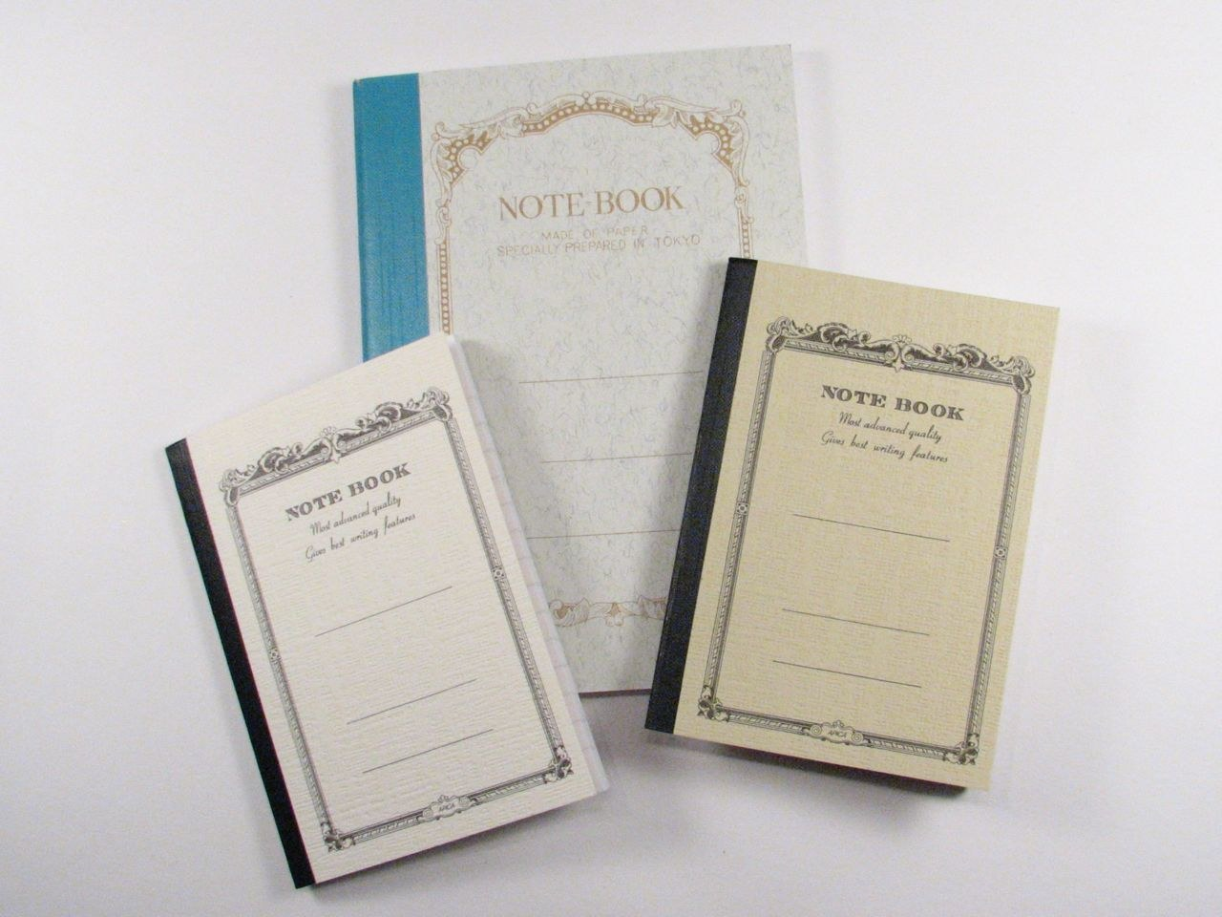
GRADE 8 · LESSON 13
Project: Writing a Reply to a Friend
Loyiha: do‘stga javob xat yozish
Project work: Writing a reply to a friend
L.Marie · CC BY 2.0
sozlar.com

Slide 2
LESSON AIMS
Bugungi maqsad
1
Fill in a planner before writing (Laser p. 21 ex. 3)
2
Tell one piece of news in the past simple
3
Describe regular free-time activities
4
Close a friendly email with the right expressions

Slide 3
VOCABULARY
A. Events and going out (1/2)
🥳️
have a great time
ajoyib vaqt o‘tkazmoq
We went to the water park and had a great time.
🌙️
spend the evening
oqshomni o‘tkazmoq
Last night I spent the evening with my grandparents.
🎭️
go to the theatre
teatrga bormoq
On Saturday our class went to the theatre to see a funny play.
🎸️
a band
musiqa guruhi
My favourite band is playing in Tashkent next month.

Slide 4
VOCABULARY
A. Events and going out (2/2)
🎟️
a ticket
chipta
I bought two tickets for the concert on Saturday.
🎂️
a birthday party
tug‘ilgan kun bazmi
Malika invited the whole class to her birthday party.
⚽️
a match
o‘yin, uchrashuv (sportda)
Did you watch the football match last night?
🏆️
win a prize
sovrin yutib olmoq
Our team won a prize in the chess competition.

Slide 5
VOCABULARY
B. Exams and results (1/2)
✅️
pass an exam
imtihondan o‘tmoq
I studied every day and passed the exam!
❌️
fail an exam
imtihondan yiqilmoq
If you fail the exam, you can take it again in June.
📊️
get the results
natijalarni bilib olmoq
We’ll get the results of the test on Friday.
📚️
revise
(imtihonga) takrorlamoq
I need to revise for my English test tonight.
💯️
a mark
baho, ball
I got a good mark for my history project.

Slide 6
VOCABULARY
B. Exams and results (2/2)
🌟️
do well
yaxshi natija ko‘rsatmoq
Jasur did well in the science test.
😓️
hard
qiyin, og‘ir
The maths exam was really hard, but I finished it on time.
🙌️
do your best
qo‘lidan kelganini qilmoq
The test is difficult, but just do your best.
😬️
nervous
hayajonlangan, xavotirda
I was very nervous before the exam.
🗒️
a test
nazorat ishi, test
We have three tests this week, so I can’t go out.

Slide 7
VOCABULARY
C. What else I do in my free time (1/2)
🐕️
walk the dog
itni sayrga olib chiqmoq
Every evening I walk the dog in the park.
🎣️
go fishing
baliq oviga bormoq
At the weekend Dad and I sometimes go fishing on the lake.
👵️
visit my grandparents
bobom va buvimnikiga bormoq
We usually visit my grandparents in the village on Sundays.
🧩️
do puzzles
pazl yig‘moq, boshqotirma yechmoq
My little brother loves doing puzzles with 500 pieces.
🏋️
go to the gym
sport zaliga bormoq
My older sister goes to the gym three times a week.

Slide 8
VOCABULARY
C. What else I do in my free time (2/2)
🏃️
go jogging
yengil yugurishga chiqmoq
Grandad goes jogging every morning before breakfast.
🧘️
do yoga
yoga bilan shug‘ullanmoq
Mum does yoga on Sunday mornings.
🏛️
go to a museum
muzeyga bormoq
Sometimes I go to a museum with my dad on Sunday afternoons.
⏳️
be busy
band bo‘lmoq
I’m really busy at the moment, so I don’t have much free time.

Slide 9
VOCABULARY
D. Replying to a friend
📰️
news
yangilik(lar)
I’ve got some great news: I’m in the school football team!
🗣️
mention
tilga olmoq, eslab o‘tmoq
Don’t forget to mention your new puppy in your email!
🙏️
thank
rahmat aytmoq
I called Grandma to thank her for the present.

Slide 10
TODAY'S WORDS IN CONTEXT
Bekzod's reply (1/2)
Hi Timur!
Thanks for your email — and for the photos! I had an exam last week too. It was hard! But I got the results on Monday and I passed! Can you believe it?
You asked what I did last night. Well, I spent the evening at home. My cousin came to our house and we played chess for two hours. We had a great time!
Cover the word list. Can you understand the words in bold from the sentence?

Slide 11
TODAY'S WORDS IN CONTEXT
Bekzod's reply (2/2)
What else do you do in your free time? You asked me the same question, so: in my free time, I usually draw. Every weekend, I go out with friends, and most evenings I read a little. But this week I'm really busy at the moment — we have three tests!
I've got to go now because my mum is calling me. Write back soon!
From, Bekzod
Cover the word list. Can you understand the words in bold from the sentence?

Slide 12
TODAY'S WORDS IN CONTEXT
Read and answer
1
What news does Bekzod give in the first paragraph?
2
What did he do last night?
3
Name two things he does in his free time.
4
Why is he busy this week?
5
Which phrase does he use to end the main part?
6
How many paragraphs are there, and what is each one about?

Slide 13
PAIRS · ESDA QOLDIMI?
Memory check — yangi so‘zlar
O‘qituvchi birikmaning boshini aytadi, siz uni to‘ldirasiz.
1
pass an exam ↔ … an exam · win a … · walk the … · do your …
2
Imtihonga tayyorlanib, darslarni qayta ko‘rib chiqish inglizcha nima? (r…)
3
Say one piece of news with a new word: a ticket, a match, a birthday party.

Slide 14
FOCUS
Rejadan xatgacha — to‘rt qator
• Subject: xat nima haqida (bir-ikki so‘z).
• 1-xatboshi: rahmat + do‘stning xatidagi bir narsa.
• 2-xatboshi: kecha nima qilding — o‘tgan zamon: went · had · spent · passed.
• 3-xatboshi: bo‘sh vaqt — hozirgi zamon: In my free time, I usually… · Every weekend, I…
• Yakun: I've got to go now because… → Write back soon! → From, + ism

Slide 15
STRATEGY
Loyiha — uch qadam
1
Read: do‘stning xatini o‘qing; ikkita savolga belgi qo‘ying (✓) va bitta yangilikning tagiga chizing.
2
Plan: jadvalni to‘ldiring — har xatboshiga ikki-uch so‘z.
3
Write: 80–100 so‘z; oxirida qayta o‘qib chiqing.

Slide 16
BOOK TASK · 14 MINUTES
Book task — Laser A2, p. 21
Do‘stning xatidan parcha va rejalashtirish jadvali.
1
ex.1 Read the extract — what did your friend do last night?
2
ex.2 Tick (✓) two questions you should answer; underline a piece of news.
3
ex.3 Complete the planner — To, Subject, 1st line, three paragraphs, closing.
4
ex.4 Write your email — be friendly!

Slide 17
PRONUNCIATION
Say it — don’t just read it
Bu so‘zlarda urg‘u va tovushga e’tibor bering:
nervous /ˈnɜːvəs/
revise /rɪˈvaɪz/
results /rɪˈzʌlts/
theatre /ˈθɪətə/
museum /mjuˈziːəm/
puzzles /ˈpʌzlz/
mention /ˈmenʃn/
yoga /ˈjəʊɡə/
Keyin ayting: I was nervous before the test, but I revised and passed.

Slide 18
WHOLE CLASS
Practice — complete the sentence (1/2)
1
In your first paragraph, ________ your friend for the email and ________ something from it.
2
'What did you do ________ ________?' 'I went to a concert.'
3
The music was wonderful and we ________ ________ ________ ________!
4
I ________ the evening at home with my family. (s…)
5
I had an exam last week. It was ________! But I ________!
6
We have a history test on Friday, so tonight I'm going to ________. (r…)

Slide 19
WHOLE CLASS
Practice — complete the sentence (2/2)
7
Don't be ________ — you know all the answers. Just do your ________!
8
________ ________ ________ ________, I usually play chess. (In my f… t…)
9
We bought two ________ online and went to see my favourite ________ play live. (t… · b…)
10
I'm really ________ at the moment — we have exams this week.
11
I've got to ________ now ________ my dinner is ready.
12
________ ________ soon! I want to hear your news.

Slide 20
PAIRS
Speaking
Juftlikda so‘rang: What did you do last night? Where were you? Who were you with? Javoblarni o‘tgan zamonda bering: went to the theatre, watched a match, spent the evening at home.
Xatingizni juftingizga o‘qib bering; u to‘rtta qismni (subject, yangilik, bo‘sh vaqt, yakun) topib, bittasi yetishmasa aytadi.

Slide 21
PAIR / GROUP WORK · 5 MINUTES
Vocabulary activity
1
Match the beginnings (1-10) with the endings (a-j).
2
Read your complete sentences aloud.
3
Give the Uzbek meaning of the key word in each sentence.
4
When you finish, swap tables with the other group.

Slide 22
UZ
Qiyin joyi — o‘zbekcha
spend the evening — «oqshomni o‘tkazmoq»; o‘tgan zamoni spent.
pass an exam — «imtihondan o‘tmoq»; «topshirmoq» degani take, ikkisi boshqa: I took the exam and I passed.
Can you believe it? — hayratni bildiradi, savol emas.
revise — imtihonga «takrorlamoq»: I revised for the test (✗ I repeated for the test).

Slide 23
HOMEWORK
Uy vazifasi
1
Laser A2 Workbook p. 16 — «Check your progress! Units 1–2» (kalendar reja).
2
Learn the 30 items with the flashcards: sozlar.com/vocab/cards/?set=grade8-lesson13
3
Xatingizni toza ko‘chirib, keyingi darsga olib keling (80–100 so‘z).

Slide 24
IMAGE CREDITS
Rasmlar manbasi
cover
L.Marie · CC BY 2.0 · https://commons.wikimedia.org/wiki/File:Notebooks.jpg

Slide 25
Uchta so‘z — ertaga ham esingizda qoladi
Juftingizga ayting, so‘ng daftaringizga yozib qo‘ying.
sozlar.com/vocab/cards/?set=grade8-lesson13

