Slide 1
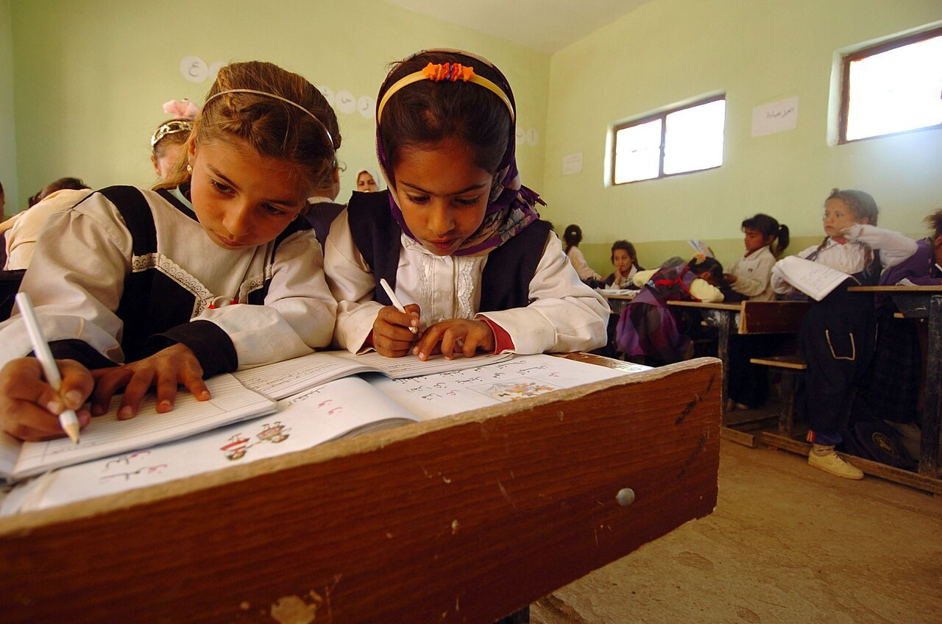
GRADE 8 · LESSON 12
Writing an Informal Email
Do‘stona elektron xat yozish
Writing an informal email
U.S. Navy photo by Photographer's Mate 1st Class Brien Aho · Public domain
sozlar.com

Slide 2
LESSON AIMS
Bugungi maqsad
1
Name the eight parts of an informal email (Laser p. 20 ex. 2)
2
Open and close an email with the right phrases
3
Join ideas with Well, Anyway and By the way
4
Make an invitation and answer it politely

Slide 3
VOCABULARY
A. An email and its parts (1/2)
📧️
an email
elektron xat
I got a long email from my cousin in Samarkand this morning.
📮️
an email address
elektron pochta manzili
Write your email address clearly, so I can answer you.
🏷️
the subject line
mavzu qatori (xat nima haqida)
Always write a short title in the subject line.
👋️
a greeting
salomlashish (xat boshida)
Start your email with a short greeting, for example ‘Hi Nodir!’
📤️
the sender
jo‘natuvchi
The sender’s name is at the end of the email.

Slide 4
VOCABULARY
A. An email and its parts (2/2)
↩️
a reply
javob xati, javob
I sent Kamola an email, but there’s no reply yet.
✍️
write back
javob yozmoq
Please write back soon and tell me about your new school.
📎️
an attachment
ilova (xatga biriktirilgan fayl)
I’m sending the photos of my models as an attachment.
📥️
receive
olmoq (xat, xabar)
Did you receive my email with the photos?
🌍️
a penfriend
yozishma do‘sti (xat orqali do‘st)
My penfriend lives in Italy, and we write to each other every month.

Slide 5
VOCABULARY
B. Style, names and endings (1/2)
🎩️
formal
rasmiy
We write formal emails to teachers and companies, not to friends.
🥶️
unfriendly
samimiy bo‘lmagan, sovuq
His reply was short and unfriendly, so I felt sad.
🔤️
first name
ism (familiyasiz)
At the end, write only your first name: Dilnoza.
🪪️
surname
familiya
In an email to a friend, you don’t need your surname.

Slide 6
VOCABULARY
B. Style, names and endings (2/2)
🖊️
sign
imzo qo‘ymoq (oxirida ismini yozmoq)
Don’t forget to sign your email with your name.
💌️
Love
mehr bilan (xat oxirida)
Nodira ends her emails to her family with ‘Love, Nodira’.
🌟️
Best wishes
eng yaxshi tilaklar bilan (xat oxirida)
Our teacher ends her emails with ‘Best wishes, Ms Karimova’.
💕️
Lots of love
ko‘p-ko‘p mehr bilan (yaqinlarga)
Grandma always finishes her messages with ‘Lots of love’.

Slide 7
VOCABULARY
C. Friendly linking words
💬️
well
xo‘sh, demak (gap boshida)
Well, I’m at school until three, but after that I’m free.
↪️
anyway
xullas, nima bo‘lganda ham
Anyway, I’d better go now — dinner is ready.
💭️
by the way
aytgancha
By the way, my brother says hello to you!
🤔️
actually
aslida
I said I hate bowling, but actually it’s quite fun.

Slide 8
VOCABULARY
D. Hobbies and invitations (1/2)
🛩️
make models
model (maket) yasamoq
My cousin makes models of old planes and ships.
📨️
invite
taklif qilmoq
I want to invite my penfriend to Tashkent next summer.
✉️
an invitation
taklif, taklifnoma
Thanks for the invitation — I’d love to come!
🚲️
go for a bike ride
velosipedda sayr qilmoq
Why don’t we go for a bike ride on Saturday morning?
🛍️
go shopping
xarid qilgani bormoq
Do you fancy going shopping at the new mall?

Slide 9
VOCABULARY
D. Hobbies and invitations (2/2)
🏙️
meet friends in town
shaharda do‘stlar bilan uchrashmoq
On Sundays I often meet friends in town for an ice cream.
🏓️
play table tennis
stol tennisi o‘ynamoq
How about playing table tennis after school?
📲️
let me know
menga xabar bermoq, bildirmoq
Let me know if you can come on Friday.
🎫️
book the tickets
chiptalarni oldindan band qilmoq
Tell me which film you want, and I’ll book the tickets online.

Slide 10
TODAY'S WORDS IN CONTEXT
Dilnoza's reply to her penfriend (1/2)
To: emma.clarke@fastmail.com &nbsp;·&nbsp; Subject: My free time
Hi Emma!
Thanks for your email. Sorry I didn't reply sooner — we had exams last week. I liked hearing about your swimming club. That's great!
You asked about my free time. Well, I'm at school until three o'clock, but after that I have two hobbies. I play the dutar — I started two years ago and my aunt taught me. I practise for about an hour a day.
My other hobby is photography. I take photos of my little brother and our cat. By the way, I'll send you some photos as an attachment next time!
Cover the word list. Can you understand the words in bold from the sentence?

Slide 11
TODAY'S WORDS IN CONTEXT
Dilnoza's reply to her penfriend (2/2)
Would you like to write to me in Uzbek one day? How about sending one short sentence in each email? Anyway, I'd better go now — I've got maths homework.
Please write back soon! Say hello to your family from me.
Love, Dilnoza
Cover the word list. Can you understand the words in bold from the sentence?

Slide 12
TODAY'S WORDS IN CONTEXT
Read and answer
1
Why didn't Dilnoza reply sooner?
2
Which two hobbies does she write about?
3
Who taught her to play the dutar, and when did she start?
4
What does she invite Emma to do?
5
Find the phrase she uses to finish the main part of the email.
6
How does she sign the email?

Slide 13
PAIRS · ESDA QOLDIMI?
Memory check — xat so‘zlari
O‘qituvchi o‘zbekcha aytadi, siz inglizchasini aytasiz.
1
elektron pochta manzili · mavzu qatori · salomlashish · jo‘natuvchi
2
ilova (biriktirilgan fayl) · javob yozmoq · imzo qo‘ymoq · familiya
3
Say two endings for a friend (Love, Lots of love) and one for a teacher (Best wishes).

Slide 14
FOCUS
Do‘stona xatning uch xatboshisi
• 1-xatboshi: do‘stingning xatiga javob — Thanks for your email. I liked hearing about…
• 2-xatboshi: o‘zing haqingda — You asked about… Well, …
• 3-xatboshi: taklif — Would you like to…? How about …ing?
• Yakun: That's all for now. / I'd better go now. → Write soon! → Love, / Best wishes, + ism
• Har xatboshi bitta mavzu haqida bo‘ladi (Solutions p. 39).

Slide 15
STRATEGY
Xat yozishdan oldin — uch qadam
1
Read: do‘stingning xatidagi yangilikni toping (nima bo‘lgan?).
2
Plan: uch xatboshiga uchta qisqa eslatma yozing.
3
Write: qoliplardan foydalaning, oxirida ismingizni qo‘ying.

Slide 16
BOOK TASK · 12 MINUTES
Book task — Laser A2, p. 20
Peter’ning Luca’ga yozgan xati.
1
ex.1 Read the email and answer three questions (kim Luca? xat qanday? kimga bunday xat yoziladi?).
2
ex.2 Match the eight parts of the email with statements a–h.
3
ex.3 Find examples in the email: first name, short forms, exclamation marks, the word Well.
4
Uyga vazifa: Workbook p. 15, ex. 1–3 (xatdagi qisqa shakllar).

Slide 17
PRONUNCIATION
Say it — don’t just read it
Yozilishi boshqa, aytilishi boshqa — kartadagi qiyin so‘zlar:
an email /ən ˈiːmeɪl/
an attachment /ən əˈtætʃmənt/
receive /rɪˈsiːv/
a penfriend /ə ˈpenfrend/
surname /ˈsɜːneɪm/
sign /saɪn/
an invitation /ən ˌɪnvɪˈteɪʃn/
actually /ˈæktʃuəli/
Keyin ayting: Did you receive my invitation? It's in the attachment.

Slide 18
WHOLE CLASS
Practice — complete the sentence (1/2)
1
Check the ________ ________ before you press 'Send' — one wrong letter and your friend won't get it. (e… a…)
2
Write two or three words in the ________ ________, for example 'My free time'. (s… l…)
3
________ your email! It was good to hear from you. (Th… for)
4
________ I didn't reply ________ — I was very busy at school.
5
You ________ ________ my free-time activities. ________, I play chess twice a week.
6
________, I had an exam last week and I passed!

Slide 19
WHOLE CLASS
Practice — complete the sentence (2/2)
7
________ ________ ________ come to my house on Sunday? (W… you l… to)
8
We got an ________ to my cousin's birthday party yesterday. (i…)
9
________ ________ meeting at four o'clock? (How a…)
10
Please ________ ________ ________ if you can come to my party on Sunday. (l… m… k…)
11
That's ________ ________ ________. Write soon!
12
I ________ three emails from my penfriend last week. (r…)

Slide 20
PAIRS
Speaking
Juftlikda taklif qiling va javob bering: Would you like to…? / How about …ing? — javob «I'd love to» yoki «Sorry, I can't» + sabab.
Xatingizni juftingizga o‘qib bering; u uchta xatboshini sanab, qaysi biri yetishmayotganini aytadi.

Slide 21
PAIR / GROUP WORK · 5 MINUTES
Vocabulary activity
1
Match the beginnings (1-10) with the endings (a-j).
2
Read your complete sentences aloud.
3
Give the Uzbek meaning of the key word in each sentence.
4
When you finish, swap tables with the other group.

Slide 22
UZ
Qiyin joyi — o‘zbekcha
How about dan keyin fe’l -ing bilan keladi: How about going for a bike ride?
Would you like dan keyin to + fe’l: Would you like to come? · invite sb to + tadbir: I'd like to invite you to my party.
Love, / Lots of love, — yaqin do‘st va oilaga; Best wishes, — kamroq yaqin odamga.
Well — «xo‘sh», yangi fikrni boshlaydi; Anyway — «xullas», mavzuni yakunlaydi; By the way — «aytgancha», qo‘shimcha gap; Actually — «aslida», kutilmagan haqiqat.

Slide 23
HOMEWORK
Uy vazifasi
1
Laser A2 Workbook p. 15, ex. 1–3 (kalendar reja).
2
Learn the 31 items with the flashcards: sozlar.com/vocab/cards/?set=grade8-lesson12
3
Do‘stingizga qisqa xat yozing (uch xatboshi, 60–80 so‘z) — keyingi darsda o‘qiymiz.

Slide 24
IMAGE CREDITS
Rasmlar manbasi
cover
U.S. Navy photo by Photographer's Mate 1st Class Brien Aho · Public domain · https://commons.wikimedia.org/w/index.php?curid=8197120

Slide 25
Uchta so‘z — ertaga ham esingizda qoladi
Juftingizga ayting, so‘ng daftaringizga yozib qo‘ying.
sozlar.com/vocab/cards/?set=grade8-lesson12

