Slide 1
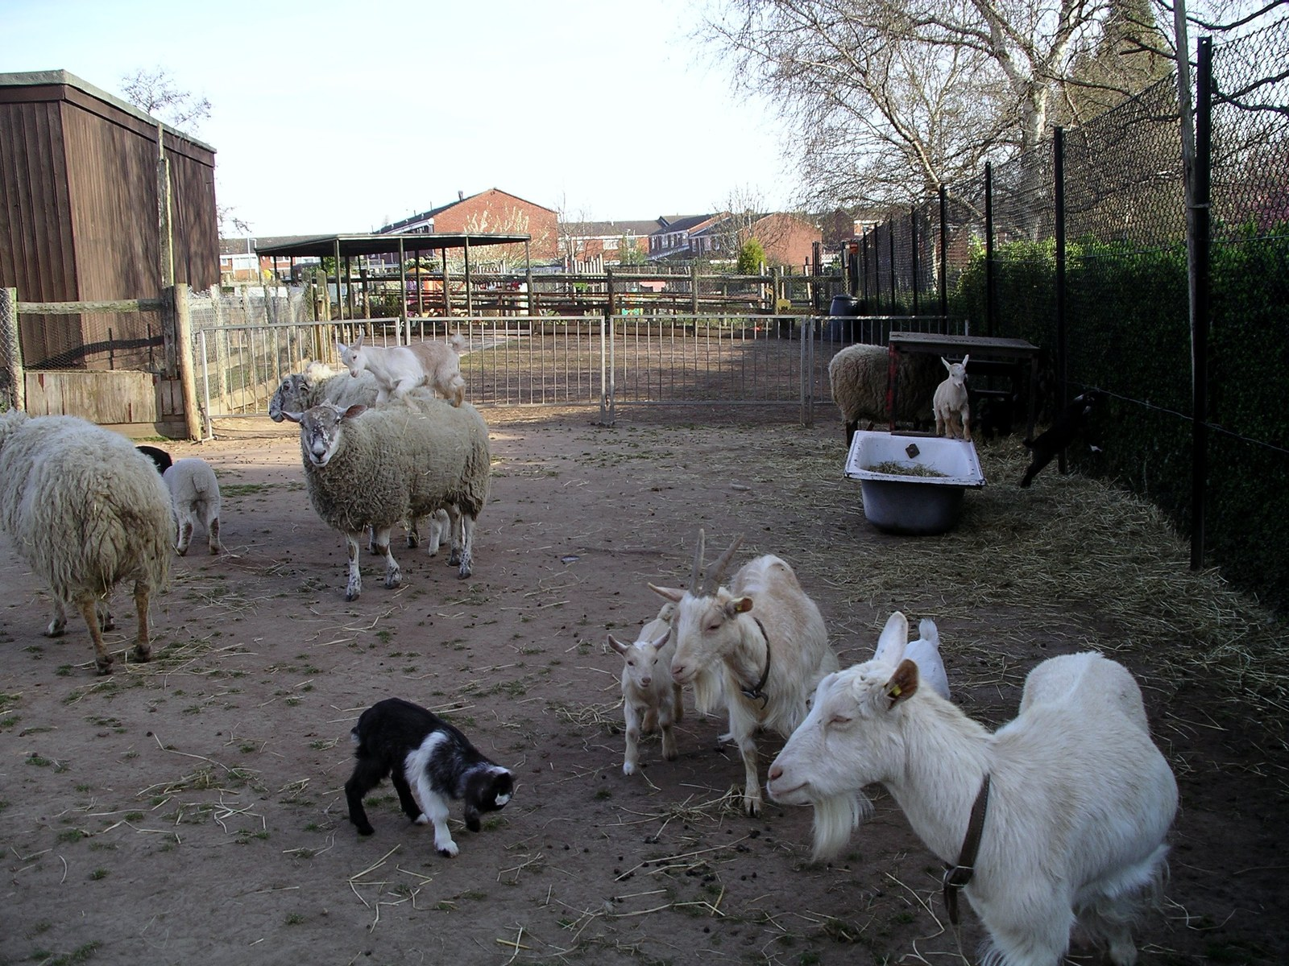
GRADE 7 · LESSON 12
Grammar: Adverbs of Frequency
Takroriylik ravishlari (always, usually, often…)
Grammar: adverbs of frequency (Unit 2)
snowmanradio · CC BY-SA 3.0
sozlar.com

Slide 2
LESSON AIMS
Bugungi maqsad
1
Put never, hardly ever, sometimes, often, usually, always on a 0–100% scale
2
Place the adverb before the main verb but after be
3
Use every day / once a week at the end of a sentence
4
Ask and answer questions with How often, What time, Where, Who, When, How many, Whose

Slide 3
FOCUS
Adverbs of frequency — the two position rules
QOIDA
QOIDA
The scale: never 0% · hardly ever · sometimes · often · usually · always 100%.
Before the main verb: We always milk the cows. He often goes to the farm.
After be: The chickens are usually noisy. Our cat is always ill.
every day / once a week go at the end: We buy eggs from a farm every week.
sometimes can also go at the end: I go with him sometimes.

Slide 4
BOOK TASK · 12 MINUTES
Book tasks — Laser A1+, p. 19
Adverbs of frequency.
1
ex.1 Rewrite each sentence so the word in bold is in the correct place (eight sentences).
2
ex.2 Use the table (always / usually / sometimes / never) to write sentences about the farm animals.
3
ex.3 Talk about you: What do you usually have for breakfast? What do you never do at the weekend?

Slide 5
VOCABULARY
A. How often? — the scale
🚫️
never
hech qachon (0%)
Our old dog never runs after the chickens.
❄️
hardly ever
deyarli hech qachon
It hardly ever snows in Termez.
🌗️
sometimes
ba’zan
I sometimes help my uncle at his farm in the summer.
🔁️
often
tez-tez
My grandparents often come to our house on Sundays.
💯️
always
doim, har doim (100%)
Kamola always does her homework before dinner.

Slide 6
VOCABULARY
B. Life on the farm (1/2)
🥚️
buy eggs
tuxum sotib olmoq
We often buy eggs from the farm near our village.
🤒️
be ill
kasal bo‘lmoq
My grandpa is hardly ever ill — he walks every morning.
🍽️
eat three meals a day
kuniga uch mahal ovqatlanmoq
I always eat three meals a day: breakfast, lunch and dinner.
🦆️
fly
uchmoq
Farm ducks hardly ever fly — they like walking and swimming.
🍏️
eat apples
olma yemoq
My little sister sometimes eats apples for breakfast.

Slide 7
VOCABULARY
B. Life on the farm (2/2)
🐐️
play with the visitors
mehmonlar bilan o‘ynamoq
The young goats always play with the visitors.
🔊️
make funny noises
kulgili ovozlar chiqarmoq
The ducks sometimes make funny noises in the morning.
😊️
be happy
xursand bo‘lmoq
Our donkey is always happy when the children come.
🐕️
bite
tishlamoq
Don’t worry — our old dog never bites.
😪️
have a sleep
bir oz uxlab olmoq
After lunch Ned often has a sleep in the field.

Slide 8
VOCABULARY
C. School and clubs (1/2)
🪪️
be a member of a club
to‘garak a’zosi bo‘lmoq
My brother is a member of a club for young artists, and he often paints there.
🤝️
join a club
to‘garakka qo‘shilmoq (yozilmoq)
New students often join a club in September.
📷️
photography club
fotografiya to‘garagi
My cousin often takes pictures of birds and flowers at photography club.
♟️
meet
yig‘ilmoq, uchrashmoq
Our chess club always meets on Tuesdays.

Slide 9
VOCABULARY
C. School and clubs (2/2)
😠️
be cross
jahli chiqmoq (achchiqlanmoq)
Our teacher is never cross with us — she’s very kind.
🏃️
arrive late
kechikib kelmoq
Bekzod hardly ever arrives late for lessons.
🥤️
be thirsty
chanqamoq
In summer I’m often thirsty, so I take a big bottle of water to school.
💬️
send text messages
SMS (matnli xabar) yubormoq
Grandma hardly ever sends text messages — she prefers to phone.

Slide 10
VOCABULARY
D. At home and free time (1/2)
🫧️
load the dishwasher
idish yuvish mashinasiga idish joylamoq
I sometimes load the dishwasher after dinner to help Mum.
💃️
go dancing
raqsga tushgani bormoq
My sister sometimes goes dancing on Saturday evenings.
🏋️
do sport
sport bilan shug‘ullanmoq
My dad often does sport in the park before work.
🏊️
go swimming
suzishga bormoq
In summer we often go swimming in the river.

Slide 11
VOCABULARY
D. At home and free time (2/2)
🛍️
go shopping
xarid qilgani bormoq
Mum always goes shopping at the bazaar on Sunday mornings.
📻️
listen to the radio
radio tinglamoq
Grandpa always listens to the radio in the kitchen.
🎈️
in your free time
bo‘sh vaqtingda
What do you often do in your free time?

Slide 12
TODAY'S WORDS IN CONTEXT
How often at Amberton Farm?
Life at Amberton Farm is always busy. The workers always get up very early and they always milk the cows before breakfast. The chickens are usually noisy in the morning!
Ned the old donkey often sleeps in the afternoon, but he always wakes up for his apple. He is usually happy, and he never bites. The cats hardly ever play with the visitors — they sometimes watch them from the roof.
How often do visitors come? Every day! Some families come once a week, and school groups often come on Fridays.
Cover the word list. Can you understand the words in bold from the sentence?

Slide 13
TODAY'S WORDS IN CONTEXT
Read and answer
1
What do the workers always do before breakfast?
2
Does Ned bite?
3
How often do the cats play with the visitors?
4
When do school groups often come?

Slide 14
PAIRS · ESDA QOLDIMI?
Memory check — fix the sentence
Juftingiz noto‘g‘ri tartibli gap aytadi, siz to‘g‘rilaysiz.
1
My dog eats usually three meals a day. · My sister goes often dancing.
2
Do you go sometimes swimming? · That duck flies never.
3
Say three things you always do and one thing you never do.

Slide 15
PRONUNCIATION
Say it — don’t just read it
Stress in adverbs of frequency and new words:
always /ˈɔːlweɪz/
often /ˈɒfn/
sometimes /ˈsʌmtaɪmz/
never /ˈnevə/
hardly ever /ˈhɑːdli ˈevə/
photography club /fəˈtɒɡrəfi klʌb/
load the dishwasher /ləʊd ðə ˈdɪʃwɒʃə/
be thirsty /bi ˈθɜːsti/
In often the t is usually silent: /ˈɒfn/.

Slide 16
WHOLE CLASS
Practice — complete the sentence (1/2)
1
0% = ________ · 100% = ________
2
We ________ milk the cows before breakfast — every single day. (100%)
3
The chickens are ________ noisy — most of the time. (odatda)
4
I ________ go swimming with my uncle — maybe once a month. (ba’zan)
5
Our cat ________ ________ bites — she's a very friendly cat. (deyarli hech qachon)
6
Correct the order: 'We every week buy eggs.' → We buy eggs ________ ________.

Slide 17
WHOLE CLASS
Practice — complete the sentence (2/2)
7
Correct the order: 'Our cat always is ill.' → Our cat ________ ________ ill.
8
Correct the order: 'I get up never at five.' → I ________ ________ ________ at five.
9
'________ ________ does the club meet?' 'Once a week.'
10
'________ pencil case is this?' 'It's my brother's.'
11
'________ ________ subjects do you do?' 'Ten.'
12
What do you ________ have for breakfast? (odatda)

Slide 18
PAIR / GROUP WORK · 8 MINUTES
Vocabulary activity
1
Match the beginnings (1-10) with the endings (a-j).
2
Read your complete sentences aloud.
3
Give the Uzbek meaning of the key word in each sentence.
4
When you finish, swap tables with the other group.

Slide 19
PAIRS
Speaking
Laser p.19 ex.3 — ask your partner the four 'Talk about you' questions.
Find someone who… always eats three meals a day / never sends text messages / often goes swimming. Ask 'How often do you…?'

Slide 20
UZ
Qiyin joyi — o‘zbekcha
O‘zbekchada ravish fe’ldan oldin keladi — inglizchada ham asosiy fe’ldan oldin: I always get up…
Faqat be (am/is/are) bilan ravish keyin keladi: She is always late.
hardly ever — «deyarli hech qachon»; never bilan gapda not ishlatilmaydi: I never go (I don't never go).
every day, once a week — gap oxirida.

Slide 21
HOMEWORK
Uy vazifasi
1
Laser A1+ Workbook pp. 14, 25, ex. 1–4.
2
Learn the 30 items with the flashcards: sozlar.com/vocab/cards/?set=grade7-lesson12
3
Write eight sentences about your week with eight different frequency words.

Slide 22
IMAGE CREDITS
Rasmlar manbasi
cover
snowmanradio · CC BY-SA 3.0 · https://commons.wikimedia.org/w/index.php?curid=1924224

Slide 23
Uchta so‘z — ertaga ham esingizda qoladi
Juftingizga ayting, so‘ng daftaringizga yozib qo‘ying.
sozlar.com/vocab/cards/?set=grade7-lesson12

