Slide 1
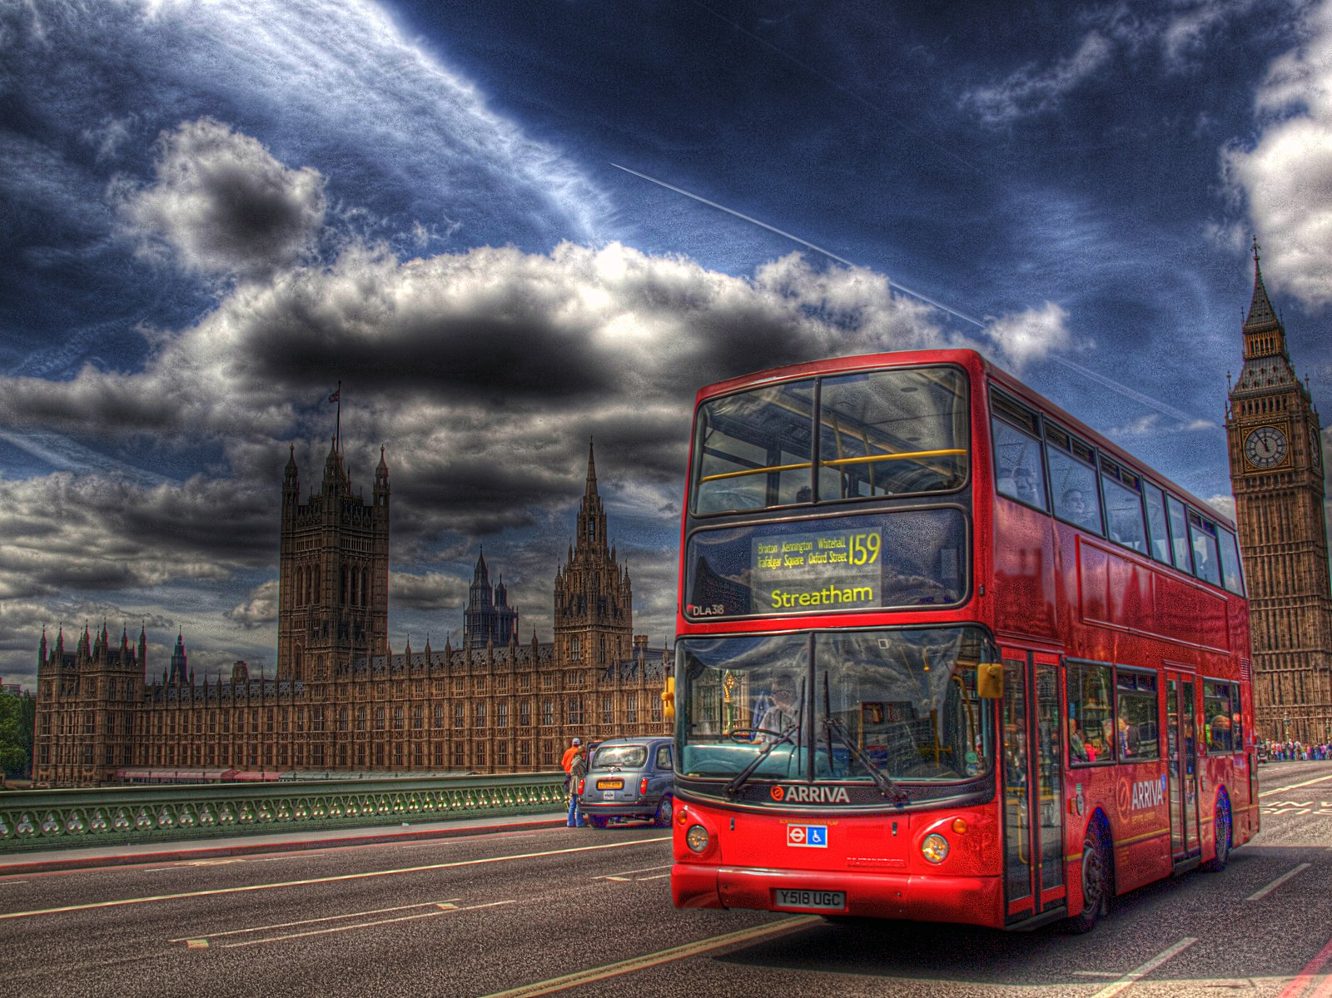
GRADE 10 · LESSON 11
Vocabulary Builder: Public Transport
So‘z boyligi: jamoat transporti, adashtiriladigan so‘zlar, birikmalar
Vocabulary builder: Public transport. Confusable words. Collocations (Unit 2)
Kevin Poh from Petaling Jaya, Malaysia · CC BY 2.0
sozlar.com

Slide 2
LESSON AIMS
Bugungi maqsad
1
Match eight public-transport words with their definitions (ex. 1)
2
Choose correctly in four confusable pairs (ex. 2)
3
Sort fourteen means of transport into get in / get out of and get on / get off (ex. 3)
4
Guess the means of transport from what a speaker says (ex. 5)

Slide 3
VOCABULARY
A. Public transport (1/2)
✈️
an airline
aviakompaniya
Which airline are you flying with?
🏢️
a terminal
aeroport terminali
Our flight leaves from Terminal 2.
🚇️
the underground
metro
The underground is the quickest way to get around Tashkent.
🛏️
a cabin
kayuta (kemadagi xona)
Our cabin on the ship had two small beds.

Slide 4
VOCABULARY
A. Public transport (2/2)
🚕️
a taxi rank
taksilar to‘xtash joyi
There’s a taxi rank right outside the station.
⛴️
a ferry
parom
We took the ferry across the lake to the island.
🛫️
take-off
(samolyotning) havoga ko‘tarilishi
Please turn off your phone before take-off.
🛬️
landing
(samolyotning) qo‘nishi
Keep your seat belt on until after landing.

Slide 5
VOCABULARY
B. Travel, journey or trip? (1/2)
🌍️
travel
sayohat (umuman; sanalmaydi)
I think travel teaches you a lot about other countries.
🛤️
a journey
yo‘l, safar (bir joydan boshqasiga)
The journey from Tashkent to Bukhara takes six hours by train.
🎒️
a trip
qisqa safar (borib qaytiladigan)
We went on a school trip to the museum.

Slide 6
VOCABULARY
B. Travel, journey or trip? (2/2)
💼️
a business trip
xizmat safari
My mum is in Moscow on a business trip this week.
🏃️
miss the bus
avtobusga ulgurmay qolmoq
I got up late and missed the bus to school.
🎫️
lose your ticket
chiptani yo‘qotib qo‘ymoq
Don’t lose your ticket — you need it to leave the station.

Slide 7
VOCABULARY
C. Getting on and off (1/2)
🚏️
get on the bus
avtobusga chiqmoq
We got on the bus at the market.
🚆️
get off the train
poyezddan tushmoq
Hundreds of people got off the train in Samarkand.
🚖️
get into a taxi
taksiga o‘tirmoq
We got into a taxi outside the hotel.
🚗️
get out of the car
mashinadan tushmoq
Dad stopped and we got out of the car.

Slide 8
VOCABULARY
C. Getting on and off (2/2)
🐎️
get on a horse
otga minmoq
It isn’t easy to get on a horse without help.
🚣️
a rowing boat
eshkakli qayiq
We hired a rowing boat on the lake.
🚎️
a trolleybus
trolleybus
The old trolleybus moved slowly along the main street.

Slide 9
VOCABULARY
D. Compound nouns (1/2)
🚄️
an express train
tezyurar poyezd
The express train doesn’t stop at small stations.
📞️
a radio taxi
chaqiruv taksisi (telefon orqali)
Call a radio taxi — it’ll be here in ten minutes.
🔴️
a double-decker bus
ikki qavatli avtobus
In London we rode on a red double-decker bus.

Slide 10
VOCABULARY
D. Compound nouns (2/2)
🛩️
a jet plane
reaktiv samolyot
A jet plane can fly from Tashkent to London in seven hours.
🏎️
a sports car
sport avtomobili
My cousin dreams of driving a red sports car.
🚃️
a local train
shahar atrofi poyezdi (elektrichka)
The local train stops at every small village.

Slide 11
TODAY'S WORDS IN CONTEXT
A day of journeys (1/2)
Last summer my family went on a trip to London. The journey started badly: we missed the bus to the airport, so we got into a taxi instead. At the terminal we checked in with our airline, and the flight was on time. Take-off was noisy, but landing was smooth.
In London we got on a double-decker bus and sat upstairs. Then we took the underground — in the rush hour! The platform was so crowded that my brother nearly lost his ticket.
Cover the word list. Can you understand the words in bold from the sentence?

Slide 12
TODAY'S WORDS IN CONTEXT
A day of journeys (2/2)
Two days later we took a ferry to France. We didn't have a cabin — it was only ninety minutes — and when we got off the ferry, a radio taxi was waiting for us. The tickets were expensive, but travel really does teach you about other people.
Cover the word list. Can you understand the words in bold from the sentence?

Slide 13
TODAY'S WORDS IN CONTEXT
Read and answer
1
Why did the family take a taxi to the airport?
2
Where did they sit on the double-decker bus?
3
Why was the platform crowded?
4
Why didn't they need a cabin on the ferry?
5
Find a pair of confusable words in the text.

Slide 14
PAIRS · ESDA QOLDIMI?
Memory check — in or on?
Juftingiz transport nomini aytadi, siz «get in» yoki «get on» deysiz.
1
car · bus · taxi · plane · horse · rowing boat · ferry · trolleybus
2
miss or lose? — the bus · your ticket · the flight · your bag
3
travel, journey or trip? — a business ___ · I love ___ — I want to see the world · the ___ took six hours

Slide 15
FOCUS
Three traps on p. 17
• travel (uncountable — the activity) · a journey (from A to B) · a trip (you go and come back, often short: a business trip, a school trip).
• miss the bus / a flight (you are too late, or you are not there) · lose your ticket / your bag (you can't find it).
• get in / get out of — small vehicles you sit inside: car, taxi, helicopter, rowing boat, balloon basket.
• get on / get off — vehicles you can stand or walk on, or ride: bus, train, plane, ship, ferry, bicycle, horse, motorbike.
• Compound nouns: noun + noun — a sports car, a double-decker bus, an express train, a taxi rank.

Slide 16
BOOK TASK · 14 MINUTES
Book tasks — Laser B1+, p. 17
Vocabulary builder: public transport.
1
ex.1 Match the words in the box with the definitions (one word you don't need).
2
ex.2 Circle the correct word: travel / journey · trip / journey · miss / lose · on / in.
3
ex.3 Complete the table: get in (into) / get out of — get on / get off.
4
ex.4 Match A and B to make compound nouns.
5
ex.5 Which means of transport is each person talking about?

Slide 17
PRONUNCIATION
Say it — don’t just read it
Word stress (ˈ marks the stress) — in compound nouns it is usually on the FIRST word:
taxi rank /ˈtæksi ræŋk/
sports car /ˈspɔːts kɑː/
rowing boat /ˈrəʊɪŋ bəʊt/
trolleybus /ˈtrɒlibʌs/
airline /ˈeəlaɪn/
underground /ˈʌndəɡraʊnd/
journey /ˈdʒɜːni/
double-decker /ˌdʌbl ˈdekə/
Double-decker is the exception: double-DECKer.

Slide 18
WHOLE CLASS
Practice — complete the sentence (1/2)
1
This is where taxis wait for passengers in the street: a ________.
2
This is a boat that carries people and cars across a river or a lake: a ________.
3
This is a system of trains in tunnels in a large city: the ________.
4
This is where you sleep on a ship: a ________.
5
I think that ________ really teaches you about other people. (travel / journey)
6
Mr Carter has gone to Moscow on a business ________. (trip / journey)

Slide 19
WHOLE CLASS
Practice — complete the sentence (2/2)
7
Hurry up, or we're going to ________ the bus! (miss / lose)
8
Don't get ________ the train unless you know where it's going! (on / in)
9
We got ________ the taxi and told the driver to go to the airport. (into / on)
10
He got ________ his bicycle and walked up the hill. (off / out of)
11
Let's sit upstairs on the ________ bus.
12
It's noisy during ________, but you can't hear the engines after that.

Slide 20
PAIR / GROUP WORK · 8 MINUTES
Vocabulary activity
1
Match the beginnings (1-10) with the endings (a-j).
2
Read your complete sentences aloud.
3
Give the Uzbek meaning of the key word in each sentence.
4
When you finish, swap tables with the other group.

Slide 21
PAIRS
Speaking
Laser p.17 ex.5 — say a sentence like a passenger; your partner guesses the means of transport.
Describe your last journey: how you got there, what you got on / off, and what went wrong.

Slide 22
UZ
Qiyin joyi — o‘zbekcha
travel — umuman sayohat qilish (sanalmaydi); journey — bir joydan boshqa joyga yo‘l; trip — borib-qaytiladigan (ko‘pincha qisqa) safar.
miss — ulgurmay qolish (avtobusdan qolmoq); lose — yo‘qotish (chiptani yo‘qotmoq).
Kichik, ichiga o‘tiriladigan transport — get in / get out of; ustiga chiqiladigan yoki minib yuriladigan — get on / get off.
Qo‘shma otlarda urg‘u odatda birinchi so‘zda: TAXI rank, SPORTS car.

Slide 23
HOMEWORK
Uy vazifasi
1
Laser B1+ Workbook pp. 12–13 (vocabulary).
2
Learn the 27 items with the flashcards: sozlar.com/vocab/cards/?set=grade10-lesson11
3
Write about a real or imaginary journey (80–100 words) using ten words from the lesson.

Slide 24
IMAGE CREDITS
Rasmlar manbasi
cover
Kevin Poh from Petaling Jaya, Malaysia · CC BY 2.0 · https://commons.wikimedia.org/w/index.php?curid=15379952

Slide 25
Uchta so‘z — ertaga ham esingizda qoladi
Juftingizga ayting, so‘ng daftaringizga yozib qo‘ying.
sozlar.com/vocab/cards/?set=grade10-lesson11

