Slide 1
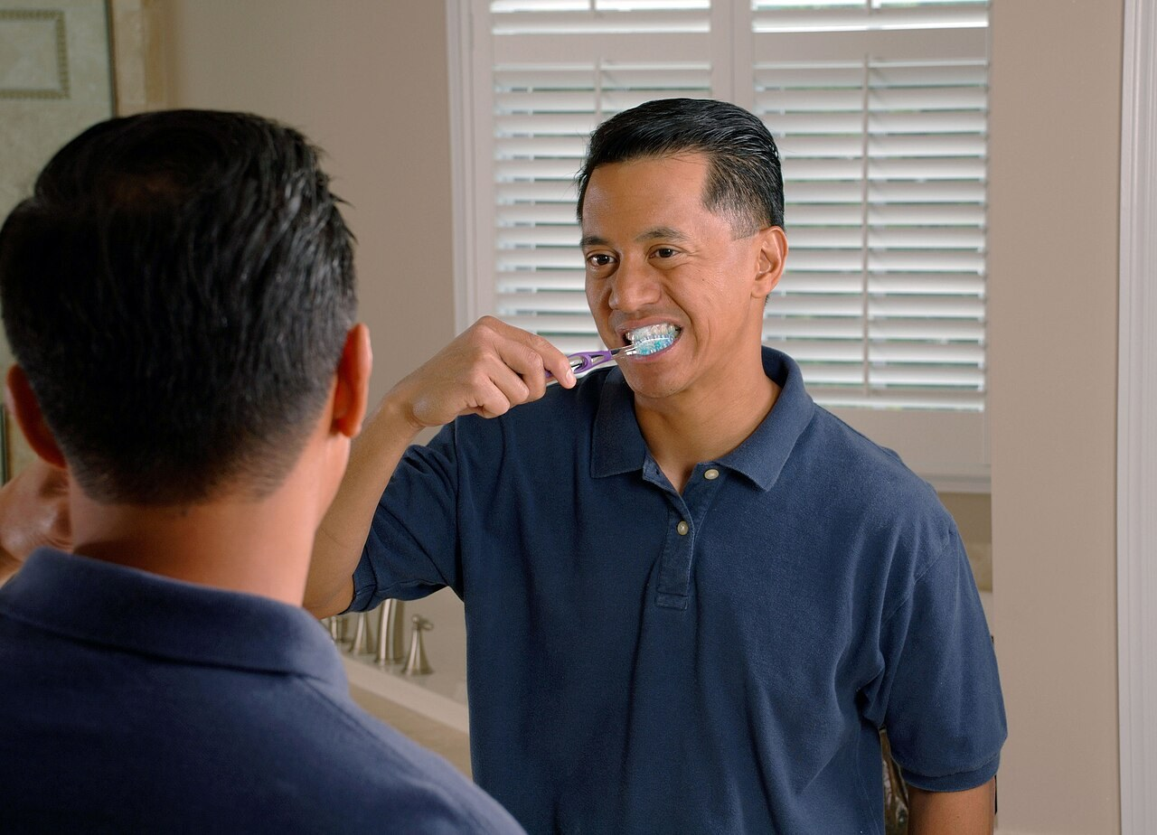
GRADE 7 · LESSON 11
Talking about Daily Activities
Kundalik ishlar haqida gapirish
Speaking: talking about daily activities (Unit 2)
Bill Branson (Photographer) · Public domain
sozlar.com

Slide 2
LESSON AIMS
Bugungi maqsad
1
Name about thirty daily activities from morning to night
2
Ask 'What time do you…? Do you… too?' and give short answers
3
Retell a partner's day with Then, After breakfast, Half an hour later
4
Say the SoundSpot sentence with clear /s/ and /ʃ/

Slide 3
VOCABULARY
A. My morning (1/3)
🌅️
wake up
uyg‘onmoq
I wake up at half past six, but I stay in bed for ten minutes.
🧍️
get up
o‘rnidan turmoq
On school days Sardor gets up at seven o’clock.
🚿️
have a shower
dushga tushmoq
My dad has a shower every morning before work.
💧️
wash your face
yuzini yuvmoq
I wash my face with cold water — then I’m awake!

Slide 4
VOCABULARY
A. My morning (2/3)
👕️
get dressed
kiyinmoq
Malika gets dressed quickly and puts on her school uniform.
🛏️
make your bed
o‘rnini yig‘ishtirmoq
Before breakfast I make my bed — Mum likes a tidy room.
🍳️
have breakfast
nonushta qilmoq
We have breakfast together at quarter past seven.
🪥️
clean your teeth
tishini yuvmoq
After breakfast Jasur cleans his teeth in the bathroom.

Slide 5
VOCABULARY
A. My morning (3/3)
🎒️
go to school
maktabga bormoq
My sister and I go to school together at eight.
🚶️
walk to school
maktabga piyoda bormoq
We live near the school, so I walk to school.
🚌️
take the bus
avtobusda bormoq (avtobusga chiqmoq)
When it rains, I take the bus to school.
🏫️
arrive at school
maktabga yetib kelmoq
I usually arrive at school ten minutes before the first lesson.

Slide 6
VOCABULARY
B. After school (1/2)
🥪️
have lunch
tushlik qilmoq
We have lunch in the school canteen at one o’clock.
🚪️
leave school
maktabdan chiqmoq
On Mondays we leave school at half past one.
🏠️
come home
uyga kelmoq
My mum comes home from work at six.
🍎️
have a snack
tamaddi qilmoq (yengil ovqatlanib olmoq)
After school I have a snack — an apple or some bread.
📚️
do your homework
uy vazifasini bajarmoq
Aziz does his homework at his desk after lunch.

Slide 7
VOCABULARY
B. After school (2/2)
⚽️
play football
futbol o‘ynamoq
On Wednesdays the boys play football in the school yard.
🌳️
go for a walk
sayrga chiqmoq
In the afternoon I go for a walk in the park with my dog.
📱️
phone a friend
do‘stiga qo‘ng‘iroq qilmoq
When I don’t understand my maths homework, I phone a friend.
🧹️
tidy your room
xonasini yig‘ishtirmoq
On Saturdays I tidy my room and help my mum.

Slide 8
VOCABULARY
C. In the evening (1/2)
🍽️
set the table
dasturxon tuzamoq
Before dinner my brother sets the table.
🍛️
have dinner
kechki ovqatlanmoq
Our family has dinner at seven o’clock in the evening.
🌛️
get into bed
o‘ringa yotmoq
At ten o’clock I get into bed and say goodnight to my parents.
📖️
read a book
kitob o‘qimoq
Every evening I read a book for twenty minutes.

Slide 9
VOCABULARY
C. In the evening (2/2)
🛌️
go to bed
uxlashga yotmoq
On school days I go to bed at ten o’clock.
💡️
turn off the light
chiroqni o‘chirmoq
At half past ten Mum turns off the light in my room.
😴️
go to sleep
uxlamoq (uyquga ketmoq)
I read for a short time and then I go to sleep.
💤️
fall asleep
uxlab qolmoq
My little brother often falls asleep in front of the TV.

Slide 10
TODAY'S WORDS IN CONTEXT
Jasur's school day
Jasur is twelve. He wakes up at quarter to seven and gets up at seven o'clock. Then he has a shower, gets dressed and has breakfast with his sister.
After breakfast, at twenty past seven, he cleans his teeth and goes to school. Half an hour later, at ten to eight, he arrives at school.
He leaves school at half past one and comes home at two. He has lunch at home, does his homework and plays football with his friends. The family has dinner at seven. Jasur watches TV for an hour, goes to bed at half past nine and goes to sleep at ten.
Cover the word list. Can you understand the words in bold from the sentence?

Slide 11
TODAY'S WORDS IN CONTEXT
Read and answer
1
What time does Jasur get up?
2
What does he do after breakfast?
3
When does he arrive at school?
4
Where does he have lunch?
5
How long does he watch TV?

Slide 12
PAIRS · ESDA QOLDIMI?
Memory check — my day in order
Juftingiz faoliyatni o‘zbekcha aytadi, siz inglizcha va vaqti bilan aytasiz.
1
tish yuvmoq · kiyinmoq · o‘rnini yig‘ishtirmoq · maktabdan chiqmoq · dasturxon tuzamoq · chiroqni o‘chirmoq
2
Put in order: fall asleep · wake up · have a snack · have breakfast · turn off the light · come home
3
Say your day in six sentences with Then and After.

Slide 13
FOCUS
Phrase Bank — telling the story of a day
• Start with a time: Jenny gets up at half past seven. (he/she + -s!)
• Then, at eight o'clock, she has breakfast.
• After breakfast, at quarter past eight, she cleans her teeth.
• Half an hour later, at half past eight, she goes to school.
• Ask and compare: What time do you…? — At… . Do you… too? — Yes, I do. / No, I don't.

Slide 14
STRATEGY
Interview — four steps (book p. 18)
1
Say the dialogue in pairs (ex.1).
2
Complete the first column of the notepad with YOUR times (ex.2).
3
Ask and answer; write your friend's times in the second column (ex.3).
4
Tell the class about your friend with the Phrase Bank (ex.4).

Slide 15
PRONUNCIATION
Say it — don’t just read it
SoundSpot — /s/ and /ʃ/. Say each phrase, then the sentence:
have a shower /hæv ə ˈʃaʊə/
wash your face /wɒʃ jə feɪs/
set the table /set ðə ˈteɪbl/
take the bus /teɪk ðə bʌs/
have a snack /hæv ə snæk/
fall asleep /fɔːl əˈsliːp/
Six sick sheep sit on one seat.
Slowly first, then as fast as you can — who can say it three times without a mistake?

Slide 16
WHOLE CLASS
Practice — complete the sentence (1/2)
1
My alarm rings at seven, so I ________ ________ at seven, but I stay in bed until quarter past.
2
I have a shower and then I ________ ________ — I put on my school clothes.
3
We ________ ________ in the kitchen at eight o'clock in the morning.
4
After breakfast I ________ ________ ________ in the bathroom.
5
I leave home at half past eight and I ________ ________ ________ at ten to nine.
6
At two o'clock I ________ ________ and walk home.

Slide 17
WHOLE CLASS
Practice — complete the sentence (2/2)
7
I ________ ________ ________ before dinner, not after.
8
My family ________ ________ in the kitchen at seven in the evening.
9
I ________ ________ ________ at ten, but I read until half past.
10
________ ________ ________ later, at half past eight, she goes to school.
11
'Do you get up at seven?' 'No, I ________.'
12
I have breakfast at eight. Do you have breakfast at eight ________?

Slide 18
PAIRS · 8 MINUTES
Speaking
Interview your partner with the notepad: twelve activities, twelve times.
Tell the class about your partner in five sentences with Then / After… / Half an hour later.

Slide 19
PAIR / GROUP WORK · 8 MINUTES
Vocabulary activity
1
Match the beginnings (1-10) with the endings (a-j).
2
Read your complete sentences aloud.
3
Give the Uzbek meaning of the key word in each sentence.
4
When you finish, swap tables with the other group.

Slide 20
UZ
Qiyin joyi — o‘zbekcha
wake up — uyg‘onish; get up — o‘rnidan turish. Ikkalasi har xil.
go to bed — uxlashga yotish; go to sleep — uyquga ketish.
Do‘stingiz haqida gapirganda fe’lga -s: She gets up… He has breakfast…
Half an hour later — «yarim soatdan keyin»; Then — «keyin, so‘ngra».
/s/ va /ʃ/: sit — «sit», sheep — «shiyp». O‘zbekchada «s» va «sh» kabi farqlanadi.

Slide 21
HOMEWORK
Uy vazifasi
1
Learn the vocabulary by heart and prepare a one-minute talk about a day at Amberton Farm (plan: speaking about a farm).
2
Learn the 29 items (sections A–C) with the flashcards: sozlar.com/vocab/cards/?set=grade7-lesson11
3
Practise the SoundSpot sentence — say it three times fast.

Slide 22
IMAGE CREDITS
Rasmlar manbasi
cover
Bill Branson (Photographer) · Public domain · https://commons.wikimedia.org/wiki/File:Man_brushing_teeth.jpg

Slide 23
Uchta so‘z — ertaga ham esingizda qoladi
Juftingizga ayting, so‘ng daftaringizga yozib qo‘ying.
sozlar.com/vocab/cards/?set=grade7-lesson11

