Slide 1
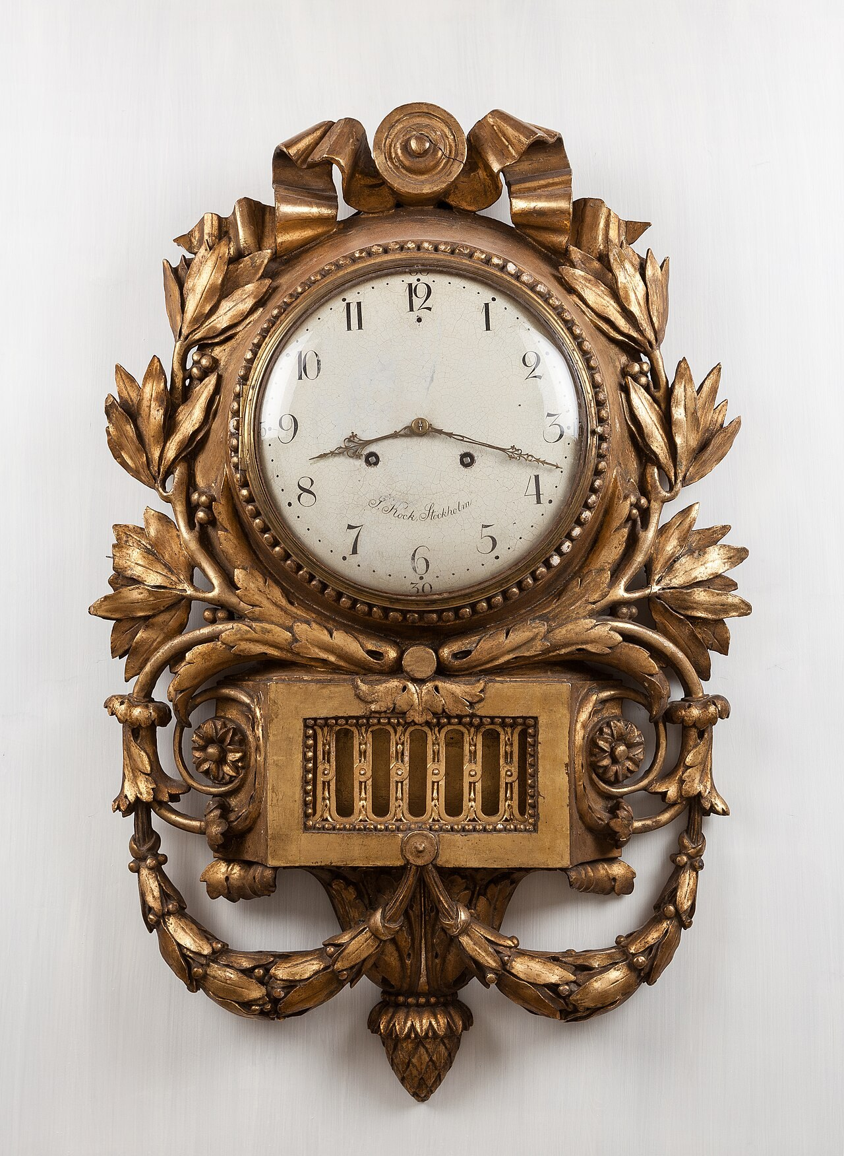
GRADE 7 · LESSON 10
Telling the Time
Vaqtni aytish
General basic vocabulary (time) (Unit 2)
Christoph Braun · CC0
sozlar.com

Slide 2
LESSON AIMS
Bugungi maqsad
1
Say any time with o'clock, half past, quarter past / to and minutes past / to
2
Use second, minute, hour, half an hour, a quarter of an hour
3
Ask 'What time is it?' and 'What time do you…?'
4
Catch times and 'once a day / week / month' while listening

Slide 3
VOCABULARY
A. On the clock (1/3)
🕒️
three o’clock
soat uch
The shop opens again at three o’clock in the afternoon.
🕞️
half past three
soat uch yarim (3:30)
Our football practice starts at half past three.
🕗️
quarter past eight
sakkizdan chorak o‘tdi (8:15)
Lessons start at quarter past eight, so I leave home at eight.
🕝️
quarter to three
uchga chorak qoldi (2:45)
It’s quarter to three — the bus comes in fifteen minutes.

Slide 4
VOCABULARY
A. On the clock (2/3)
🕚️
twenty past eleven
o‘n birdan yigirma daqiqa o‘tdi (11:20)
Our long break is at twenty past eleven.
🕑️
five to three
uchga besh daqiqa qoldi (2:55)
Hurry up, Dilnoza! It’s five to three and the film starts at three.
🚆️
seven fifteen
yetti-yu o‘n besh daqiqa (7:15)
My train leaves at seven fifteen — that’s quarter past seven.
☀️
midday
tush payti (soat 12:00)
In summer the sun is very hot at midday.

Slide 5
VOCABULARY
A. On the clock (3/3)
🌙️
midnight
yarim tun (soat 00:00)
On New Year’s Eve we stay up until midnight.
🏛️
a.m.
tushdan oldin (00:00 dan 12:00 gacha)
The museum opens at 9 a.m. every day.
🏫️
p.m.
tushdan keyin (12:00 dan 24:00 gacha)
On Fridays our last lesson finishes at 1 p.m.

Slide 6
VOCABULARY
B. Minutes and hours (1/2)
⏱️
a second
bir soniya
Can you wait a second? I’m looking for my keys.
⏲️
a minute
bir daqiqa
Our teacher gives us a minute to think about each question.
⌛️
an hour
bir soat (vaqt o‘lchovi)
Our English lesson is less than an hour — it’s forty-five minutes.
🚶️
half an hour
yarim soat
It takes half an hour to walk to my grandma’s house.
🚌️
a quarter of an hour
chorak soat (15 daqiqa)
The bus is late, so we wait for a quarter of an hour at the stop.

Slide 7
VOCABULARY
B. Minutes and hours (2/2)
🎬️
in an hour
bir soatdan keyin
The film starts in an hour, so let’s do our homework now.
♟️
for two hours
ikki soat davomida
On Sundays I play chess with my dad for two hours.
🕰️
a clock
soat (devor yoki stol soati)
There’s a clock above the board in our classroom.
⏰️
an alarm clock
budilnik (uyg‘otuvchi soat)
My alarm clock rings at half past six every morning.

Slide 8
VOCABULARY
C. Early, late or on time?
👦️
tell the time
soatga qarab vaqtni aytmoq
My little brother is six, and he can tell the time now.
🐓️
early
erta, barvaqt
Farmers get up very early, at five o’clock.
🏃️
late
kech; kechikib
Don’t be late — the test starts at eight!
🚉️
on time
o‘z vaqtida
The train to Samarkand always leaves on time.

Slide 9
VOCABULARY
D. How often? (listening) (1/2)
🎨️
on Thursdays
payshanba kunlari
We have art on Thursdays, after lunch.
🐟️
once a day
kuniga bir marta
I feed my fish once a day, in the morning.
🏊️
once a week
haftasiga bir marta
Aziz goes to the swimming pool once a week, on Sundays.
🗓️
once a month
oyiga bir marta
We visit our cousins in Bukhara once a month.

Slide 10
VOCABULARY
D. How often? (listening) (2/2)
🪥️
twice a day
kuniga ikki marta
Clean your teeth twice a day, in the morning and at night.
🧳️
go on holiday
ta’tilga (dam olishga) bormoq
Every summer my family goes on holiday to Chimgan.
🏖️
go to the beach
sohilga (plyajga) bormoq
When it’s very hot, we go to the beach at the lake.
🚜️
work on a farm
fermada ishlamoq
My uncle and aunt work on a farm near Jizzakh.

Slide 11
TODAY'S WORDS IN CONTEXT
A donkey who can count
I'm Ned, the old donkey at Amberton Farm. I haven't got a watch, but there's a big clock on the wall. Right now it's twelve o'clock — midday. I have lunch in an hour, at one o'clock. That's sixty minutes, or 3,600 seconds!
After lunch, at half past one, I have a sleep. I usually sleep for two hours. A quarter of an hour after that, at quarter to four, a visitor gives me an apple.
Some visitors come once a week, others once a month. Some of them get up very early to come here. I never go to bed late — I'm asleep long before midnight!
Cover the word list. Can you understand the words in bold from the sentence?

Slide 12
TODAY'S WORDS IN CONTEXT
Read and answer
1
What time does Ned have lunch?
2
How many seconds are there in an hour?
3
How long does Ned usually sleep?
4
When does Ned get his apple?

Slide 13
PAIRS · ESDA QOLDIMI?
Memory check — the clock game
O‘qituvchi soatni ko‘rsatadi, sinf inglizcha aytadi. So‘ng juftlikda.
1
8.15 · 9.30 · 10.45 · 11.20 · 2.55 · 12.00
2
How many seconds in a minute? How many minutes in half an hour?
3
Say one thing you do twice a day, one thing you do once a week and one thing you do once a month.

Slide 14
FOCUS
Telling the time — the system
• :00 — three o'clock · :30 — half past three.
• :15 — quarter past eight · :45 — quarter to nine.
• Minutes past for 1–30, minutes to for 31–59: 11.20 twenty past eleven, 2.55 five to three.
• at + time: at seven o'clock · for + length: for two hours.
• 12.00 = midday, 00.00 = midnight; a.m. = before midday, p.m. = after.

Slide 15
BOOK TASK · 10 MINUTES
Book tasks — Laser A1+, p. 17
Wordpower and Listening.
1
Wordpower ex.1 Label the clocks with the seven words.
2
Wordpower ex.2 Ned's text: each bold word is in the wrong place — write the correct word.
3
Listening ex.1 Five speakers — match each one with a person.
4
Listening ex.2 Listen again and choose A, B or C.
5
ex.3 Talk about you: Do you live on a farm? Would you like to?

Slide 16
TASK 1 · GIST
First listening — true or false?
Listen once. Write T or F. Do not stop at an unknown word.
1
Speaker 1 gets up at half past five every day.
T / F
2
Speaker 2 works at the farm.
T / F
3
Speaker 3 visits the farm once a week.
T / F
4
The farm opens at six o'clock.
T / F
5
Mrs Collins has lunch at midday.
T / F
6
Anna really likes the donkey.
T / F

Slide 17
TASK 2 · DETAILS
Second listening — complete the sentences
Listen again. Write a word, number or short phrase in each gap.
1
Speaker 1 usually gets up at ________.
2
Speaker 2 goes to school at ________.
3
Speaker 3 often goes to the ________ in summer.
4
Mrs Collins has a cup of tea at ________.
5
Anna comes to the farm once a ________.

Slide 18
PRONUNCIATION
Say it — don’t just read it
Linking sounds in times — repeat:
half past /hɑːf pɑːst/
quarter to /ˈkwɔːtə tə/
o'clock /əˈklɒk/
an hour /ən ˈaʊə/
a minute /ə ˈmɪnɪt/
midnight /ˈmɪdnaɪt/
an alarm clock /ən əˈlɑːm klɒk/
The h in hour is silent — so we say AN hour.

Slide 19
WHOLE CLASS
Practice — complete the sentence (1/2)
1
8:30 — It's ________ ________ eight.
2
2:45 — It's ________ ________ three.
3
8:15 — It's ________ ________ eight.
4
12:00 in the day is ________, and 00:00 is ________.
5
There are sixty ________ in a minute and sixty ________ in an hour.
6
Fifteen minutes is a ________ ________ ________ ________.

Slide 20
WHOLE CLASS
Practice — complete the sentence (2/2)
7
Thirty minutes is ________ ________ ________.
8
My grandfather never needs an ________ ________ — he wakes up with the sun.
9
'What ________ is it?' 'It's ten to nine.'
10
Lessons start at 8 ________ and finish at 2 ________.
11
I go to the swimming pool ________ ________ ________ — every Saturday.
12
In August we ________ ________ ________ to the mountains.

Slide 21
PAIRS
Speaking
Draw five clocks and ask your partner: 'What time is it?'
Ask: 'What time do you get up / go to bed on Saturday?' Answer with 'at…'.

Slide 22
PAIR / GROUP WORK · 8 MINUTES
Vocabulary activity
1
Match the beginnings (1-10) with the endings (a-j).
2
Read your complete sentences aloud.
3
Give the Uzbek meaning of the key word in each sentence.
4
When you finish, swap tables with the other group.

Slide 23
UZ
Qiyin joyi — o‘zbekcha
O‘zbekcha «sakkiz yarim» — inglizcha half past eight («sakkizdan yarim o‘tdi»).
«To‘qqizga chorak qoldi» — quarter to nine; «sakkizdan chorak o‘tdi» — quarter past eight.
Soat vaqtida at: at seven o'clock; davomiylikda for: for two hours.
hour dagi h o‘qilmaydi — shuning uchun an hour.

Slide 24
HOMEWORK
Uy vazifasi
1
Laser A1+ Workbook p. 13, ex. 1–2.
2
Learn the 32 items (sections A–D) with the flashcards: sozlar.com/vocab/cards/?set=grade7-lesson10
3
Write your Saturday: six things and the time you do them, all in words.

Slide 25
IMAGE CREDITS
Rasmlar manbasi
cover
Christoph Braun · CC0 · https://commons.wikimedia.org/wiki/File:Pendulum_clock_by_Jacob_Kock,_antique_furniture_photography,_IMG_0931_edit.jpg

Slide 26
Uchta so‘z — ertaga ham esingizda qoladi
Juftingizga ayting, so‘ng daftaringizga yozib qo‘ying.
sozlar.com/vocab/cards/?set=grade7-lesson10

