Slide 1
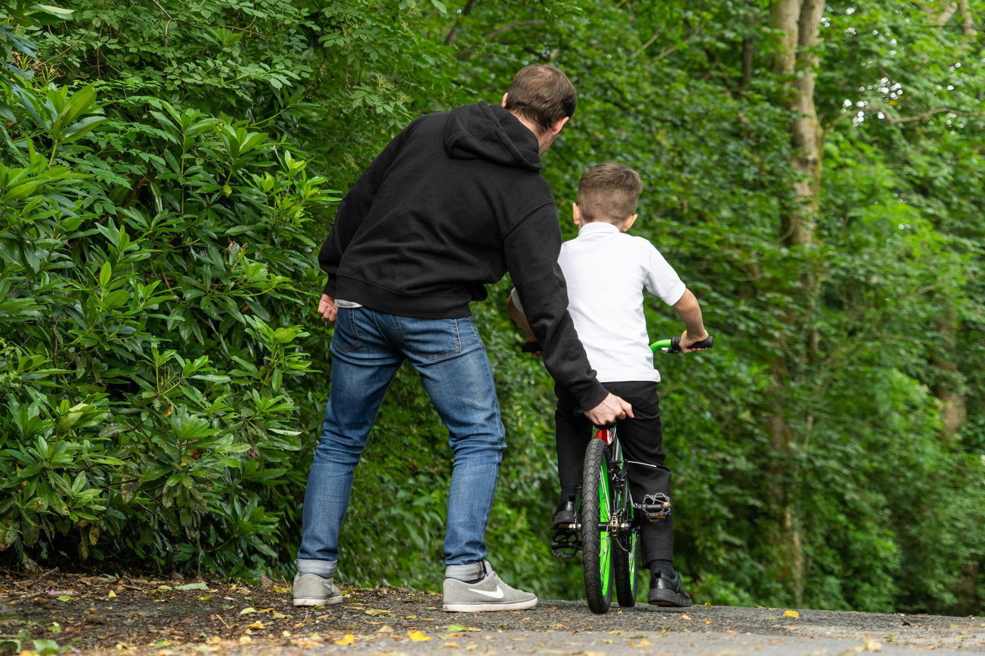
GRADE 10 · LESSON 10
Grammar Clinic: Past Tense Review
O‘tgan zamonlar takrori (Past Simple va Past Continuous)
Grammar clinic: Past tense review (Unit 2)
Alextredz · CC BY-SA 4.0
sozlar.com

Slide 2
LESSON AIMS
Bugungi maqsad
1
Match four uses of past tenses with examples from the transport text (ex. 1–2)
2
Correct four tense mistakes and find the correct sentence (ex. 4)
3
Complete the 'Learning to ride!' story (ex. 5)
4
Tell a short story about learning a skill using while / when / as

Slide 3
FOCUS
Past simple or past continuous?
QOIDA
QOIDA
Past simple — a finished action, a sequence, or a repeated past action: made its first flight in 1783.
Past continuous — in progress at a past moment; it sets the scene: it was raining.
Interruption: long = past continuous, short = past simple: They were admiring the view when they saw smoke.
while / as + past continuous · when + past simple (usually).
States (be, have = own, know, want, believe) are not continuous: I wanted, NOT I was wanting.

Slide 4
BOOK TASK · 12 MINUTES
Book tasks — Laser B1+, p. 16
Look at Grammar database pp. 168–170 first.
1
ex.1 Match sentences 1–4 from the transport text with explanations a–d.
2
ex.2 Find more examples in the text on pp. 14–15.
3
ex.3 The plane story — past simple or past continuous (six sentences).
4
ex.4 Correct the mistakes — one sentence has no mistake. Which one?
5
ex.5 'Learning to ride!' — complete the text with the verbs in the box.

Slide 5
VOCABULARY
A. Travel stories (1/3)
👨‍✈️
pilot
uchuvchi
The pilot was smiling when he walked off the plane.
💨️
smoke
tutun
They were admiring the mountains when they suddenly saw smoke.
🔥️
burn
yonmoq
The balloon was burning, but the two men stayed calm.
🧊️
iceberg
aysberg
People were dancing on the ship when it hit an iceberg.

Slide 6
VOCABULARY
A. Travel stories (2/3)
🚑️
an accident
baxtsiz hodisa, avariya
We were waiting at the bus stop when the accident happened.
👀️
notice
payqamoq, ko‘zi tushmoq
As we were walking into the station, I noticed a lost dog.
🪟️
look out of the window
derazadan qaramoq
I looked out of the window and saw the sea below us.
😌️
close your eyes
ko‘zini yummoq
I closed my eyes while the plane was taking off.

Slide 7
VOCABULARY
A. Travel stories (3/3)
📢️
shout
baqirmoq, qichqirmoq
Somebody shouted ‘Stop!’ just as the bus was leaving.
📺️
a TV programme
teleko‘rsatuv
I was watching a TV programme about old cars when you called.
🏛️
the history of transport
transport tarixi
Last year we studied the history of transport at school.
⏰️
be late
kechikmoq
The train was late, so we waited on the platform for an hour.

Slide 8
VOCABULARY
B. Learning to ride a bike (1/2)
🚲️
learn to ride a bike
velosiped minishni o‘rganmoq
I learnt to ride a bike when I was seven.
🛞️
stabilisers
yordamchi g‘ildirakchalar
My first bike had stabilisers, so I never fell off.
🤲️
push
itarmoq
Dad was pushing the bike while I was trying to pedal.
🤕️
fall off your bike
velosipeddan yiqilmoq
I fell off my bike twice that afternoon, but I didn’t cry.
🙌️
by yourself
o‘zi, hech kimning yordamisiz
‘You were riding by yourself for a whole minute!’ Dad said.

Slide 9
VOCABULARY
B. Learning to ride a bike (2/2)
🌳️
the local park
yaqin atrofdagi bog‘
We were playing football in the local park when it started to rain.
⚖️
keep your balance
muvozanatni saqlamoq
At first I couldn’t keep my balance, so I fell a lot.
⛑️
a helmet
dubulg‘a (kaska)
Luckily, I was wearing a helmet when I fell.
🧘️
patient
sabrli
My dad was very patient while he was teaching me.
🌅️
go for a ride
(velosipedda) sayrga chiqmoq
Every evening that summer we went for a ride along the river.

Slide 10
VOCABULARY
C. Story linkers (1/2)
⚡️
suddenly
birdan, to‘satdan
We were walking home when it suddenly started to snow.
💡️
at that moment
aynan o‘sha paytda
We were playing cards. At that moment, all the lights went out.
☎️
just as
aynan …ayotgan paytda
Just as we were leaving the house, the phone rang.
⏱️
after a moment
bir lahzadan so‘ng
After a moment, I realised Dad wasn’t holding the bike.

Slide 11
VOCABULARY
C. Story linkers (2/2)
👏️
as soon as
…gan zahoti
As soon as the plane landed, everybody started clapping.
📅️
one day
bir kuni
One day, while I was walking to school, I found a wallet.
🍀️
luckily
baxtimizga, omadimiz kelib
The bus was full, but luckily the driver let us on.
🏁️
in the end
oxir-oqibat, nihoyat
We missed the last bus, but in the end my uncle drove us home.

Slide 12
TODAY'S WORDS IN CONTEXT
The night train (1/2)
It was raining hard and people were hurrying along the platform when my brother and I got on the night train to Bukhara. A family were sitting near us and an old man was looking out of the window.
We found our seats, put our bags up and started a game of cards. While we were playing, the lights suddenly went out. Nobody moved. Just as my brother was saying 'Don't worry', a baby started to cry.
Cover the word list. Can you understand the words in bold from the sentence?

Slide 13
TODAY'S WORDS IN CONTEXT
The night train (2/2)
Luckily, after a moment the lights came on again. The old man smiled: 'This happened almost every week when I was young,' he said. 'We travelled by this train every summer.' We didn't sleep much that night, but in the end it didn't matter — we arrived at seven, and the sun was shining.
Cover the word list. Can you understand the words in bold from the sentence?

Slide 14
TODAY'S WORDS IN CONTEXT
Read and answer
1
What was the weather like when they got on the train?
2
What were the narrator and his or her brother doing when the lights went out?
3
Find a past state in the text.
4
Find a repeated action in the past.
5
Which sentence sets the scene at the start?

Slide 15
PAIRS · ESDA QOLDIMI?
Memory check — which use is it?
Juftingiz gap aytadi, siz qaysi qo‘llanish ekanini aytasiz: tugagan · jarayon · takror · holat.
1
The pilot was talking to us. · The train was late again. · We noticed smoke over the hills.
2
Every summer we went for a ride along the river. · The ship was sailing towards an iceberg. · I had a red helmet.
3
Make one sentence with suddenly and one with just as.

Slide 16
PRONUNCIATION
Say it — don’t just read it
Hard words from the lesson — say each one in a past continuous sentence with weak was / were:
pilot /ˈpaɪlət/
iceberg /ˈaɪsbɜːɡ/
accident /ˈæksɪdənt/
stabilisers /ˈsteɪbəlaɪzəz/
helmet /ˈhelmɪt/
patient /ˈpeɪʃnt/
suddenly /ˈsʌdənli/
luckily /ˈlʌkɪli/
In a sentence was and were are short: /wəz/, /wə/ — stress falls on the -ing verb: The pilot /wəz/ LANDing.

Slide 17
WHOLE CLASS
Practice — complete the sentence (1/2)
1
We ________ by plane to Paris last summer. (fly — single action)
2
We ________ ________ over the sea when one engine suddenly stopped. (fly)
3
While the pilot ________ ________ us this, the second engine stopped. (tell)
4
I had my eyes closed when somebody ________, 'Look!' (shout)
5
It ________ ________ and people were hurrying home. (rain — the scene)
6
For centuries the horse ________ the fastest means of transport. (be — a state)

Slide 18
WHOLE CLASS
Practice — complete the sentence (2/2)
7
People ________ bicycles without pedals before 1840. (ride — repeated)
8
When you called, I ________ ________ a programme about transport. (watch)
9
I ________ ________ in a taxi when the accident happened, so I saw everything. (sit)
10
My dad ________ me to ride a bike when I was six. (teach)
11
Of course, I ________ ________ my bike many times after that. (fall)
12
________ ________ the pilot was closing the door, a man ran onto the plane. (= exactly at the moment when)

Slide 19
PAIR / GROUP WORK · 3 MINUTES
Vocabulary activity
1
Match the beginnings (1-10) with the endings (a-j).
2
Read your complete sentences aloud.
3
Give the Uzbek meaning of the key word in each sentence.
4
When you finish, swap tables with the other group.

Slide 20
PAIRS · 7 MINUTES
Speaking
Do you remember learning to ride a bike (or to swim, or to cook)? Who taught you? What happened? (ex. 6)
Chain story: each student adds one sentence to 'It was raining and…' using suddenly, just as, at that moment or in the end.

Slide 21
UZ
Qiyin joyi — o‘zbekcha
Past continuous — o‘zbekcha «-ayotgan edi»: were flying — «uchayotgan edik».
Uzoq ish + uni bo‘lgan qisqa voqea: …ayotganimizda (while) … birdan … bo‘ldi (when + past simple).
Holat fe’llari (know, want, be, believe) continuous bo‘lmaydi: I wanted, I was wanting emas.
Hikoya boshida manzara: It was raining and people were hurrying home — «yomg‘ir yog‘ayotgan, odamlar uyga shoshilayotgan edi».
teach → taught, fall → fell, ride → rode — noto‘g‘ri fe’llarni yod oling.

Slide 22
HOMEWORK
Uy vazifasi
1
Laser B1+ Workbook p. 12, ex. 1–2.
2
Learn the 30 items with the flashcards: sozlar.com/vocab/cards/?set=grade10-lesson10
3
Write a 100-word story: 'I remember one day in particular…' (use at least three past continuous verbs and three linkers from section C).

Slide 23
IMAGE CREDITS
Rasmlar manbasi
cover
Alextredz · CC BY-SA 4.0 · https://commons.wikimedia.org/w/index.php?curid=107955704

Slide 24
Uchta so‘z — ertaga ham esingizda qoladi
Juftingizga ayting, so‘ng daftaringizga yozib qo‘ying.
sozlar.com/vocab/cards/?set=grade10-lesson10

